Slide 1
Testosterone Deficiency
& Diabetes
Besins Healthcare
Global Medical Affairs
March 2021

Slide 2







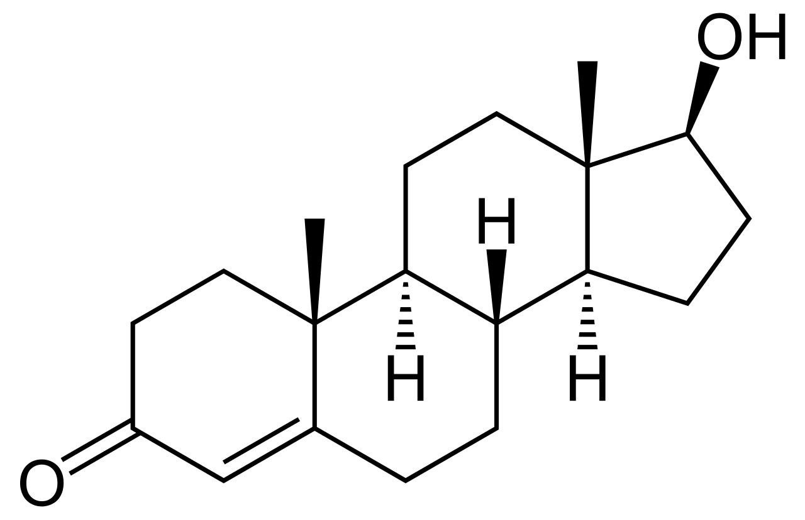

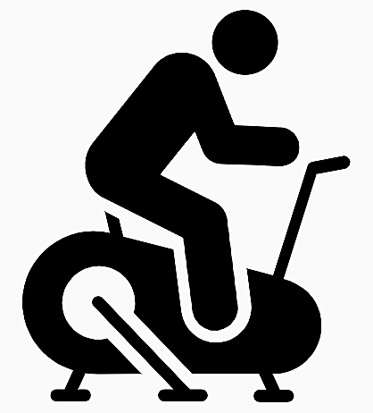
Diabetes and testosterone
Men with hypogonadism are at increased risk of developing incident T2DM
Low testosterone
levels in men
are associated with:¹
Chronic conditions including metabolic syndrome,
T2DM, dyslipidaemia, hypertension and CV disease
1 in 3 men with T2DM have hypogonadotrophic hypogonadism and an associated increased risk of CV and all-cause mortality
Conventional management approaches
focus on:
The link between
T2DM and hypogonadism
is considered bidirectional
Lifestyle strategies
Weight loss
Exercise
  However, these are often challenging & hence of limited success
  CV, cardiovascular; T2DM, type 2 diabetes mellitus
1. Goodale T et al. Methodist Debakey Cardiovasc J 2017;13:68–72.
Notes:
Low testosterone levels in men are associated with a number of chronic conditions including metabolic syndrome, T2DM, dyslipidaemia, hypertension and cardiovascular disease.
T2DM, type 2 diabetes mellitus
Reference
Goodale T et al. Methodist Debakey Cardiovasc J 2017;13:68–72.

Slide 3



REVITALISE: low testosterone is common among men with T2DM and ED in real-world UK practice
The REVITALISE audit assessed the prevalence of men with T2DM who were at risk of ED and/or testosterone deficiency
N=43,633
men were reviewed
T2DM
(n=3185)
Total testosterone
<12 nmol/L (n=81)
Overall
prevalence
Overall
prevalence
REVITALISE
13 primary care
practices across
the UK
7.3%
39.9%
T2DM + ED*
(n=627)
Total testosterone
<8 nmol/L (n=38)
n=203 had a
testosterone
test
32.4%
Not asked about ED (n=1067)
Overall
prevalence
Overall
prevalence
Overall
prevalence
33.5%
19.7%
18.7%
  *n=1491 men were asked about ED but had no complaint
  or diagnosis of ED
  ED, erectile dysfunction, T2DM, type 2 diabetes mellitus
  David J et al. Diabetes Prim Care 2017;19:67–72.
Notes:
The aim of the REVITALISE audit was to assess the care of men with and without T2DM who may be at risk of testosterone deficiency and/or ED, and identify where the clinical management of these individuals could be improved.
The REVITALISE audit was conducted at 13 primary care practices across the UK (Birmingham, Bridgend, Corby, Coventry, Doncaster, Dudley, Durham, Gloucester, Heywood, Manchester and Sandwell).
The average practice size was 7319 patients (smallest: 2093 patients, largest: 14,732 patients). Information from patients at each centre was gathered between 13 October 2015 and 28 April 2016.
Data for the previous 24 months from the date on which the audit was conducted were collected electronically from primary care clinical systems (EMIS Web, InPS Vision and SystmOne), with the same search criteria applied across all the systems in all practices.
Data on the incidence of ED, testosterone testing, total testosterone levels and the use of TTh in men with or without T2DM were recorded in a stepwise manner.
Serum total testosterone levels were stratified as follows:
Normal: >12 nmol/L.
Borderline: >8 and ≤12 nmol/L.
Low testosterone: ≤8 nmol/L.
ED, erectile dysfunction; T2DM, type 2 diabetes mellitus; TTh, testosterone therapy
Reference
David J et al. Diabetes Prim Care 2017;19:67–72.

Slide 4
Men with T2DM frequently have low testosterone levels
Cross-sectional study to assess the prevalence of clinical hypogonadism in 355 men with T2DM (mean age 58.1 years)
In total, 20% (n=71) and 31% (n=109) of men with T2DM had total testosterone levels <8 nmol/L and 8–12 nmol/L, respectively
  Free testosterone <0.255 nmol/L: 50% (n=179)
Proportion of men with low or borderline low testosterone levels per decade of life (n=180)
Total testosterone <8 nmol/L
Total testosterone <12 nmol/L
Calculated free testosterone <0.255 nmol/L
Patients (%)
Patients (%)
Age (years)
Age (years)
  T2DM, type 2 diabetes mellitus
  Kapoor D et al. Diabetes Care 2007;30:911–17.
Notes:
This cross-sectional study assessed the prevalence of clinical hypogonadism in men with T2DM.
It included 355 men with T2DM (mean age: 58.1 years) who were registered with the Centre for Diabetes and Endocrinology, Barnsley Hospital NHS Foundation Trust, Barnsley, UK. Study participants were recruited from the diabetic clinic and district retinal screening programme.
In total, 70 patients were treated with diet alone, 95 with insulin, and 160 with oral hypoglycaemic agents.
Patients were excluded if they had any inflammatory disease or infection with elevated CRP
>10 mg/L, or were already receiving TTh.
Assessments were always made between 8:00 and 10:00 in the morning.
Total testosterone levels were measured by ELISA, with <8 nmol/L considered ‘low’ and
8–12 nmol/L considered ‘borderline low’.
Age distribution and mean total and free testosterone levels, respectively, were:
<40 years (n=13; 4%): 11.1 and 4.05 nmol/L.
40–49 years (n=60; 17%): 12.3 and 4.34 nmol/L.
50–59 years (n=124; 35%): 12.4 and 4.05 nmol/L.
60–69 years (n=112; 32%): 13.5 and 4.03 nmol/L.
>69 years (n=46; 12%): 12.45 and 3.51 nmol/L.
20% of men (n=71) had total testosterone levels <8 nmol/L.
31% of men (n=109) had total testosterone levels between 8–12 nmol/L.
50% of men (n=179) had free testosterone levels <0.255 nmol/L.
CRP, C-reactive protein; ELISA, enzyme-linked immunosorbent assay; NHS, National Health Service; T2DM, type 2 diabetes mellitus; TTh, testosterone therapy
Reference
Kapoor D et al. Diabetes Care 2007;30:911–7.

Slide 5
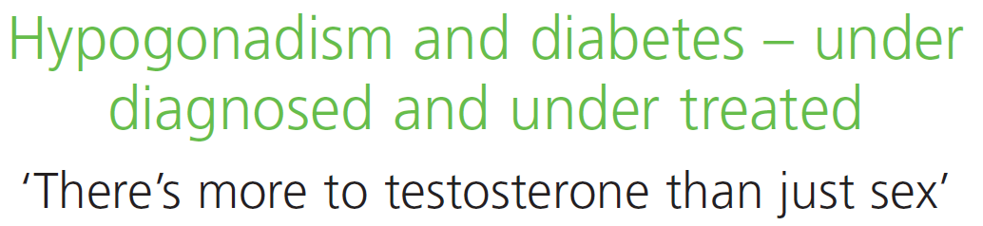
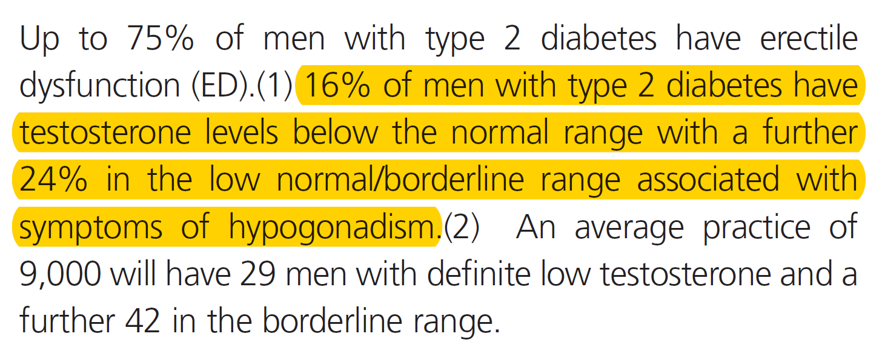

Low testosterone and hypogonadal symptoms are common in men with T2DM
40%
of men with T2DM have testosterone levels <12 nmol/L
NHS, UK National Health Service; T2DM, type 2 diabetes mellitus
Notes:
NHS Factsheet #36
A Factsheet produced in March 2012 (#36) by the NHS highlights the high number of men with T2DM who also have low testosterone and/or hypogonadal symptoms.
Among men with T2DM, 16% are hypogonadal; a further 24% have low-normal/borderline testosterone levels, but present with symptoms of hypogonadism.
Therefore, the prevalence of men with T2DM and testosterone levels <12 nmol/L is ~40%.
NHS, UK National Health Service; T2DM, type 2 diabetes mellitus

Slide 6

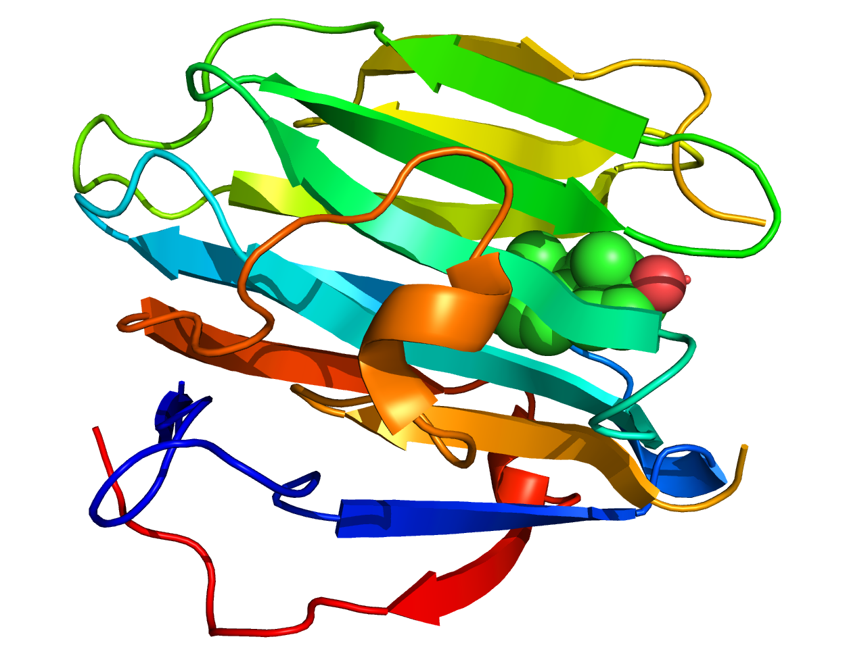
Low testosterone and SHBG levels are associated with an increased likelihood of T2DM
Prospective, population-based cohort study of 1030 men in the MMAS (mean age: 53.9 years) followed for up to 9 years
After controlling for potential confounders*, T2DM at follow-up was predicted jointly and independently by lower baseline levels of free testosterone and SHBG
Likelihood of T2DM according to testosterone and SHBG status among middle-aged men in the MMAS
OR (95% CI)
for incident T2DM
1.58 (1.08 to 2.29)
p=0.017
1.89 (1.14 to 3.14)
p=0.014
2.0
3.0
4.0
5.0
Odds ratio (95% CI)
  *Total and free testosterone, SHBG, presence of hypogonadism (total testosterone <8.7 nmol/L), hypertension, heart disease and depression, body mass index
  CI, confidence interval; MMAS, Massachusetts Male Aging Study; OR, odds ratio; SD, standard deviation; SHBG, sex hormone-binding globulin; T2DM, type 2 diabetes mellitus
Stellato RK et al. Diabetes Care 2000;23:490–4.
Notes:
This was an analysis of the MMAS cohort, a population-based random sample of men aged 40–70 years in the USA.
Of the 1,709 men enrolled in 1987–1989, 1156 were followed up 7–10 years later.
Men with T2DM at enrolment were excluded from all analyses; 54 men in the analysis sample (5%) had a new diagnosis of T2DM between the enrolment and follow-up visits.
After controlling for potential confounders, T2DM at follow-up was predicted jointly and independently by lower baseline levels of free testosterone and SHBG.
These findings are consistent with previous (mainly cross-sectional) reports, suggesting that low levels of testosterone and SHBG play a role in the development of insulin resistance and subsequent T2DM.
MMAS, Massachusetts Male Aging Study; SHBG, sex hormone-binding globulin;
T2DM, type 2 diabetes mellitus
Reference
Stellato RK et al. Diabetes Care 2000;23:490–4.

Slide 7

Low testosterone and SHBG levels are associated with an increased likelihood of T2DM and metabolic syndrome
Prospective, population-based cohort study of 702 men in Finland
(mean age: 51.3 years) followed for up to 11 years
After controlling for potential confounders*, T2DM or metabolic syndrome at follow-up were independently predicted by lower baseline levels of total testosterone and SHBG
Likelihood of T2DM or metabolic syndrome according to testosterone and SHBG status in middle-aged men
OR (95% CI) for incident
T2DM or metabolic syndrome
2.33 (1.32 to 4.11); p<0.05
2.28 (1.54 to 3.38); p<0.05
4.34 (2.45 to 7.70); p<0.05
2.78 (1.88 to 4.12); p<0.05
5.0
Odds ratio (95% CI)
  *Age, presence of cardiovascular disease, smoking status, alcohol consumption, and socioeconomic status
  CI, confidence interval; MMAS, Massachusetts Male Aging Study; OR, odds ratio; SD, standard deviation; SHBG, sex hormone-binding globulin; T2DM, type 2 diabetes mellitus
Laaksonen DE et al. Diabetes Care 2004;27:1036–41.
Notes:
This was a population-based cohort study in 702 men in Finland aged 42, 48, 54 or 60 years
at baseline examination in 1987–1989, of whom 854 underwent repeat examination in
1998–2001. Men had neither T2DM nor the metabolic syndrome at baseline. Low total testosterone was defined as <11 nmol/L (317 ng/dL).
After 11 years of follow-up, 147 men had developed metabolic syndrome (defined by National Cholesterol Education Program criteria) and 57 men had developed T2DM.
After adjustment for age, concentrations of total testosterone, calculated free testosterone, or SHBG in the lower fourth increased the risk of incident T2DM by 1.7- to 4.3-fold, although the association with calculated free testosterone did not reach statistical significance.
Similarly, after adjusting for age, men with concentrations of total testosterone, calculated free testosterone, or SHBG in the lower fourth were 1.7–2.8 times more likely to develop metabolic syndrome than other men during the 11-year follow-up.
Baseline concentrations of serum total and calculated free testosterone and SHBG were lower in men who developed T2DM or metabolic syndrome during follow-up, but for calculated free testosterone, the difference was statistically significant only for men who developed metabolic syndrome.
Adjustment for other potential confounders (age, presence of CVD, smoking status, alcohol consumption, and socioeconomic status) had little effect on the associations.
CVD, cardiovascular disease; SHBG, sex hormone-binding globulin; T2DM, type 2 diabetes mellitus
Reference
Laaksonen DE et al. Diabetes Care 2004;27:1036–41.

Slide 8
Low testosterone and T2DM are linked
In a study of 1,413 men aged ≥20 years in NHANES III, those in the first (lowest) tertiles of low free and total testosterone were four times more likely to have diabetes than those in the third tertiles [OR 4.12 (95% CI: 1.25 to 13.55 and OR 3.93 (95% CI: 1.39 to 11.13), respectively]¹
A meta-analysis of 37 prospective and cross-sectional studies showed that:²
  After adjusting for age and BMI, T2DM was associated with lower total testosterone levels (p<0.0001)
  Analysis of longitudinal studies demonstrated that baseline total testosterone was significantly lower among patients with incident diabetes versus controls [HR -2.08 (95% CI: -3.57 to -0.59); p<0.001]
  Analysis of RCTs showed that TTh was associated with a significant reduction in fasting plasma glucose, HbA_{1c}, fat mass and triglycerides
  BMI, body mass index; CI, confidence interval; HbA_{1c}, glycated haemoglobin; NHANES III, Third National Health and Nutrition Examination Survey; OR, odds ratio;
  RR, relative risk; T2DM, type 2 diabetes mellitus
1. Selvin E et al. Diabetes Care 2007;30:234–8; 2. Corona G et al. J Sex Med 2011;34:528–40.
Notes:
In a study conducted in 1,413 men aged ≥20 years who participated in NHANES III:¹
Low free testosterone concentrations in the normal range were associated with diabetes, independent of adiposity.
In multivariate models adjusted for age, race/ethnicity, and adiposity, men in the first tertile (lowest) of free testosterone level were four times more likely to have prevalent diabetes compared with men in the third tertile [OR 4.12 (95% CI: 1.25
to 13.55)].
These associations persisted even after excluding men with clinically abnormal testosterone concentrations, defined as total testosterone <11.3 mmol/L or free testosterone <0.2 nmol/L.
Corona et al. performed a literature search to identify prospective and cross-sectional studies investigating the relationship between androgen levels and type 2 diabetes mellitus (T2DM).²
A total of 37 studies were included in the meta-analysis.
Patients with T2DM showed significantly lower testosterone plasma levels compared with those without diabetes.
Similar results were obtained when patients with T2DM with and without erectile dysfunction were analysed separately.
In a multiple regression model, after adjusting for age and body mass index (BMI), T2DM was still associated with lower total testosterone levels (adjusted r = -0.568; p<0.0001).
Analysis of longitudinal studies demonstrated that baseline TT was significantly lower in men with incident diabetes compared with controls (hazard ratio = -2.08 [95% CI -3.57;-0.59]; p<0.001).
When combining the RCTs, TRT was associated with a significant reduction in fasting plasma glucose, glycated haemoglobin, fat mass and triglycerides. No significant difference was observed for total and high-density lipoprotein cholesterol, blood pressure or BMI.
These data suggest that T2DM can be considered independently associated with male hypogonadism.
BMI, body mass index; CI, confidence interval; NHANES III, Third National Health and Nutrition Examination Survey;
OR, odds ratio; RCT, randomised controlled trial; T2DM, type 2 diabetes mellitus; TTh, testosterone therapy
References
1. Selvin E et al. Diabetes Care 2007;30:234–8; 2. Corona G et al. J Sex Med 2011;34:528–40.

Slide 9





Guideline recommendations for men with T2DM
Guideline
Recommendation
BSSM¹
Screen for testosterone deficiency in all men with T2DM
AACE/
ACE²
All male patients with T2DM should be evaluated to exclude testosterone deficiency
In men with diabetes and symptoms or signs of testosterone deficiency, e.g. decreased libido or ED, consider screening with a morning serum testosterone level
ADA³
Consider testosterone assessment in men with a disease or treatment in which testosterone deficiency is common and in whom treatment may be indicated, such as T2DM
EAU⁴
  AACE, American Association of Clinical Endocrinologists; ACE, American College of Endocrinology; ADA, American Diabetes Association; BSSM, British Society for Sexual Medicine; EAU, European Associate of Urology; ED, erectile dysfunction; T2DM, type 2 diabetes mellitus
1. Hackett G et al. J Sex Med 2017;14:1504–23; 2. Garvey WT et al. Endocr Pract 2016;22(Suppl. 3):1–203; 3. American Diabetes Association. Diabetes Care 2019;42(Suppl.1):S34–S45; 4. Dohle GR et al. European Association of Urology Guidelines on Male Hypogonadism 2018. Available at: https://uroweb.org/guideline/male-hypogonadism/ (last accessed September 2020).
Notes:
Guidelines from the BSSM, AACE/ACE, ADA and EAU all recognise the link between T2DM and hypogonadism, and recommend screening for low testosterone in this population.
AACE, American Association of Clinical Endocrinologists; ACE, American College of Endocrinology; ADA, American Diabetes Association; BSSM, British Society for Sexual Medicine; EAU, European Associate of Urology; T2DM, type 2 diabetes mellitus
References
1. Hackett G et al. J Sex Med 2017;14:1504–23; 2. Garvey WT et al. Endocr Pract 2016;22(Suppl. 3):1–203; 3. American Diabetes Association. Diabetes Care 2019;42(Suppl.1):S34–S45; 4. Dohle GR et al. European Association of Urology Guidelines on Male Hypogonadism 2018. Available at: https://uroweb.org/guideline/male-hypogonadism/ (last accessed September 2020).

Slide 10
TTh significantly improves glycaemic control in obese, hypogonadal men
Analysis of two prospective, cumulative registry studies including 411 obese, hypogonadal men (mean age: 59.5 years) treated with TTh, of whom 25% had prediabetes, 42% had T2DM and 6% had T1DM
TTh significantly improved glycaemic control at 8 years of follow-up
Association between TTh and increased sexual activity in men with low testosterone
Effect of TTh on glycaemic control in obese, hypogonadal men
  BMI, body mass index; HbA_{1c}, glycated haemoglobin; T1DM, type 1 diabetes mellitus; T2DM, type 2 diabetes mellitus; TTh, testosterone therapy
Saad F et al. Int J Obesity 2016;40:162–70.
BMI 30.0–34.9 kg/m²
HbA_{1c} reduction: 1.15% (p<0.0001)
BMI 35.0–39.9 kg/m²
HbA_{1c} reduction: 1.79% (p<0.0001)
BMI ≥40 kg/m²
HbA_{1c} reduction: 1.87% (p<0.0001)
Notes:
This study investigated the effects of long-term TTh for up to 8 years in obese, hypogonadal men.
From two prospective, cumulative registry studies of 622 hypogonadal men, 411 (66.1% of all patients) with varying classes of obesity were identified:
Class I (BMI 30–34.9 kg/m²): n=214; mean age 58.6 years.
Class II (BMI 35–39.9 kg/m²): n=150; mean age 60.4 years.
Class III (BMI ≥40 kg/m²): n=47; mean age 60.5 years.
Among these obese, hypogonadal men, 72.7% (n=299) had prediabetes or diabetes [prediabetes: 25.1% (n=103), T2DM: 42.1% (n=173), T1DM: 5.6% (n=23)].
All men were treated with TTh (testosterone undecanoate injection) for up to 8 years.
Men were entered into the registry once they had received 1 year of TTh.
Inclusion criteria were two separate morning measures of total testosterone ≤12.1 nmol /L and the presence of hypogonadal symptoms measured by the Aging Males’ symptoms scale.
Exclusion criteria for TTh included previous treatment with androgens, prostate cancer or any suspicion thereof, International Prostate Symptom Score of 419 points, breast cancer, a history of congestive heart failure or recent angina, or severe untreated sleep apnoea.
Significant reductions in HbA_{1c} with long-term TTh were observed (all p<0.0001):
Class I: 6.67% to 5.4% (change from baseline of −1.2%).
Class II: 7.5% to 5.8 (change from baseline of −1.8%).
Class III: 7.6% to 5.7% (change from baseline of −1.9%).
BMI, body mass index; HbA_{1c}, glycated haemoglobin; T1DM, type 1 diabetes mellitus;
T2DM, type 2 diabetes mellitus; TTh, testosterone therapy
Reference
Saad F et al. Int J Obesity 2016;40:162–70.

Slide 11
Significant improvements in glycaemic control with TTh are lost if treatment is interrupted, but reappear when TTh is resumed
Observational registry study including 262 middle-aged and elderly hypogonadal men who received TTh for up to 11 years, representing 2088.5 patient-years
Significant decreases in fasting glucose and HbA_{1c} seen with TTh use were reversed upon withdrawal of TTh, but returned again to pre-interruption values when TTh was restarted
Association between TTh and increased sexual activity in men with low testosterone
Effect of continuous or interrupted TTh on glycaemic control in men with low testosterone
Continuous TTh (n=115) Interrupted TTh (n=147)
Fasting glucose
(mg/dL)
p<0.0001
HbA_{1c} (%)
p<0.0001
p<0.0001
p<0.0001
p=NS
p=NS
p=0.0043
p=0.0012
1
2
3
1
2
3
Period
Period
p values are for comparison of end of period vs beginning of period
HbA_{1c}, glycated haemoglobin; TTh, testosterone therapy
Yassin A et al. Clin Endocrinol 2016;84:107–14.
Notes:
This observational registry study included 262 hypogonadal, middle-aged and elderly men who received TTh for a maximum of 11 years, representing 2088.5 patient-years.
After having been on TTh for a mean duration of 65.5 months, treatment was temporarily interrupted in 147 patients for a mean of 16.9 months due to cost reimbursement issues,
as well as PCa for 7 of these patients. All men resumed TTh for a mean period of 14.5 months.
The other 115 men were treated continuously with TTh.
Serum total and free testosterone levels increased significantly in both groups. In men who received continuous TTh, serum testosterone levels were maintained over the study period, while in men whose TTh was interrupted, testosterone levels returned to baseline but increased to previous levels after treatment was resumed.
In men on continuous TTh, there was a progressive significant improvement in fasting glucose levels and HbA_{1c}. In men on intermittent therapy, there was a similar initial significant improvement in both glycaemic control parameters, which was reversed when TTh was interrupted, but became evident again after TTh was reinstated.
HbA_{1c}, glycated haemoglobin; PCa, prostate cancer; TTh, testosterone therapy
Reference
Yassin A et al. Clin Endocrinol 2016;84:107–14.

Slide 12
TTh is independently associated with reduced mortality in men with T2DM
Prospective study of 857 men with T2DM from 5 UK primary care practices: 320 were eugonadal and 537 were hypogonadal* (n=175 TTh-treated, n=362 did not receive TTh)
Mortality in eugonadal men or hypogonadal/TTh-treated men was significantly reduced versus hypogonadal/TTh-untreated men [HR 0.62 (95% CI: 0.41 to 0.94) and HR 0.38
(95% CI: 0.16 to 0.90), respectively]
Effect of TTh on mortality in men with T2DM with or without hypogonadism (N=857)
*Total testosterone ≤12 nmol/L or free testosterone ≤0.25 nmol/L
CI, confidence interval; HR, hazard ratio; TTh, testosterone therapy; T2DM, type 2 diabetes mellitus
Hackett G et al. Int J Clin Pract 2016;70:244–53.
Notes:
The primary aim of this longitudinal, observational study was to assess the association between mortality, testosterone levels and TTh use in 857 men with T2DM enrolled from 5 primary care practices between April 2007 and April 2009.
Based on early morning serum testosterone levels, men were classified as being eugonadal (total testosterone >12 nmol/L and free testosterone >0.25 nmol/L) or hypogonadal (total testosterone
≤12 nmol/L or free testosterone ≤0.25 nmol/L). In patients with total testosterone ≤12 nmol/L,
a second morning testosterone measurement was taken at ≥2 weeks later, according to European Association of Urology guidelines.
Of these men, 175/637 with serum total testosterone ≤12 nmol/L or free testosterone ≤0.25 nmol/L received TTh for a mean of 3.8 years. PDE-5 inhibitors and statins were prescribed to 175/857 and 662/857 men, respectively.
The primary endpoint of the study was all-cause mortality. Cox regression analysis was used to study the association between TTh and mortality.
Compared with the hypogonadal/TTh-untreated group, mortality in the eugonadal (p=0.023) and hypogonadal/ TTh-treated (p=0.027) groups was significantly reduced.
After repeating the Cox regression analysis in 682/857 men not given a PDE-5 inhibitor (which may
be a confounding factor), mortality in the eugonadal and hypogonadal/TTh-treated groups was significantly lower than in the reference hypogonadal/TTh-untreated group.
Low baseline testosterone is associated with increased all-cause mortality in men with T2DM, and
TTh is independently associated with reduced all-cause mortality, especially in men aged >60 years.
PDE-5, phosphodiesterase type 5; T2DM, type 2 diabetes mellitus; TTh, testosterone therapy
Reference
Hackett G et al. Int J Clin Pract 2016;70:244–53.

Slide 13
TTh is independently associated with reduced mortality in men with T2DM
Effect of TTh on mortality among men with T2DM (N=581)
Study of 581 men with T2DM who had testosterone levels measured during 2002–05 and were followed up for a mean of 5.8 years
  Eugonadal status (total testosterone
  >10.4 nmol/L): n=343
  Hypogonadal status (total testosterone
  ≤10.4 nmol/L): n=238
Mortality was significantly increased in hypogonadal vs eugonadal men (17% vs 9%, respectively; p=0.003), and TTh-untreated vs TTh-treated hypogonadal men (20% vs 9%, respectively; p=0.002)
There was a significant decrease in survival in TTh-untreated men versus TTh-treated and eugonadal men, after controlling for covariates*
1.00
Hypogonadal/TTh-treated
0.95
Eugonadal
0.90
Cumulative survival
0.85
Hypogonadal/TTh-untreated
HR 2.3 (95% CI: 1.3 to 3.9); p=0.004
0.80
0
20
40
60
80
Months of survival
*Age, weight, height, body mass index, glycated haemoglobin, pre-existing cardiovascular disease, smoking, statin and ARB/ACE inhibitor treatment
ACE, angiotensin-converting enzyme; ARB, angiotensin receptor blocker; CI, confidence interval; HR, hazard ratio; TTh, testosterone therapy; T2DM, type 2 diabetes mellitus. Muraleedharan V et al. Eur J Endocrinol 2013;166:725–33.
Notes:
This 6-year follow-up study included 581 men with type 2 diabetes who had testosterone levels measured between 2002–05.
Mortality rates were compared between eugonadal men (total testosterone >10.4 nmol/L; n=343) and hypogonadal men (total testosterone ≤10.4 nmol/L; n=238).
The effect of TTh (as per normal clinical practice: 85.9% testosterone gel and 14.1% intramuscular testosterone undecanoate) was assessed retrospectively in the hypogonadal group.
Kaplan–Meier survival curves showed a significant decrease in survival in the hypogonadal group compared with the eugonadal group (p=0.002).
In the Cox regression model, after adjusting for covariates of age, weight, height, body mass index, glycated haemoglobin, pre-existing cardiovascular disease, smoking, statin and angiotensin receptor blocker/angiotensin-converting enzyme inhibitor therapy) at baseline, the hazard ratio for decreased survival was 2.02 (95% CI: 1.2 to 3.4); p=0.009.
Mean baseline testosterone levels were significantly low in patients who died (10.9 ± 5.2 nmol/L) compared with those who were alive (12.6 ± 5.5 nmol/L; p=0.018). The mortality rate was 17.2% (41/238) in hypogonadal men compared with 9% (31/343; p=0.003) in eugonadal men.
Of the 238 hypogonadal men, 64 (27%) received TTh and 174 did not. A total of 60 hypogonadal men received TTh for ≥12 months and 51 had treatment for ≥2 years.
There was a significant increase in mortality rate in the TTh-untreated group (20.1% [35/174]) compared with the TTh-treated group [9.4% (6/64); p=0.002] and eugonadal men [9.1% (31/340)].
The multivariate-adjusted hazard ratio for decreased survival in TTh-untreated hypogonadal men was
2.3 (95% CI: 1.3 to 3.9; p=0.004).
Low testosterone levels predicted an increase in all-cause mortality during long-term follow-up.
CI, confidence interval; T2DM, type 2 diabetes mellitus; TTh, testosterone therapy
Reference
Muraleedharan V et al. Eur J Endocrinol 2013;166;725–33.

Slide 14

Long-term TTh use in men with hypogonadism prevents progression from prediabetes to T2DM and improves glycaemic control, lipid profile and AMS scale score
Long-term registry study to evaluate whether TTh use in men with hypogonadism and prediabetes prevents progression to T2DM
In total, 316 men with prediabetes (HbA_{1c} 5.7–6.4%) and total testosterone level ≤12.1 nmol/L plus symptoms of hypogonadism were analysed, of whom 229 received TTh, and 87 served as untreated controls
Association between TTh and increased sexual activity in men with low testosterone
Effect of TTh on glycaemic control in men with hypogonadism and T2DM (N=316)
TTh Placebo Difference
1.5
1.0
1.0
0.5
0.5
0
0
Change in fasting glucose (mmol/L)
Change in HbA_{1c} (%)
-0.5
-1.0
-0.5
-1.5
-1.0
0
1
2
3
4
5
6
7
8
0
1
2
3
4
5
6
7
8
Year
Year
AMS, Aging Males’ Symptoms; HbA_{1c}, glycated haemoglobin; T2DM, type 2 diabetes mellitus; TTh, testosterone therapy
Yassin A et al. Diabetes Care 2019;42:1104–11.
Notes:
This registry study analysed 316 men with prediabetes (defined as HbA_{1c} 5.7–6.4%) and total testosterone levels ≤12.1 nmol/L with symptoms of hypogonadism.
Patients in this study were pooled from two ongoing urological registries.
In total, 229 men received parenteral testosterone undecanoate every 12 weeks after an initial 6-week interval and 87 men served as untreated controls.
The following parameters were measured: total testosterone, weight, waist circumference, body weight, haemoglobin, haematocrit, fasting glucose, HbA_{1c}, systolic/diastolic blood pressure, heart rate, and lipids (total cholesterol, low-density lipoprotein cholesterol,
high-density lipoprotein cholesterol, triglycerides).
Metabolic and anthropometric parameters were measured twice-yearly for 8 years.
TTh led to substantial improvements in glycaemic parameters; both fasting blood glucose and HbA_{1c} values were reduced in the TTh-treated group but were increased in the
TTh-untreated group.
HbA_{1c}, glycated haemoglobin; TTh, testosterone therapy
Reference
Yassin A et al. Diabetes Care 2019;42:1104–11.

Slide 15
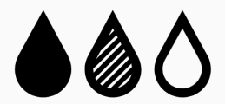



Long-term TTh use in men with hypogonadism prevents progression from prediabetes to T2DM and improves glycaemic control, lipid profile and AMS scale score
TTh-treated group (n=229)
TTh-untreated group (n=87)
HbA_{1c} decreased by 0.39%
Significant improvement in fasting glucose
90% of men achieved normal
glucose regulation (HbA_{1c} <5.7%)
0% of men progressed to T2DM (HbA_{1c} >6.5%)
HbA_{1c} increased by 0.63%
Significant worsening in fasting glucose
1% of men achieved normal
glucose regulation (HbA_{1c} <5.7%)
40% of men progressed to T2DM (HbA_{1c} >6.5%)
Significant improvements in lipid profile and AMS scale score
Significant worsening in lipid profile and AMS scale score
Incidence of non-fatal MI: 0.4%
Incidence of non-fatal MI: 5.7%
Mortality: 7.4%
Mortality: 16.1%
AMS, Aging Males’ Symptoms; HbA_{1c}, glycated haemoglobin; T2DM, type 2 diabetes mellitus; TTh, testosterone therapy
Yassin A et al. Diabetes Care 2019;42:1104–11.
Notes:
HbA_{1c} decreased by 0.39 ± 0.03% (p<0.0001) in the TTh-treated group and increased by
0.63 ± 0.1% (p<0.0001) in the TTh-untreated group.
The differences in glucose concentrations and HbA_{1c} were substantial and significant between the two groups throughout the entire follow-up period, amounting to a difference in HbA_{1c} of 1.02% at 8 years.
In the TTh-treated group, 90% achieved normal glucose regulation (HbA_{1c} <5.7%) versus
1% in the TTh-untreated group.
In the TTh-untreated group, 40.2% of men progressed to T2DM (HbA_{1c} >6.5%), compared with 0% of TTh-treated men.
TTh was also associated with significant improvements in fasting glucose, lipids accumulation product, total cholesterol, low-density lipoprotein cholesterol, high-density lipoprotein cholesterol, non-high-density lipoprotein cholesterol, triglycerides and Aging Males’ Symptoms (AMS) scale scores. Significant deterioration in all these parameters was seen
in the TTh-untreated group.
Mortality was 7.4% in the TTh-treated group and 16.1% in the TTh-untreated group (p<0.05).
The incidence of non-fatal myocardial infarction was 0.4% in the TTh-treated group and 5.7% in the TTh-untreated group (p<0.005).
HbA_{1c}, glycated haemoglobin; T2DM, type 2 diabetes mellitus; TTh, testosterone therapy
Reference
Yassin A et al. Diabetes Care 2019;42:1104–11.

Slide 16
Long-term TTh use in men with hypogonadism and T2DM significantly improves glycaemic control
Prospective, long-term, single-centre registry study in Germany to evaluate the effects of TTh use in men with hypogonadism and T2DM
In total, 356 men with T2DM [HbA_{1c} 62–79 mmol/mol (7.8–9.4%)] and total testosterone level ≤12.1 nmol/L plus symptoms of hypogonadism were analysed, of whom 178 received TTh, and 178 served as untreated controls
Association between TTh and increased sexual activity in men with low testosterone
Effect of TTh on glycaemic control in men with hypogonadism and T2DM (N=356)
TTh Untreated Difference
2
40
1
20
0
0
Change in fasting glucose (mmol/L)
Change in HbA_{1c} (mmol/mol)
-1
-20
-2
-40
-3
-60
-4
-80
0
1
2
3
4
5
6
7
8
9
10
11
0
1
2
3
4
5
6
7
8
9
10
11
Year
Year
p<0.0001 between groups.
HbA_{1c}, glycated haemoglobin; T2DM, type 2 diabetes mellitus; TTh, testosterone therapy
Haider KS et al. Diabetes Obes Metab 2020;doi: 10.1111/dom.14122.
Notes:
This registry study analysed 356 men with diabetes [baseline HbA_{1c} of 62–79 mmol/mol (7.8–9.4%)] and total testosterone levels ≤12.1 nmol/L with symptoms of hypogonadism.
All patients were managed by the same local diabetes centre and received standard diabetes treatment, including mandatory educational courses and materials.
In total, 178 men received parenteral testosterone undecanoate every 12 weeks after an initial 6-week interval and 178 men served as untreated controls.
The following parameters were measured: height, weight, waist circumference, blood pressure, haemoglobin, haematocrit, fasting glucose, HbA_{1c}, insulin, systolic/diastolic blood pressure, heart rate, lipids (total cholesterol, low-density lipoprotein cholesterol,
high-density lipoprotein cholesterol, triglycerides), high-sensitivity C-reactive protein, total testosterone, quality of life (assessed using the Aging Males’ Symptoms scale) and erectile function (assessed using the International Index of Erectile Function – Erectile Function domain).
Clinical variables were assessed at least twice-yearly for 11 years.
TTh led to significant and sustained gradual reductions in fasting blood glucose and HbA_{1c} values in hypogonadal men with T2DM; in contrast, both parameters increased in the
TTh-untreated group.
HbA_{1c}, glycated haemoglobin; T2DM, type 2 diabetes mellitus; TTh, testosterone therapy
Reference
Haider KS et al. Diabetes Obes Metab 2020;doi: 10.1111/dom.14122.

Slide 17

Long-term TTh use in men with hypogonadism and T2DM is associated with disease remission, return to normal glucose control, and decreased all-cause mortality
Effect of TTh on disease parameters and mortality in men with hypogonadism and T2DM (N=356)
HbA_{1c} ≤47.5 mmol/mol
HbA_{1c} ≤53.0 mmol/mol
Men achieving outcome (%)
100
80
TTh
60
Untreated
Survival (%)
40
20
0
0
1
2
3
4
5
6
7
8
9
10
11
12
Patients, n
Year
TTh
Untreated
178 178 178 168 154 125 113 101 86 76 60 55 42
178 178 178 176 165 153 144 134 120 110 86 49 18
HbA_{1c}, glycated haemoglobin; T2DM, type 2 diabetes mellitus; TTh, testosterone therapy
Haider KS et al. Diabetes Obes Metab 2020;doi: 10.1111/dom.14122.
Notes:
This registry study analysed 356 men with diabetes [baseline HbA_{1c} of 62–79 mmol/mol (7.8–9.4%)]
and total testosterone levels ≤12.1 nmol/L with symptoms of hypogonadism.
All patients were managed by the same local diabetes centre and received standard diabetes treatment, including mandatory educational courses and materials.
In total, 178 men received parenteral testosterone undecanoate every 12 weeks after an initial 6-week interval and 178 men served as untreated controls.
The following parameters were measured: height, weight, waist circumference, blood pressure, haemoglobin, haematocrit, fasting glucose, HbA_{1c}, insulin, systolic/diastolic blood pressure, heart rate, lipids (total cholesterol, low-density lipoprotein cholesterol, high-density lipoprotein cholesterol, triglycerides), high-sensitivity
C-reactive protein, total testosterone, quality of life (assessed using the Aging Males’ Symptoms scale) and erectile function (assessed using the International Index of Erectile Function – Erectile Function domain).
Clinical variables were assessed at least twice-yearly for 11 years.
Among men with T2DM receiving TTh:
34.3% and 46.6% achieved remission of T2DM [defined as HbA_{1c} <47.5 mmol/mol (6.5%) and discontinuation of all glucose-lowering agents, including metformin] and normal glucose regulation [defined as HbA_{1c} <39 mmol/mol (5.7%)], respectively. Of the latter, 22 men had been on insulin at baseline. The mean time to discontinuation of glucose-lowering medications was 8.6 ± 2.9 years,
and the mean time following remission was 2.5 ± 2.3 years. There were no relapses.
83.1% and 91.0% achieved HbA_{1c} values of 47.5 mmol/mol and 53.0 mmol/mol, respectively.
In contrast, no remission of T2DM or reduction in glucose or HbA_{1c} levels was noted in the untreated group.
There were fewer all-cause deaths in the TTh group than the untreated group [13 (7.3%) versus 52 (29.2%)].
These observations are consistent with other studies showing reduced mortality in men with hypogonadism and T2DM receiving TTh.
HbA_{1c}, glycated haemoglobin; T2DM, type 2 diabetes mellitus; TTh, testosterone therapy
Reference
Haider KS et al. Diabetes Obes Metab 2020;doi: 10.1111/dom.14122.

Slide 18
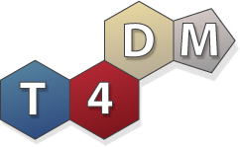
The T4DM study: in high-risk men, TTh decreased the 2-year risk of T2DM by 41% beyond lifestyle interventions alone
Randomised, double-blind, placebo-controlled multicentre Phase 3 trial in men aged 50–74 years (N=1007) with waist circumference >95cm, serum total testosterone ≤14nmol/L
and newly diagnosed T2DM
Men were randomised 1:1 to either TTh (1000 mg/4 mL IM) or placebo at baseline, 6 weeks and then 3-monthly for 2 years; all were enrolled in a lifestyle program
Co-primary 2-year endpoints
Proportion of men with OGTT 2-hour glucose ≥11.1 mmol/L at 2 years
Mean change in OGTT 2-hour glucose at 2 years (mmol/L)
IM, intramuscular; OGTT, oral glucose tolerance test; T2DM, type 2 diabetes mellitus; TTh, testosterone therapy
Wittert GA et al. Diabetes 2020;69(Suppl 1): https://doi.org/10.2337/db20-274-OR.
Notes:
The primary hypothesis of the T4DM study was that TTh for 2 years will prevent progression to, or reverse, T2DM in high-risk men concurrently enrolled in a community-based lifestyle programme.¹
A key secondary hypothesis was that TTh for 2 years will lead to metabolically favourable changes in body composition, improve sexual function and enhance adherence to the lifestyle programme.¹
This randomised, placebo-controlled, double-blind, 2-year, Phase IIIb trial was conducted at 6 Australian Tertiary Care centres.²
Inclusion criteria were age 50–74 years; waist circumference ≥95 cm; OGTT 2-hour glucose 7.8–15.0 nmol/L (140–270 ng/dL) and serum testosterone concentration ≤14 nmol/L.²
Exclusion criteria were: HPG pathology; TTh in the past 12 months; any prior anabolic steroid abuse; medications affecting testosterone or sex hormone-binding globulin; previously diagnosed T2DM; medication to lower blood glucose; OGTT 2-hour glucose >15 mmol/L;
anti-obesity drugs, prior or planned bariatric surgery; major cardiovascular event in previous 6 months or active cardiac disease; systolic blood pressure ≥160 mmHg, diastolic blood pressure ≥100 mmHg, transient ischaemic attack or stroke within the previous 3 years and significant psychiatric disorder.²
HPG, hypothalamo-pituitary-gonadal; OGTT, oral glucose tolerance test; T2DM, type 2 diabetes mellitus; TTh, testosterone therapy
References
1. Wittert GA et al. Diabetes 2020;69(Suppl 1): https://doi.org/10.2337/db20-274-OR.
2. Wittert G et al. Diabetes Obes Metab 2019;21:772–80.

Slide 19
T4DM Participants n=1007
Parameter | Placebo Group (n=503) | Testosterone Group (n=504)
Age (years) | 59.6 (6.4) | 59.8 (6.3)
BMI kg/m² | 34.6 (5.1) | 34.8 (5.1)
Prediabetes (2-hour glucose 7.8 ≥to <11.1 mmol/L) | 400 (79.5%) | 397 (78.8%)
Diabetes (2-hour glucose ≥11.1-15.0 mmol/L) | 100 (19.9%) | 100 (19.8%)
HbA1c (%) | 5.7 (0.5) | 5.7 (0.5)
Screening Serum Testosterone nmol/L (ECLIA) | 10.0 (2.5) | 9.9 (2.5)
Serum Testosterone nmol/L (LCMS/MS) | 13.9 (4.6) | 13.4 (4.1)
Participants with data for primary endpoint analysis at 2 years | 413 (82.1%) | 443 (87.9%)
Wittert GA et al. Diabetes 2020;69(Suppl 1): https://doi.org/10.2337/db20-274-OR
Data are mean (SD), or n (%)

Slide 20
The T4DM study: changes in HPG axis markers over time
Blood trough levels were taken prior to each injection
Sex steroids were assayed using liquid chromatography–mass spectrometry
Placebo
TTh
20
2.0
18
1.6
260
16
1.2
E2 (pg/mL)
Testosterone (nmol/L)
DHT (nmol/L)
220
14
0.8
12
0.4
180
0
6
12
18
24
0
6
12
18
24
0
6
12
18
24
Months from randomisation
Months from randomisation
Months from randomisation
8
10
50
6
8
45
4
6
E2 (pg/mL)
LH (IU/L)
FSH (IU/L)
40
4
2
2
35
0
0
30
0
6
12
18
24
0
6
12
18
24
0
6
12
18
24
Months from randomisation
Months from randomisation
Months from randomisation
DHT, dihydrotestosterone; E2, oestradiol; FSH, follicle-stimulating hormone; HPG, hypothalamo-pituitary-gonadal; LH, luteinising hormone; TTh, testosterone therapy
Wittert GA et al. Diabetes 2020;69(Suppl 1): https://doi.org/10.2337/db20-274-OR.
Notes:
Reference
Wittert GA et al. Diabetes 2020;69(Suppl 1): https://doi.org/10.2337/db20-274-OR.

Slide 21
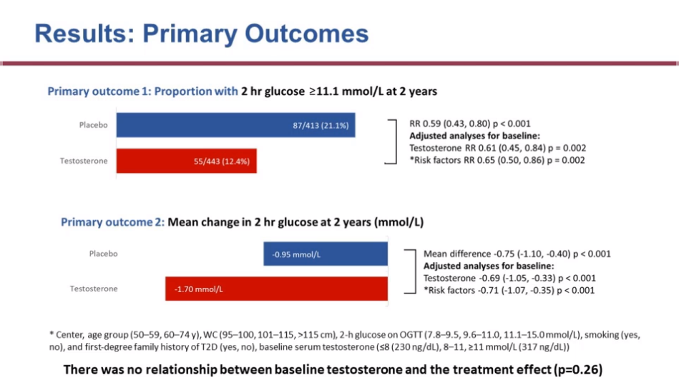
The T4DM study: primary outcomes
Primary outcome 1: proportion of men with OGTT 2-hour glucose ≥11.1 mmol/L at 2 years
Placebo
TTh
87/413 (21.1%)
RR 0.59 (95% CI: 0.43, 080); p<0.001
Adjusted analyses for baseline:
Testosterone RR 0.61 (95% CI: 0.45, 0.84); p=0.002
*Risk factors RR 0.65 (95% CI: 0.50, 0.86); p=0.002
55/443 (12.4%)
Primary outcome 2: mean change in OGTT 2-hour glucose at 2 years (mmol/L)
Mean difference -0.75 (95% CI: 01.10, -0.40); p<0.001
Adjusted analyses for baseline:
Testosterone -0.69 (95% CI: -1.05, -0.33); p<0.001
*Risk factors -0.71 (95% CI: -1.07, -0.35); p<0.001
-0.95 mmol/L
Placebo
TTh
-1.70 mmol/L
TTh decreased RR of T2DM at 2 years by ~40% beyond lifestyle programme alone
There was no relationship between baseline testosterone and the treatment effect (p=0.26)
*Centre, age group (50–59, 60–74 years), WC (95–100, 101–115, >115 cm), 2-hour glucose on OGTT (7.8–9.5, 9.6–11.0, 11.1–15.0 mmol/L), smoking (yes, no),
first-degree family history of T2DM (yes, no), baseline serum testosterone (≤8, 8–11, ≥11 mmol/L)
CI, confidence interval; OGTT, oral glucose tolerance test; T2DM, type 2 diabetes mellitus; TTh, testosterone therapy; WC, waist circumference
Wittert GA et al. Diabetes 2020;69(Suppl 1): https://doi.org/10.2337/db20-274-OR.
Notes:
Reference
Wittert GA et al. Diabetes 2020;69(Suppl 1): https://doi.org/10.2337/db20-274-OR.

Slide 22
The T4DM study: secondary outcomes
Change from baseline in body composition
Change from baseline in sexual function
-8
-6
-4
-2
0
2
-1.0
-0.5
0
0.5
1.0
1.5
p=0.06
Body weight (kg)
Erectile function score
Waist circumference (cm)
Orgasmic function score
Total muscle mass (kg)
Sexual desire score
Total fat mass (kg)
Intercourse
satisfaction score
Abdominal fat (%)
Arm muscle mass (kg)
Overall sexual
satisfaction score
Grip strength (kg)
p=0.14
Total LUTS score
Placebo TTh
Placebo TTh
All p<0.001 unless otherwise stated
LUTS, lower urinary tract symptoms; TTh, testosterone therapy
Wittert GA et al. Diabetes 2020;69(Suppl 1): https://doi.org/10.2337/db20-274-OR.
Notes:
TTh was associated with favourable changes in body composition.
Patients treated with TTh showed greater decreases from baseline in fasting glucose
(-0.17 mmol/L), waist circumference (-2.1 cm), total fat mass (-2.7 kg) and abdominal fat mass (-2.3%), and greater increases in total muscle mass (+1.7 kg), arm muscle mass
(+0.36 kg) and hand grip strength (+2.2 kg) versus those receiving placebo (all p<0.004).
TTh was also associated with small benefits on sexual function.
TTh, testosterone therapy
Reference
Wittert GA et al. Diabetes 2020;69(Suppl 1): https://doi.org/10.2337/db20-274-OR.

Slide 23
The T4DM study: secondary outcomes (cont.)
 | Placebo | TTh | Relative risk (95% CI) |  | p value
 | n/N (%)
Endpoint
Normalised blood glucose (OGTT 2-hour glucose <7.8 mmol/L) | 179/413 (43.3) | 230/443 (51.9) |  | 1.20 (1.04 to 1.38) | 0.012
Reported use of anti-diabetic drugs | 16/503 (3.2) | 20/504 (4.0) |  | 1.25 (0.65 to 2.38) | 0.50
Compliant with lifestyle program | 132/471 (28.0) | 144/480 (30.0) |  | 1.07 (0.88 to 1.31) | 0.50
Achieved sufficient weekly exercise | 280/398 (70.4) | 293/434 (67.5) |  | 0.96 (0.88 to 1.05) | 0.38
0.5
5
Favours placebo
Favours TTh
CI, confidence interval; OGTT, oral glucose tolerance test; TTh, testosterone therapy
Wittert GA et al. Diabetes 2020;69(Suppl 1): https://doi.org/10.2337/db20-274-OR.
Notes:
Reference
Wittert GA at al. Diabetes 2020;69(Suppl 1): https://doi.org/10.2337/db20-274-OR.

Slide 24
The T4DM study: safety
Summary of safety triggers by treatment
Summary of Serious AEs by treatment
 | Placebo | TTh
Participants receiving ≥1 dose of treatment | 503/503 | 504/504
Any trigger | 93/485 (19.2%) | 185/492 (37.6%)
Haematocrit ≥54%* | 6/484 (1.2%) | 106/491 (21.6%)
Increased PSA | 87/468 (18.6%) | 109/480 (22.7%)
25/106 (5% of total) had HCT ≥ 54 on repeat testing and were excluded from the study
 | Placebo | TTh
 | 41 (7%) | 55 (11%)
Arrhythmias | 3 | 8
IHD | 13 | 7
Cerebrovascular disease | 3 | 4
BPH | 3 | 8
Prostate cancer | 5 | 4
Depression | 3 | 1
Venous thrombotic events | 0 | 2
Other cancers | 10 | 4
There were 2 deaths in each group
*Denominators reflect patients with ≥1 haematocrit reading on study
BPH, benign prostatic hyperplasia; IHD, ischaemic heart disease; PSA, prostate-specific antigen; TTh, testosterone therapy
Wittert GA et al. Diabetes 2020;69(Suppl 1): https://doi.org/10.2337/db20-274-OR.
Notes:
Frequent treatment-induced elevations of haematocrit were reported. Risk factors for an increase in haematocrit should be considered before prescribing TTh.
The cardiovascular safety profile of TTh in this patient population was reassuring.
Of the 106 participants who recorded haematocrit ≥54%:
25 ceased study treatment due to confirmed raised haematocrit following hospital pathology service repeat testing
38 had flagged haematocrit occur at weeks 90 or 102 after the final study injection had already been given
5 ceased treatment for another reason prior to the visit with the flagged haematocrit
3 ceased treatment at the same visit as the flagged haematocrit for another reason
40 continued treatment after recording raised haematocrit; according to the protocol, participants should only have continued study injections if a local site (hospital) pathology test returned haematocrit <0.54% on repeat – the men in this group had haematocrit at or just over 0.54% on the core laboratory measurement, but were <0.54 on repeat and did not attract a subsequent flag
TTh, testosterone therapy
Reference Wittert GA et al. Diabetes 2020;69(Suppl 1): https://doi.org/10.2337/db20-274-OR.

Slide 25
Summary
Men with T2DM often have low testosterone levels^{1–3}
Conversely, men with low testosterone and/or SHBG levels are more likely to have T2DM^{4–6}
In men with hypogonadism and T2DM, TTh significantly improves glycaemic control and is associated with reduced mortality^{7–10}
TTh administration for ≥2 years can prevent progression from prediabetes to T2DM and normalise glucose regulation in men with hypogonadism^{7,11}
Improvements in glycaemic control with TTh are lost if treatment is stopped, but reappear when TTh is restarted¹²
SHBG, sex hormone-binding globulin; TTh, testosterone therapy; T2DM, type 2 diabetes mellitus
1. David J et al. Diabetes Prim Care 2017;19:67–72; 2. Kapoor D et al. Diabetes Care 2007;30:911–17; 3. Corona G et al. J Sex Med 2011;34:528–40; 4. Stellato RK et al. Diabetes Care 2000;23:490–4; 5. Laaksonen DE et al. Diabetes Care 2004;27:1036–41; 6. Selvin E et al. Diabetes Care 2007;30:234–8; 7. Yassin A et al. Diabetes Care 2019;42:1104–11; 8. Saad F et al. Int J Obesity 2016;40:162–70; 9. Hackett G et al. Int J Clin Pract 2016;70:244–53; 10. Muraleedharan V et al. Eur J Endocrinol 2013;166:725–33; 11. Wittert GA et al. Diabetes 2020;69(Suppl 1): https://doi.org/10.2337/db20-274-OR; 12. Yassin A et al. Clin Endocrinol 2016;84:107–14.

