Slide 1
Testosterone & Obesity
Besins Healthcare
Global Medical Affairs
March 2021

Slide 2
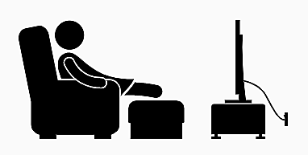
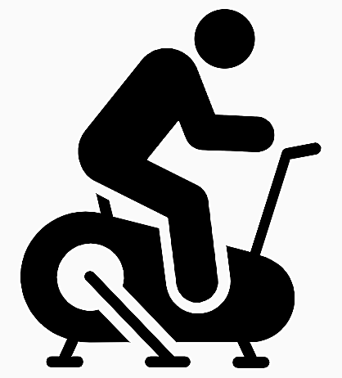
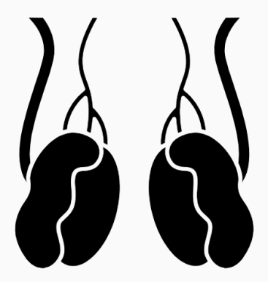
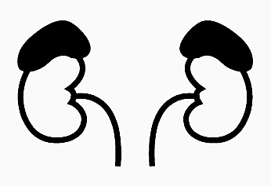
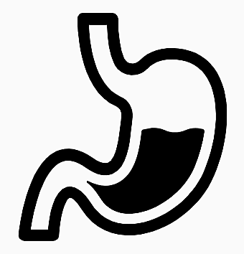
Obesity and testosterone
Factors contributing to obesity include:²
650 million
Metabolic dysregulation
More than
adults have obesity worldwide¹
Sedentary lifestyle
Lifestyle modification is the cornerstone of obesity management²
However, the ability to achieve and maintain clinically meaningful weight loss with such interventions is limited
Inability to regulate energy intake and expenditure
Alternative approaches to treatment²
Endocrine function disruption
Pharmaco -therapy
Bariatric surgery
May be associated with unacceptable side effects^{2,3}
1. WHO. Obesity and overweight. https://www.who.int/news-room/fact-sheets/detail/obesity-and-overweight (accessed October 2020); 2. Saad F et al. Int J Obes (Lond) 2020;44:1264–78; 3. Traish AM. Curr Opin Endocrinol Diabetes Obes 2014;21:313–22.
Notes:
The World Health Organization estimated that in 2016, more than 1.9 billion adults aged ≥18 years were overweight, of whom 650 million were obese.¹
Several pathophysiological mechanisms contribute to obesity, including:²
Metabolic dysregulation.
Inability to regulate energy intake and expenditure.
Sedentary lifestyle.
Disruptions of endocrine function.
Current management strategies for the treatment of obesity include dieting, exercise and other behavioural lifestyle changes.²
Pharmacotherapeutic agents and bariatric surgery are also used to treat and manage obesity.²
However, currently approved medical therapies appear to be of limited benefit, and may have undesirable adverse side-effects in long-term management of obesity that can reduce adherence and lead to treatment discontinuation.³
Bariatric surgery may not be appropriate or available for all patients with obesity, and is not without risks and complications. It necessitates careful patient selection, and patients must be followed-up closely after surgery.²
References
1. WHO. Obesity and overweight. https://www.who.int/news-room/fact-sheets/detail/obesity-and-overweight (accessed October 2020); 2. Saad F et al. Int J Obes (Lond) 2020;44:1264–78; 3. Traish AM. Curr Opin Endocrinol Diabetes Obes 2014;21:313–22.

Slide 3
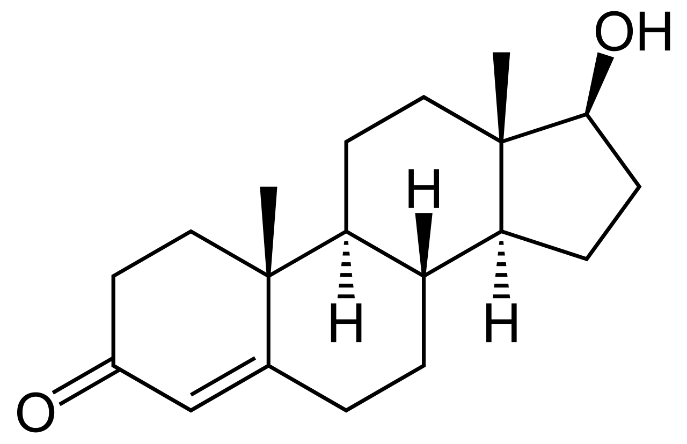
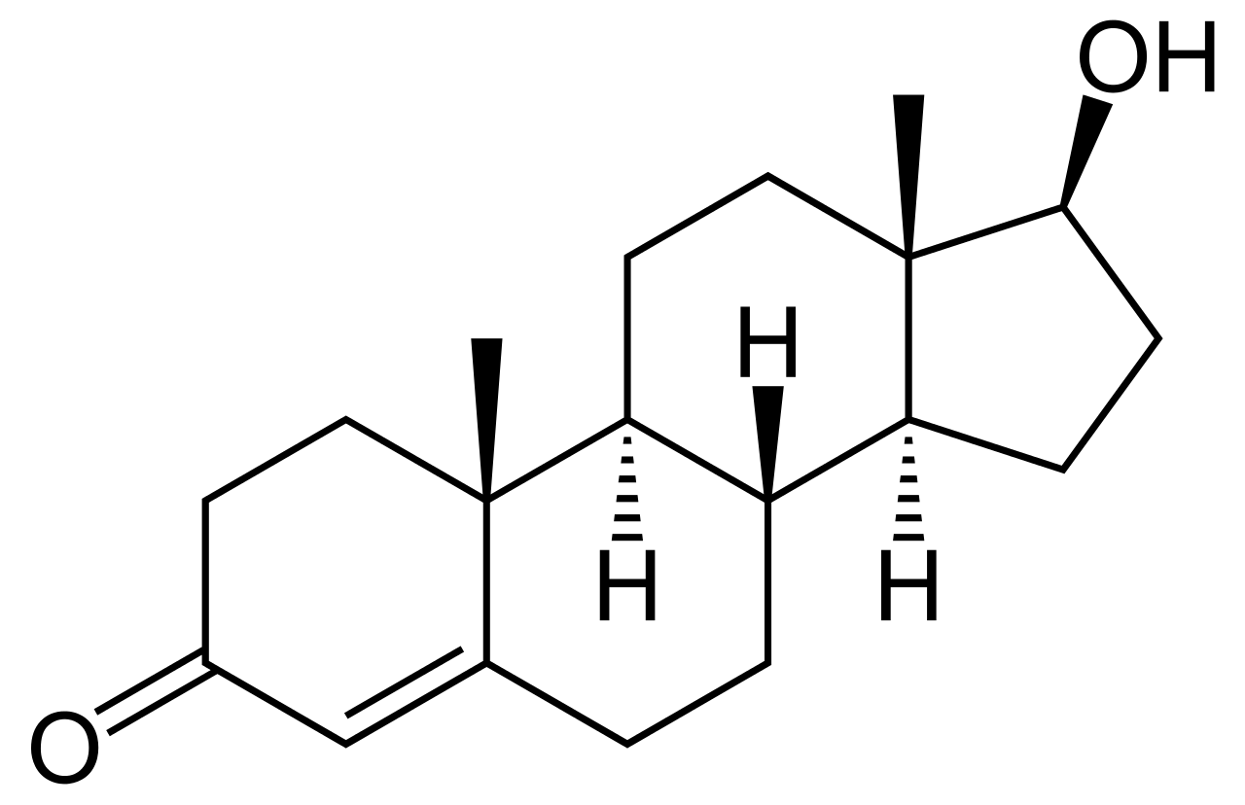
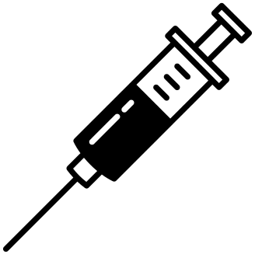
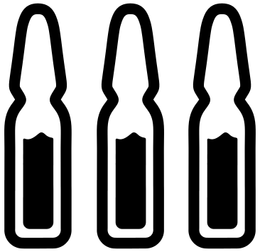
Influence of testosterone on body composition
Testosterone
Regulates the metabolism of carbohydrates, proteins and fat
Major influence on body fat composition and muscle mass in men^{1,2}
Obesity is strongly associated with low testosterone, particularly in men with a BMI >40 kg/m² ^{2,3}
Low testosterone^{1,2}
Affects energy production/utilisation and results in storage of lipids, increased adipogenesis and altered mitochondrial function
Is associated with increased fat mass, particularly central adiposity
TTh in hypogonadal men results in normalisation of glucose utilisation and increased lipid oxidation²
BMI, body mass index; TTh, testosterone therapy
1. Kelly DM, Jones TH. J Endocrinol 2013;217:R25–R45; 2. Traish AM. Curr Opin Endocrinol Diabetes Obes 2014;21:313–22; 3. Saad F et al. Int J Obes (Lond) 2020;44:1264–78.
Notes:
Testosterone plays a key role in carbohydrate, fat and protein metabolism.¹
It has been known for some time that testosterone has a major influence on body fat composition and muscle mass in the male.^{1,2}
Increased waist circumference and obesity are associated with reduced testosterone levels, and approximately 40–75% of men with obesity are hypogonadal.² In particular, men with a BMI >40 kg/m² have a high likelihood of hypogonadism.³
Testosterone deficiency:
Affects energy production and utilisation and therefore upsets this physiological balance resulting in storage of lipids and increased adipogenesis and altering mitochondrial function.²
Is associated with an increased fat mass (in particular central adiposity), reduced insulin sensitivity, impaired glucose tolerance, elevated triglycerides and LDL-C, and low HDL-C. All these factors are components of the metabolic syndrome and type 2 diabetes mellitus, contributing to cardiovascular risk.¹
In hypogonadal men, TTh administration results in improved insulin sensitivity, increased lipid oxidation, and reduction in fat mass with a concomitant gain in fat-free mass.²
BMI, body mass index; HDL-C, high-density lipoprotein cholesterol; LDL-C, low-density lipoprotein cholesterol; TTh, testosterone therapy
References
1. Kelly DM, Jones TH. J Endocrinol 2013;217:R25–R45; 2. Traish AM. Curr Opin Endocrinol Diabetes Obes 2014;21:313–22; 3. Saad F et al. Int J Obes (Lond) 2020;44:1264–78.

Slide 4
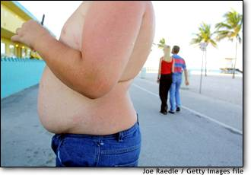
Metabolic syndrome
Metabolic syndrome is a cluster of risk factors for CV disease and T2DM
These include abdominal obesity, raised blood pressure, dyslipidaemia (raised TG and lowered HDL-C) and raised blood glucose¹
Patients with metabolic syndrome are twice as likely to develop CV disease over the next 5–10 years as those without it, and their lifetime risk will be greater still¹
Metabolic syndrome also confers a 5-fold increased risk of T2DM¹
IDF Consensus Worldwide Definition of the Metabolic Syndrome²
 | Abdominal obesity (Europids: ♂ WC ≥94 cm)
 | plus any 2 of (or treatment for) the following:
 | Elevated TG | ≥1.7 mmol/L
 | Reduced HDL-C | <1.03 mmol/L (♂)
 | Raised blood pressure | ≥130/85 mmHg
 | Raised fasting plasma glucose | ≥5.6 mmol/L
CV, cardiovascular; HDL-C, high-density lipoprotein cholesterol; T2DM, type 2 diabetes mellitus; TG, triglycerides; WC, waist circumference
1. Alberti KG et al. Circulation 2009;20;120:1640–5; 2. International Diabetes Federation 2006. https://www.idf.org/e-library/consensus-statements/60-idfconsensus-worldwide-definitionof-the-metabolic-syndrome.html (accessed July 2020).
Notes:
It is estimated that ~20–25% of the world’s adult population have metabolic syndrome.
While the pathogenesis of the metabolic syndrome and each of its components is complex and not well understood, central obesity and insulin resistance are acknowledged as important causative factors.
Central (i.e. abdominal) obesity is easily assessed using waist circumference and is independently associated with each of the other metabolic syndrome components, including insulin resistance.
According to the International Diabetes Federation 2006 definition, central obesity is a prerequisite risk factor for diagnosis of the metabolic syndrome. Insulin resistance, which is difficult to measure in day-to-day clinical practice, is not an essential requirement.
Reference
International Diabetes Federation 2006. https://www.idf.org/e-library/consensus-statements/60-idfconsensus-worldwide-definitionof-the-metabolic-syndrome.html (accessed July 2020).

Slide 5
Visceral fat is an active endocrine organ
Hypertension
Dyslipidaemia
Other characteristics of metabolic syndrome
↑Lipoprotein lipase
↑IL-6
↑Angiotensinogen
Inflammation
↑ Insulin + IGF (insulin-like growth factor)
Low testosterone
↑FFA
↑TNFα
_{Adipose} _{tissue}
↑Resistin
↑Adipsin (Complement D)
↑Leptin
Testosterone → oestrogen
Insulin resistance and type 2 diabetes mellitus
↑Lactate
↓Adiponectin
↑Plasminogen activator inhibitor-1 (PAI-1)
Atherosclerosis
Endothelial dysfunction
Vascular remodelling
FFA, free fatty acid; IL-6, interleukin-6; TNF, tumour necrosis factor
Adapted from Ahima RS. Obesity 2006;14(Suppl 5):242S–9S; Ahima RS, Flier JS. Trends Endocrinol Metab 2000;11:327–32; Grundy SM. J Clin Endocrinol Metab 2004;89:2595–600; Lyon CJ et al. Endocrinology 2003;144:2195–200; Trayhurn P et al. Br J Nutr 2004;92:347–55; Pelusi C, Pasquali R. Curr Obes Rep 2012;1:181–90; Lee HK et al. World J Mens Health 2013;31:136–40; Jung UJ, Choi M-S. Int J Mol Sci 2014;15:6184–223.
Notes:
Adipose tissue is a dynamic endocrine organ that secretes a number of factors that are increasingly recognised to contribute to systemic and vascular inflammation.¹
These factors are collectively known as adipokines and include TNFα, leptin, PAI-1, IL-6, resistin and angiotensinogen.¹
Adipokines have been shown to directly or indirectly regulate a number of processes that contribute to the development of atherosclerosis, including hypertension, endothelial dysfunction, insulin resistance and vascular remodelling.¹
Several adipokines are preferentially expressed in visceral adipose tissue, and the secretion of proinflammatory adipokines is elevated with increasing adiposity.¹
The relationship between obesity and low testosterone levels in men is complex and appears to be bidirectional. Low testosterone levels predict the development of central obesity while obesity predicts low total and free testosterone levels.²
Pro-inflammatory mediators may contribute to lower testosterone levels in obese men either directly or indirectly.²
IL, interleukin; PAI-1, plasminogen activator inhibitor-1; TNFα, tumour necrosis factor alpha
Reference
1. Lyon CJ et al. Endocrinology 2003;144:2195–200; 2. Pelusi C, Pasquali R. Curr Obes Rep 2012;1:181–90.
Sign in

Slide 6
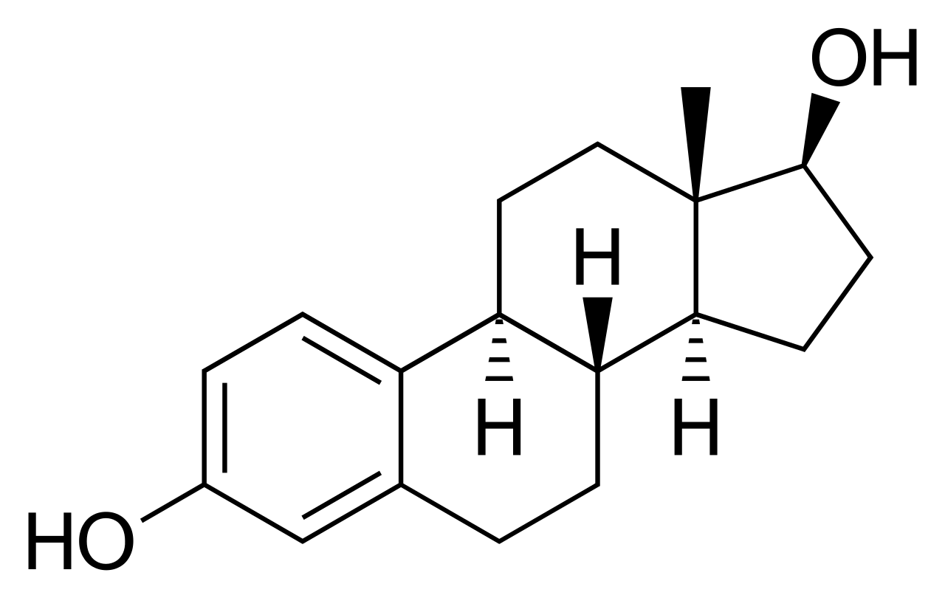
The Hypogonadal–Obesity–Adipocytokine hypothesis
Hypothalamic–pituitary –gonadal axis
Oestradiol
Hypothalamic-pituitary axis
Hypogonadal–obesity cycle
TNFα
IL-6
Leptin
Insulin resistance
LH pulse amplitude
Adipocyte number/size
Aromatase
Testis
Triglyceride uptake
Adipose tissue
_{Adipose} _{tissue}
Testosterone
Lipoprotein lipase activity
IL, interleukin; LH, luteinising hormone; TNF, tumour necrosis factor Adapted from Muraleedharan V, Jones TH. Ther Adv Endocrinol Metab 2010;1:207–23.
Notes:
The metabolic syndrome is a multiplex risk factor that arises from insulin resistance accompanying abnormal adipose deposition and function.
Adipose tissue is a metabolically active endocrine organ that produces cytokines (adipocytokines) that link the various components of the metabolic syndrome and their cardiovascular effects.
Several adipocytokines are preferentially expressed in visceral adipose tissue, and the secretion of proinflammatory adipocytokines is elevated with increasing adiposity.
The hypogonadal-obesity cycle hypothesis was proposed by Cohen in 1999. Testosterone inhibits lipoprotein lipase in adipocytes, the enzyme which breaks down circulating TG to absorbable free fatty acids, which are then taken up into fat cells and converted back to TG for storage.
The hypothesis suggests that low testosterone as a result of high aromatase activity leads to a cycle which promotes increasing adipocyte number and fat deposition, gradually leading to a further lowering of testosterone levels.
High aromatase activity in adipocytes converts testosterone to oestradiol. Reduced tissue testosterone facilitates TG storage in adipocytes by allowing increased lipoprotein lipase activity and stimulating pluripotent stem cells to mature into adipocytes. Increased adipocyte mass is associated with greater insulin resistance. Oestradiol and adipocytokines, tumour necrosis factor α, interleukin-6 and leptin (as a result of leptin resistance in human obesity) inhibit the hypothalamic–pituitary–gonadal axis response to decreasing androgen levels.
The hypogonadal-obesity-adipocytokine hypothesis explains why the body cannot respond to low testosterone levels by a compensatory production of the hormone.
TG, triglycerides
Reference
Muraleedharan V, Jones TH. Ther Adv Endocrinol Metab 2010;1:207–23.
Sign in

Slide 7
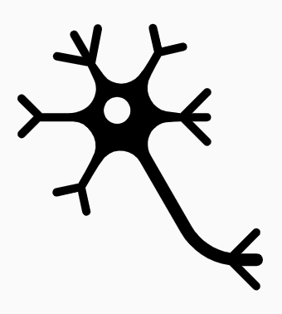
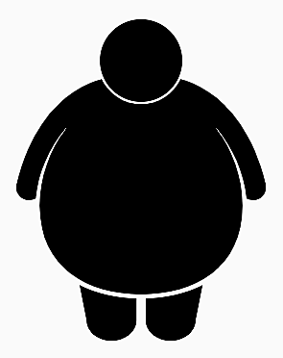
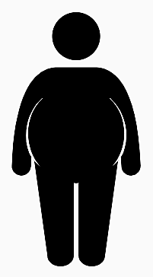
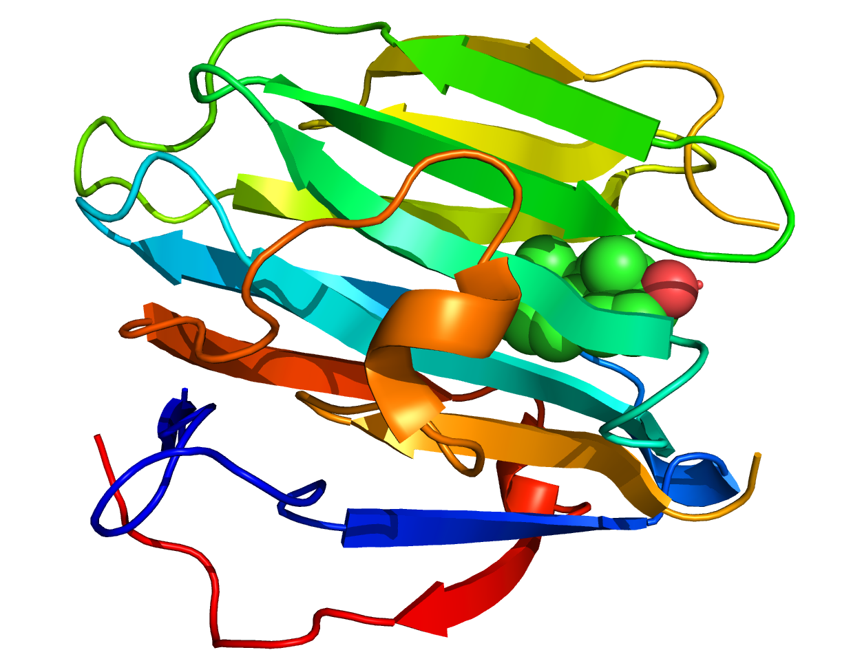
Bidirectional relationship between adipose tissue and testosterone
In modest obesity, low circulating total testosterone concentrations primarily reflect reduced concentrations of SHBG
Marked obesity can lead to hypothalamic-pituitary-gonadal axis suppression, likely mediated via pro-inflammatory cytokine and dysregulated leptin signalling, and aggravated by associated comorbidities
Both central leptin resistance and inhibitory leptin action at the testicular level may play a role
Cytokines may inhibit the hypothalamic-pituitary-gonadal axis at multiple levels
Potential mechanisms for increased adiposity suppressing the hypothalamic-pituitary-gonadal axis
Hypothalamic neurons
Leptin
Cytokines
Hypothalamic-pituitary axis
Decrease in free testosterone
Modest
obesity
Marked
obesity
SHBG
Decrease in total testosterone
Testosterone
_{Adipose} _{tissue}
Stimulation of adipocyte differentiation and triglyceride uptake
Oestradiol
Adipose tissue
Clinical features of hypogonadism
Loss of
muscle mass
Age-associated comorbidities
SHBG, sex hormone-binding globulin
Grossman M. Clin Endocrinol (Oxf) 2018;89:11–21.
Muscle
Notes:
Men with class 1 or class 2 obesity (BMI: 30 to <35 kg/m² or 35 to <40 kg/m², respectively) primarily have low total testosterone concentrations (reduced by as much as 50% versus age-matched men without obesity), which reflect obesity-associated decreases in its circulating carrier protein, SHBG.
In contrast, men with class 3 obesity (BMI: ≥40 kg/m²) demonstrate reductions in both total and free testosterone concentrations. Gonadotrophin concentrations are comparable to those in control individuals without obesity, while luteinising hormone diurnal concentrations and pulse amplitudes are reduced.
These findings suggest that in otherwise healthy, young to middle-aged men, marked obesity is required to genuinely suppress the HPT axis at the biochemical level.
Both central leptin resistance and inhibitory leptin action at the testicular level may play a role in suppression of the HPT axis, and cytokines may inhibit the HPT axis at multiple levels.
In turn, low testosterone and/or low oestradiol may promote adipose tissue accumulation. Androgen deficiency-like clinical features may be due to low sex-steroid concentrations (both testosterone and oestradiol) and/or age-associated accumulation of comorbid burden and sarcopenic obesity. Loss of muscle mass is primarily due to low testosterone concentrations, whereas accumulation of fat mass may primarily be due to low oestradiol concentrations.
BMI, body mass index; HPT, hypothalamic-pituitary-testicular; SHBG, sex hormone-binding globulin
Reference
Grossman M. Clin Endocrinol 2018;89:11–21.

Slide 8
Australian study: randomised controlled trial of the effect of TTh on body composition in men with obesity & low testosterone
56-week, randomised, double-blind, parallel-group, placebo-controlled trial conducted at a tertiary referral centre to evaluate the effect of TTh on body composition over and above caloric restriction
Men (median age: 53 years) with obesity (BMI ≥30 kg/m²) and total testosterone level ≤12 nmol/L who received 10 weeks of a very-low-energy diet followed by 46 weeks of weight maintenance were randomised to receive:
10-weekly 1000 mg intramuscular testosterone undecanoate (n=49; cases)
Matching placebo (n=51; controls)
Main outcome measures
Between-group differences in fat and lean mass measured by DEXA and visceral fat area by CT
BMI, body mass index; CT, computed tomography; DEXA, dual-energy X-ray absorptiometry; TTh, testosterone therapy
Ng Tang Fui M et al. BMC Med 2016;14:153.
Notes:
Based on a hypothesis that TTh can augment diet-induced loss of fat mass and prevent loss of muscle mass, a randomised, double-blind, parallel-group, placebo-controlled trial was conducted at a tertiary referral centre in Australia.
In total, 100 men (median age: 53 years) with obesity (BMI: ≥30 kg/m²) and total testosterone level ≤12 nmol/L receiving 10 weeks of a very-low-energy diet followed by 46 weeks of weight maintenance were randomly assigned at baseline to 56 weeks of 10-weekly intramuscular testosterone undecanoate (n=49, cases) or matching placebo (n=51, controls).
Main outcome measures were the between-group difference in fat and lean mass by DEXA, and visceral fat area by CT.
A total of 82 men completed the study.
BMI, body mass index; CT, computed tomography; DEXA, dual-energy X-ray absorptiometry
Reference
Ng Tang Fui M et al. BMC Med 2016;14:153.

Slide 9
Australian study: TTh augments diet-induced loss of total fat and visceral fat mass in men with obesity and low testosterone
Change from baseline in main outcomes for men with obesity and low testosterone receiving TTh vs placebo (N=100)
At the end of the 10-week very-low-energy diet phase, men in both treatment groups had lost the same amount of body weight, with no difference in body composition
Following resumption of normal foods as part of an energy-restricted diet, men receiving TTh maintained weight loss (p=0.62), while men on placebo regained weight (p=0.06)
At Week 56, men receiving TTh had lost significantly more fat mass and visceral fat, while regaining diet-induced loss of lean mass, versus men on placebo
Weeks 0–10
Weeks 0–56
Mean (95% CI) p value
Fat mass (kg)
-0.4 (-3.0 to 2.2) 0.78
-2.9 (-5.7 to -0.2) 0.04
Fat mass (%)
-0.7 (-2.4 to 1.0) 0.40
-2.8 (-4.6 to -1.0) 0.003
Lean mass (kg)
0.9 (-1.0 to 2.8) 0.36
3.4 (1.3 to 5.5) 0.002
VAT area (mm² x 1000)
-1.1 (-3.4 to 1.3) 0.36
-2.7 (-5.2 to -1.8) 0.04
Body weight (kg)
1.5 (-2.0 to 5.1) 0.40
-0.5 (-4.3 to 3.3) 0.80
Mean adjusted between-group difference* (95% CI)
*Difference between TTh and placebo groups (mean adjusted difference) refers to the change over time across groups (linear mixed effects model)
CI, confidence interval; TTh, testosterone therapy; VAT, visceral abdominal tissue
Ng Tang Fui M et al. BMC Med 2016;14:153.
Notes:
At the end of the 10-week, very-low-energy diet phase, both the TTh [–12.0 kg (95% CI:–14.5 to –9.5)] and control [–13.5 kg (95% CI: –16.0 to –11.0)] groups had lost the same amount of body weight, with no difference in body composition.
Following resumption of normal foods as part of an energy-restricted diet shown to prevent weight regain, body weights remained largely stable from Week 10 onwards until study end (Week 56). In particular, men receiving TTh maintained weight loss (p=0.62), while those on placebo regained weight (p=0.06).
At study end, men in the TTh group had lost significantly more fat mass [mean adjusted between-group difference –2.9 kg (95% CI: –5.7 to –0.2); p=0.04], fat mass percentage [mean adjusted between-group difference –2.8% (95% CI: –4.6 to –1.0); p=0.003] and visceral fat [mean adjusted between-group difference –2678 mm² (95% CI: –5180 to –176); p=0.04], compared with controls.
Although both groups lost the same lean mass following very-low-energy dietary intake [TTh group –3.9 kg (95% CI: –5.3 to –2.6) and control group –4.8 kg (95% CI: –6.2 to –3.5); p=0.36], patients receiving TTh regained lean mass [3.3 kg (95% CI: 1.9 to 4.7); p<0.001] during weight maintenance, in contrast to controls [0.8 kg (95% CI: –0.7 to 2.3); p=0.29] so that at study end (Week 56), the TTh group had an attenuated reduction in lean mass compared to controls [mean adjusted between-group difference 3.4 kg (95% CI: 1.3 to 5.5); p=0.002].
CI, confidence interval; TTh, testosterone therapy
Reference
Ng Tang Fui M et al. BMC Med 2016;14:153.

Slide 10
Long-term registry study: real-world, controlled registry study to evaluate the effects of TTh in hypogonadal men with overweight or obesity
Long-term, real-world registry study to evaluate the effects of TTh on anthropometric and metabolic parameters in 823 men with testosterone deficiency (total testosterone ≤12.1 nmol/L; age 60.6 ± 7.0 years)
Obesity: 57.6% (n=474), overweight: 34.8% (n=286), normal weight: 7.7% (n=63)
428 men received testosterone undecanoate 1000 mg injections every 12 weeks, following an initial 6-week interval
395 men remained untreated and served as controls
Main outcome measures
Anthropometric and metabolic parameters were measured at least twice a year and changes were adjusted for confounding factors* to account for baseline differences between groups
*Age, weight, waist circumference, fasting plasma glucose, blood pressure, lipid levels and Aging Males’ Symptoms scale score.
TTh, testosterone therapy
Saad F et al. Int J Obes (Lond) 2020;44:1264–78.
Notes:
This is an ongoing, long-term, real-world registry study to evaluate the effects of TTh on anthropometric and metabolic parameters in 823 hypogonadal men (total testosterone ≤12.1 nmol/L; mean age 60.6 years) with either normal weight, overweight or obesity, compared with TTh-untreated men.
Among these 823 men, 474 (57.6%) were obese, 286 (34.8%) were overweight, and 63 (7.7%) had normal weight.
Testosterone undecanoate 1000 mg injections were administered to 428 men every 12 weeks following an initial 6-week interval, while 395 men remained untreated and served as controls.
Measures of anthropometric and metabolic parameters were performed at least twice a year and changes were adjusted for age, weight, waist circumference, fasting plasma glucose, blood pressure, lipid levels and the Aging Males’ Symptoms scale to account for any baseline differences between groups.
TTh, testosterone therapy
Reference
Saad F et al. Int J Obes (Lond) 2020;44:1264–78.

Slide 11
Long-term registry study: long-term TTh produced a significant reduction in body weight in hypogonadal men with overweight or obesity
After 11 years, weight changes among patient subgroups were:
Normal weight: 3.4 ± 1.2 kg loss in men receiving TTh (p<0.005 vs baseline) vs 6.1 ± 0.7 kg gain in untreated men (p<0.0001 vs baseline)
Overweight: 8.5 ± 0.4 kg loss in men receiving TTh vs 6.0 ± 0.3 kg gain in untreated men (both p<0.0001 vs baseline)
Obesity: 23.2 ± 0.3 kg loss in men receiving TTh vs 4.2 ± 0.5 kg gain in untreated men (both p<0.0001 vs baseline)
Changes in weight in hypogonadal men with normal weight, overweight or obesity treated with or without TTh
Normal
Overweight
Obese
Testosterone
Placebo
LS mean (SE) change from baseline in weight (kg)
Baseline
1
2
3
4
5
6
7
8
9
10
11
Baseline
1
2
3
4
5
6
7
8
9
10
11
Baseline
1
2
3
4
5
6
7
8
9
10
11
No. at risk
Testosterone: n=
Placebo: n=
P value*:
Year
Year
Year
26
37
26
37
26
37
26
37
25
37
25
37
20
37
18
36
10
36
6
35
6
30
5
14
121
165
121
165
119
165
118
165
106
164
96
163
84
162
81
160
70
149
60
134
47
95
39
55
280
193
281
192
279
192
276
192
264
181
248
171
242
155
232
141
184
118
172
106
150
80
131
42
NS
<0.05
<0.0001
NS
<0.0001
<0.05
<0.0001
<0.0005
*Between groups per year; LS, least squares; SE, standard error; TTh, testosterone therapy
Saad F et al. Int J Obes (Lond) 2020;44:1264–78.
Notes:
At 11 years, in 26 men with normal weight receiving TTh, body weight decreased by 3.4 ± 1.2 kg (p<0.005) and increased by 6.1 ± 0.7 kg (p<0.0001) in 37 men with normal weight who were untreated.
Similarly, in men with overweight, body weight decreased by 8.5 ± 0.4 kg in TTh-treated men (n=113) and increased by 6.0 ± 0.3 kg in TTh-untreated men (n=167) (p<0.0001 for both).
In men with obesity, weight decreased by 23.2 ± 0.3 kg in the TTh-treated group (n=281), compared with a 4.2 ± 0.5 kg increase in the untreated group (n=193) (p<0.0001 for both).
TTh, testosterone therapy
Reference
Saad F et al. Int J Obes (Lond) 2020;44:1264–78.

Slide 12
Long-term registry study: long-term TTh produced a significant reduction in percent body weight in hypogonadal men with overweight or obesity
After 11 years, percent weight changes among patient subgroups were:
Normal weight: 4.8 ± 1.5% loss in men receiving TTh (p<0.005 vs baseline) vs 8.0 ± 0.9% gain in untreated men (p<0.0001 vs baseline)
Overweight: 9.6 ± 0.4% loss in men receiving TTh vs 6.9 ± 0.3% gain in untreated men (both p<0.0001 vs baseline)
Obesity: 20.6 ± 0.3% loss in men receiving TTh vs 5.1 ± 0.4% gain in untreated men (both p<0.0001 vs baseline)
Percent weight changes in hypogonadal men with normal weight, overweight or obesity treated with or without TTh
Normal
Overweight
Obese
Testosterone
Placebo
LS mean (SE) change from baseline in weight (%)
Baseline
1
2
3
4
5
6
7
8
9
10
11
Baseline
1
2
3
4
5
6
7
8
9
10
11
Baseline
1
2
3
4
5
6
7
8
9
10
11
No. at risk
Testosterone: n=
Placebo: n=
P value*:
Year
Year
Year
26
37
26
37
26
37
26
37
25
37
25
37
20
37
18
36
10
36
6
35
6
30
5
14
121
165
121
165
119
165
118
165
106
164
96
163
84
162
81
160
70
149
60
134
47
95
39
55
280
193
281
192
279
192
276
192
264
181
248
171
242
155
232
141
184
118
172
106
150
80
131
42
<0.0001
<0.05
NS
<0.0001
<0.05
<0.0001
<0.0005
<0.0001
*Between groups per year; LS, least squares; SE, standard error; TTh, testosterone therapy
Saad F et al. Int J Obes (Lond) 2020;44:1264–78.
Notes:
When percent weight change was analysed at 11 years, men with normal weight on TTh lost 4.8 ± 1.5% (p<0.005), while TTh-untreated men gained 8.0 ± 0.9% (p<0.0001).
In obese men, weight decreased by 23.2 ± 0.3 kg in the TTh-treated group (n=281), compared with a 4.2 ± 0.5 kg increase in the untreated group (n=193) (p<0.0001 for both).
Among men with overweight, those on TTh lost 9.6 ± 0.4%, in contrast to TTh-untreated men, who gained 6.9 ± 0.3% (p<0.0001 for both).
Men with obesity on TTh lost 20.6 ± 0.3%, while TTh-untreated men with obesity gained 5.1 ± 0.4% (p<0.0001 for both).
TTh, testosterone therapy
Reference
Saad F et al. Int J Obes (Lond) 2020;44:1264–78.

Slide 13
Long-term registry study: long-term TTh produced a significant decrease in waist circumference in hypogonadal men with overweight or obesity
After 11 years, percent weight changes among patient subgroups were:
Normal weight: 3.4 ± 0.8 cm loss in men receiving TTh vs 5.5 ± 0.5 cm gain in untreated men (both p<0.0001 vs baseline)
Overweight: 4.7 ± 0.3 cm loss in men receiving TTh vs 5.5 ± 0.2 cm gain in untreated men (both p<0.0001 vs baseline)
Obesity: 12.9 ± 0.2 cm loss in men receiving TTh vs 5.6 ± 0.4 cm gain in untreated men (both p<0.0001 vs baseline)
Changes in waist circumference in hypogonadal men with normal weight, overweight or obesity treated with or without TTh
Normal
Overweight
Obese
Testosterone
Placebo
LS mean (SE) change from baseline in waist circumference (cm)
Baseline
1
2
3
4
5
6
7
8
9
10
11
Baseline
1
2
3
4
5
6
7
8
9
10
11
Baseline
1
2
3
4
5
6
7
8
9
10
11
No. at risk
Testosterone: n=
Placebo: n=
P value*:
Year
Year
Year
26
37
26
37
26
37
26
37
25
37
25
37
20
37
18
36
10
36
6
35
6
30
5
14
121
165
121
165
119
165
118
165
106
164
96
163
84
162
81
160
70
149
60
134
47
95
39
55
280
193
281
192
279
192
276
192
264
181
248
171
242
155
232
141
184
118
172
106
150
80
131
42
NS
<0.05
<0.05
NS
<0.0001
<0.0001
<0.005
<0.0001
*Between groups per year; LS, least squares; SE, standard error; TTh, testosterone therapy
Saad F et al. Int J Obes (Lond) 2020;44:1264–78.
Notes:
At 11 years, in men with normal weight receiving TTh, waist circumference decreased by 3.4 ± 0.8 cm and increased in TTh-untreated men by 5.5 ± 0.5 cm (p<0.0001 for both).
In men with overweight on TTh, waist circumference decreased by 4.7 ± 0.3 cm and increased by 5.5 ± 0.2 cm in untreated overweight men (p<0.0001 for both).
In men with obesity on TTh, waist circumference decreased by 12.9 ± 0.2 cm and increased by 5.6 ± 0.4 cm in TTh-untreated men with obesity (p<0.0001 for both).
TTh, testosterone therapy
Reference
Saad F et al. Int J Obes (Lond) 2020;44:1264–78.

Slide 14
Long-term TTh in men with low testosterone and obesity produces significant and sustained weight loss
Analysis of 411 men with hypogonadism and different classes of obesity who received TTh for up to 8 years in 2 observational registries
Class 1 weight loss from baseline: 16.8% (17.4 kg)
Class 2 weight loss from baseline: 21.6% (25.3 kg)
Class 3 weight loss from baseline: 23.6% (30.5 kg)
In all classes, changes in weight were statistically significant for all 8 years versus the previous year
Weight change in hypogonadal men on long-term TTh
0
Class 1: BMI 30–34.9 kg/m²
Class 2: BMI 35–39.9 kg/m²
Class 3: BMI >40 kg/m²
-5
*
-10
*
Change in weight from baseline (%)
*
Men achieving weight loss category, by class:
 | Class 1 | Class 2 | Class 3
≥5% loss | 93.5% | 98.0% | 100.0%
≥10% loss | 67.3% | 89.3% | 95.7%
≥15% loss | 39.7% | 72.0% | 89.4%
≥20% loss | 16.4% | 43.3% | 59.6%
-15
*
-20
*
*p<0.0001 vs baseline (for all groups)
*
-25
*
*
Baseline
1
2
3
4
5
6
7
8
Class 1: n=
Class 2: n=
Class 3: n=
Year
214
150
47
214
150
46
213
146
47
207
144
45
174
125
45
161
124
43
139
100
34
86
67
28
70
56
24
BMI, body mass index; TTh, testosterone therapy
Saad F et al. Int J Obes (Lond) 2016;40:162–70.
Graph adapted from Saad F et al. Int J Obes (Lond) 2016;40:162–70
Notes:
From two independent observational registries, a total of 411 obese, hypogonadal men receiving TTh in urological clinics was identified. The effects of TTh on anthropometric and metabolic parameters were studied for up to 8 years (mean follow-up: 6 years).
All men received long-acting injections of testosterone undecanoate in 3-monthly intervals.
In all three classes of obesity, TTh produced significant weight loss.
Patients with class 1 obesity: mean weight decreased from 102.6 ± 6.4 to 84.1 ± 4.9 kg, change from baseline: −17.4 ± 0.5 kg and −16.8 ± 0.4%.
Patients with class 2 obesity: mean weight decreased from 116.8 ± 6.9 to 91.3 ± 6.3 kg, change from baseline: −25.3 ± 0.5 kg and −21.5 ± 0.4%.
Patients with class 3 obesity: weight decreased from 129.0 ± 5.6 to 98.9 ± 4.8 kg, change from baseline: −30.5 ± 0.7 kg and −23.6 ± 0.5%.
TTh, testosterone therapy
Reference
Saad F et al. Int J Obes (Lond) 2016;40:162–70.

Slide 15
Long-term TTh in men with low testosterone and obesity produces significant and sustained decreases in BMI and waist circumference
Reduction of waist circumference
Reduction of BMI
150
Baseline Year 1 Year 2 Year 3 Year 4
Year 5 Year 6 Year 7 Year 8
45
Class 1: BMI 30–34.9 kg/m²
Class 2: BMI 35–39.9 kg/m²
Class 3: BMI >40 kg/m²
140
# *
40
# *
130
# *
*
# *
# *
Mean (SE) waist circumference (cm)
47
# *
p=0.0009
# *
# *
120
*
47
# *
Mean (SE) BMI (kg/m²)
p=NS
150
# *
47
# *
#*
p=0.0043
35
# *
#
*
150
# *
#*
p=NS
*
p=NS
*
p=NS
*
*
# *
p=0.0322
45
*
# *
p=0.0001
146
#*
45
# *
# *
110
p=0.0027
*
# *
214
# *
p=NS
*
43
214
# *
*
*
p=NS
144
126
124
*
34
28
24
# *
#
*
213
207
174
*
100
67
56
30
# *
# *
p=0.0001
*
p=0.0097
*
100
161
139
86
*
p=0.0001
*
#
*
70
#
*
p=0.0068
*
*p<0.0001 vs baseline; #p<0.0001 vs previous year
90
Class 1
Class 2
Class 3
Baseline
1
2
3
4
5
6
7
8
*p<0.0001 vs baseline; #p<0.0001 vs previous year;
all other p values indicate comparison to previous year
Class 1: n=
Class 2: n=
Class 3: n=
Year
214
150
47
214
150
46
213
146
47
207
144
45
174
126
45
161
124
43
139
100
34
86
67
28
70
56
24
Changes in waist circumference versus the previous year were significant for the first 6 years
Improvement in metabolic function was reflected by a decrease in inflammatory biomarkers and improved liver function
Graphs adapted from Saad F et al. Int J Obes (Lond) 2016;40:162–70
BMI, body mass index; NS, not significant; SE, standard error; TTh, testosterone therapy
Saad F et al. Int J Obes (Lond) 2016;40:162–70.
Notes:
In all three classes of obesity, TTh produced significant decreases in waist circumference and BMI.
Patients with class 1 obesity: mean waist circumference decreased from 106.8 ± 7.4 cm to 95.1 ± 5.3 cm, change from baseline: −10.6 ± 0.3 cm. BMI decreased from 32.69 ± 1.4 kg/m² to 27.07 ± 1.57 kg/m², change from baseline: −5.52 ± 0.15 kg/m².
Patients with class 2 obesity: mean waist circumference decreased from 113.5 ± 7.5 cm to 100.0 ± 5.4 cm, change from baseline: −13.9 ± 0.4 cm. BMI decreased from 37.32 ± 1.45 kg/m² to 29.49 ± 1.71 kg/m², change from baseline: −8.15 ± 0.17 kg/m².
Patients with class 3 obesity: mean waist circumference decreased from 118.5 ± 5.6 cm to 103.8 ± 4.9 cm, change from baseline: −14.3 ± 0.4 cm. BMI decreased from 41.93 ± 1.48 kg/m² to 32.46 ± 1.59 kg/m², change from baseline −9.96 ± 0.29 kg/m².
Changes in waist circumference versus the previous year were significant for the first 6 years; changes in BMI versus the previous year were significant for all years, except for the class 3 group, where significant comparisons were observed for the first 6 years.
Improvement in metabolic function was reflected by a decrease in inflammatory biomarkers and improved liver function.
BMI, body mass index; TTh, testosterone therapy
Reference
Saad F et al. Int J Obes (Lond) 2016;40:162–70.

Slide 16
Long-term TTh in men with low testosterone and obesity is associated with significant improvements in HR-QoL, prostate parameters and erectile function
Across all obesity classes, TTh was associated with significant improvements in:
HR-QoL (assessed by reduction in AMS score)
LUTS and urinary flow (assessed by IPSS)
Erectile function (assessed by IIEF-EF)
Changes in AMS score, IPSS and IIEF-EF score in hypogonadal men with obesity receiving long-term TTh for up to 8 years
HR-QoL
Prostate parameters
Erectile function
Class 1
(n=214)
Class 2
(n=150)
Class 3
(n=47)
Class 1
(n=214)
Class 2
(n=150)
Class 3
(n=47)
IIEF-EF scores at 8 years reflected a return to nearly normal function (>26)
Class 1: 24.8, Class 2: 24.3, Class 3: 25.4
0
Change (SE) in IIEF-EF
Change (SE) in AMS score
Change (SE) in IPSS
Class 1
(n=214)
Class 2
(n=150)
Class 3
(n=47)
Class 1: BMI 30–34.9 kg/m²
Class 2: BMI 35–39.9 kg/m²
Class 3: BMI >40 kg/m²
*p<0.0001 vs baseline; AMS, Aging Males’ Symptoms Scale; HR- QoL, health-related quality of life; IIEF-EF, erectile function domain of the International Index of Erectile Function; IPSS, International Prostate Symptom Score; LUTS, lower urinary tract symptoms; SE, standard error; TTh, testosterone therapy
Saad F et al. Int J Obes (Lond) 2016;40:162–70.
Graphs adapted from Saad F et al. Int J Obes (Lond) 2016;40:162–70
Notes:
TTh use resulted in significant improvement in HR-QoL, as demonstrated by a marked and significant reduction in the AMS (32-point reduction in class 1, 33-point reduction in class 2 and 38-point reduction in class 3 obesity).
Similarly, a significant reduction was recorded in IPSS for all classes of obesity, indicating that TTh improves LUTS in men with obesity, as well as urinary flow.
A higher IIEF-EF score was recorded among TTh-treated men, suggesting that TTh improves erectile function in obese men, irrespective of class of obesity.
IIEF-EF scores at 8 years reflected a return to nearly normal function (IIEF-EF score >26) for all obesity classes: 24.8 (Class 1), 24.3 (Class 2) and 25.4 (Class 3).
AMS, Aging Males’ Symptoms Scale; HR-QoL, health-related quality of life; IIEF-EF, erectile function domain of the International Index of Erectile Function; LUTS, lower urinary tract symptoms; TTh, testosterone therapy
Reference
Saad F et al. Int J Obes (Lond) 2016;40:162–70.

Slide 17
Long-term TTh improves components of the metabolic syndrome and other anthropometric and metabolic parameters
Irrespective of body weight at baseline, long-term TTh in hypogonadal men was also associated with:
Improvement in BMI
Decreased fasting blood glucose and HbA_{1c}
Improvement in lipid profile
Gradual decreases in systolic and diastolic BP, and pulse pressure
BMI, body mass index; HbA_{1c}, glycated haemoglobin; TTh, testosterone therapy
Saad F et al. Int J Obes (Lond) 2020;44:1264–78; Traish AM. Curr Opin Endocrinol Diabetes Obes 2014;21:313–22.
Notes:
Irrespective of body weight at baseline, long-term TTh of up to 11 years improves components of the metabolic syndrome, and other anthropometric and metabolic parameters.^{1,2}
TTh decreased fasting blood glucose and HbA_{1c}, and improved lipid profiles. Gradual decreases in blood pressure (both systolic and diastolic) and pulse pressure occurred in TTh-treated men in each body weight group (normal weight, overweight, obesity).¹
In hypogonadal men, long-term TTh:
Preserves visceral adipose tissue function; in contrast, testosterone deficiency leads to derangement and dysfunction of visceral adipose tissue metabolism.²
Produces significant reductions in total cholesterol, LDL-C and triglycerides, and increases HDL-C.²
Reduces fasting glucose, HbA_{1c}, the non-specific inflammatory marker, hsCRP, and the liver enzymes AST and ALA, suggesting improvement in hyperglycaemia and a reduction in the inflammatory response/inflammation.²
Improves erectile function.²
Increases vigour and reduces fatigue.²
These changes in physical and behavioural activity result in improved HR-QoL.²
ALA, alanine aminotransferase; AST, aspartate aminotransferase; BMI, body mass index; HbA_{1c}, glycated haemoglobin; HDL-C, high-density lipoprotein cholesterol; HR-QoL, health-related quality of life; hsCRP, high-sensitivity C-reactive protein; LDL-C, low-density lipoprotein cholesterol; TTh, testosterone therapy
References
1. Saad F et al. Int J Obes (Lond) 2020;44:1264–78; 2. Traish AM. Curr Opin Endocrinol Diabetes Obes 2014;21:313–22.

Slide 18
Guideline recommendations for men with obesity
AACE/ACE obesity guidelines recommend that:
Men with an increased waist circumference (≥94 cm in Europids) or obesity should be assessed for hypogonadism [Grade B]
Vice versa, all men with hypogonadism should be evaluated for the presence of overweight or obesity [Grade B]
Men with T2DM should be evaluated to exclude hypogonadism [Grade B]
Men with frank hypogonadism and obesity not seeking fertility should be considered for TTh, in addition to lifestyle intervention [Grade A]
In these patients, TTh use results in weight loss, decreased waist circumference, and improvements in metabolic parameters (fasting plasma glucose, HbA_{1c}, lipid profile, and blood pressure)
AACE, American Association of Clinical Endocrinologists; ACE, American College of Endocrinology; HbA_{1c}, glycated haemoglobin; T2DM, type 2 diabetes mellitus; TTh, testosterone therapy
Garvey WT et al. Endocr Pract 2016;22(Suppl. 3):1–203.
Notes:
Guidelines from the AACE/ACE recognise the link between obesity and hypogonadism, and advise the appropriate use of TTh, in addition to lifestyle intervention, as a treatment option for hypogonadal men with obesity.
AACE, American Association of Clinical Endocrinologists; ACE, American College of Endocrinology; TTh, testosterone therapy
Reference
Garvey WT et al. Endocr Pract 2016;22(Suppl. 3):1–203.

Slide 19
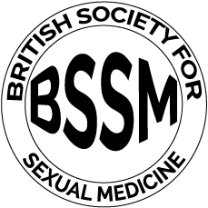
Guideline recommendations for men with obesity
BSSM & EAU Guidelines recommend:
Screening for testosterone deficiency in all men with BMI >30 kg/m2 or waist circumference (WC) >102 cm2 ¹
Include testosterone assessment in men with a disease in which testosterone deficiency is common, and in whom treatment may be indicated, such as obesity ²
BSSM, British Society for Sexual Medicine; EAU, European Association of Urology; BMI, Body Mass Index;
1. Hackett G, et al. J Sex Med 2017;14:1504-23; 2. Dohle GR, et al. Guidelines of Male Hypogonadism. European Association of Urology 2018. Available at: https://uroweb.org/guideline/male-hypogonadism/#4 Accessed October 2019
Notes:
References:
Hackett G, et al. J Sex Med 2017;14:1504-23;
Dohle GR, et al. Guidelines of Male Hypogonadism. European Association of Urology 2018. Available at: https://uroweb.org/guideline/male-hypogonadism/#4 Accessed October 2019

Slide 20
Summary
Testosterone plays a key role in carbohydrate, fat and protein metabolism and has a major influence on male body fat composition and muscle mass^{1,2}
Obesity is associated with reduced testosterone levels in men³
Randomised clinical trial and real-world evidence shows that long-term TTh administration in hypogonadal men with overweight and obesity:
Produces clinically meaningful weight loss^{3–5}
Improves body composition^{3,4}
Ameliorates components of the metabolic syndrome^{2, 3–5}
Improves health-related quality of life⁵
TTh, testosterone therapy
1. Kelly DM, Jones TH. J Endocrinol 2013;217:R25–R45; 2. Traish AM. Curr Opin Endocrinol Diabetes Obes 2014;21:313–22; 3. Saad F et al. Int J Obes (Lond) 2020;44:1264–78; 4. Ng Tang Fui M et al. BMC Med 2016;14:153; 5. Saad F et al. Int J Obes (Lond) 2016;40:162–70.

