Slide 1
Testosterone Deficiency & Opioids
Besins Healthcare
Global Medical Affairs
March 2021

Slide 2
Testosterone and opioids: overview
Chronic non-cancer pain is one of the most common GP consultations in the UK
Opioid prescribing to treat chronic non-cancer pain has increased rapidly over the past 20 years¹
Higher doses and the use of more potent/longer-acting opioids are associated with increased risk of harms including opioid dependence and overdose¹
Regular opioid use in men with chronic pain can suppress testosterone levels leading to opioid-induced hypogonadism^{2,3}
Testosterone levels also decrease progressively as a function of age and comorbidities, which are common in men with chronic non-cancer pain^{3,4}
Up to 50% of adults in the UK have chronic non-cancer pain¹
Opioid-induced hypogonadism is an under-recognised condition⁵
GP, general practitioner
1. Scott LJ et al. Br J Gen Pract 2020;70:e111–9; 2. Bawor M et al. Drug Alcohol Depend 2015;149:1–9; 3. Coluzzi F et al. J Endocrinol Invest 2018;41:1377–88; 4. Rubinstein A & Carpenter DM. Am J Med 2014;127:1195–201. 5. Reddy RG et al. BMJ 2010; Aug 31;341:c4462.
Notes:
Chronic non-cancer pain, defined as a painful condition lasting for ≥3 months and not associated with a cancer diagnosis, affects 35–51% of adults in the UK.¹
It is one of the most common reasons for GP consultations in the UK, and opioid prescribing to treat it has grown in the last 20 years.¹
Long-term opioid use is associated with significant healthcare, workplace and criminal justice costs, as well as serious adverse events including opioid dependence and opioid-related deaths.¹
Furthermore, the risk of harm increases at high doses, and additional benefit is unlikely above an average daily morphine equivalent dose of 120 mg.¹
Various studies, including a systematic review and meta-analysis, demonstrate that testosterone levels are suppressed in men receiving regular opioids, regardless of opioid type or indication of use.^{2,3}
Testosterone levels also decrease progressively as a function of age and comorbidities, which are common in men with chronic non-cancer pain.^{3,4}
In a large cohort of men on daily opioid therapy for chronic pain (N=1585), the presence of 2 or 3 metabolic syndrome-associated conditions and age 50 years also increased the odds of androgen deficiency.⁴
Opioid-induced hypogonadism is an under-recognised condition⁵
GP, general practitioner
References
1. Scott LJ et al. Br J Gen Pract 2020;70:e111–9; 2. Bawor M et al. Drug Alcohol Depend 2015;149:1–9; 3. Coluzzi F et al. J Endocrinol Invest 2018;41:1377–88; 4. Rubinstein A & Carpenter DM. Am J Med 2014;127:1195–201. 5. Reddy RG et al. BMJ 2010; Aug 31;341:c4462.

Slide 3
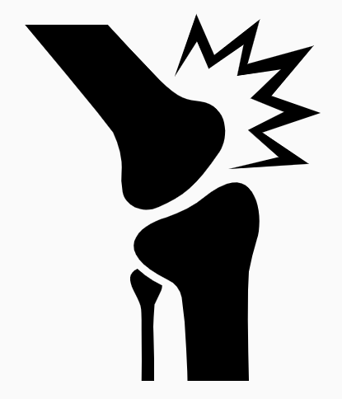
Testosterone deficiency is common in chronic opioid users
Reported prevalence of opioid-induced hypogonadism across studies is 19–86%^{1–3}
Prevalence varies depending on the testosterone threshold used to define hypogonadism³
Most studies report overall prevalence rates of >50%, confirming the significant impact of opioids in reducing testosterone levels³
Prevalence of low testosterone among chronic opioid users and men with other conditions⁴
53–74%
Rheumatoid arthritis
19–47%
Prevalence of low testosterone (%)
1. Abs R et al. J Clin Endocr Metab 2000;85:2215–22; 2. Ajo R et al. J Sex Med 2016;13:1377–86; 3. Coluzzi F et al. J Endocrinol Invest 2018;41:1377–88; 4. Khera M et al. J Sex Med 2016;13:1787–804.
Notes:
The reported prevalence of opioid-induced hypogonadism across studies is 19–86%.^{1–3}
In men with chronic pain receiving either long-term intrathecal opioids (n=29) or non-opioid analgesics (n=11; control group), serum testosterone levels were significantly lower in the opioid group versus controls (p<0.001); 25 of the 29 opioid patients (86.2%) and 1 control patient showed a serum testosterone level <9.0 nmol/L (<260 ng/dL).¹
In a descriptive, cross-sectional pilot study of consecutive patients with chronic non-cancer pain on long-term opioids (N=750), opioid-induced hypogonadism [serum testosterone <10.4 nmol/L (<300 ng/dL)] was found in 19% of patients.²
The prevalence of opioid-induced hypogonadism varies depending on the testosterone threshold used to define it.³
While definitions vary, most studies report overall prevalence rates of >50%, confirming the significant impact of opioids in reducing testosterone levels.³
Testosterone levels are often low in chronic conditions, such as obesity, diabetes, hypertension and hyperlipidaemia, as well as in men receiving opioid therapy.⁴
In a retrospective cohort study of men treated with opioids for chronic pain (N=81), 53% had a morning testosterone level <8.66 nmol/L (<250 ng/dL); moreover, testosterone deficiency was found in 74% of men on long-acting opioid therapy.⁴
References
1. Abs R et al. J Clin Endocr Metab 2000;85:2215–22; 2. Ajo R et al. J Sex Med 2016;13:1377–86; 3. Coluzzi F et al. J Endocrinol Invest 2018;41:1377–88; 4. Khera M et al. J Sex Med 2016;13:1787–804.

Slide 4
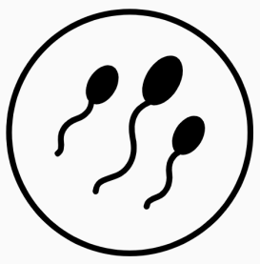
Opioid-induced hypogonadism is associated with reduced sexual function and quality of life
Opioid-induced hypogonadism is associated with a range of conditions, including:
Decreased libido
Erectile dysfunction
Bone loss
Infertility
Low mood
Reduced quality of life
ED, erectile dysfunction
Coluzzi F et al. J Endocrinol Invest 2018;41:1377–88.
Notes:
Opioid-induced hypogonadism has significant negative clinical consequences on sexual function, mood, bone density and body composition, and can also lead to the development of infertility.
In addition, opioid-induced hypogonadism can impair pain control leading to hyperalgesia, which can contribute to sexual dysfunction, mood impairment and a reduced quality of life.
Reference
Coluzzi F et al. J Endocrinol Invest 2018;41:1377–88.

Slide 5
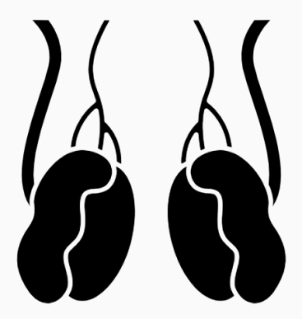
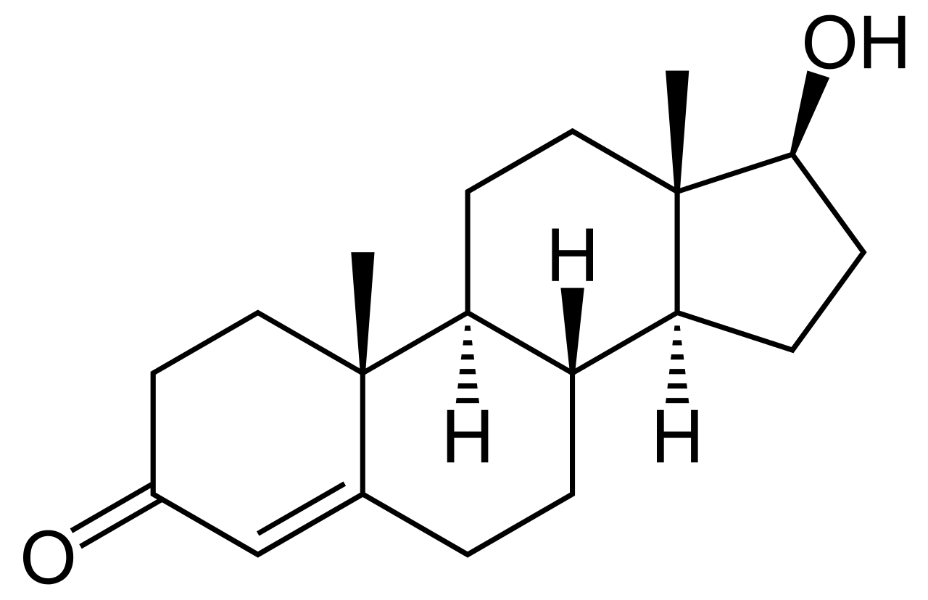
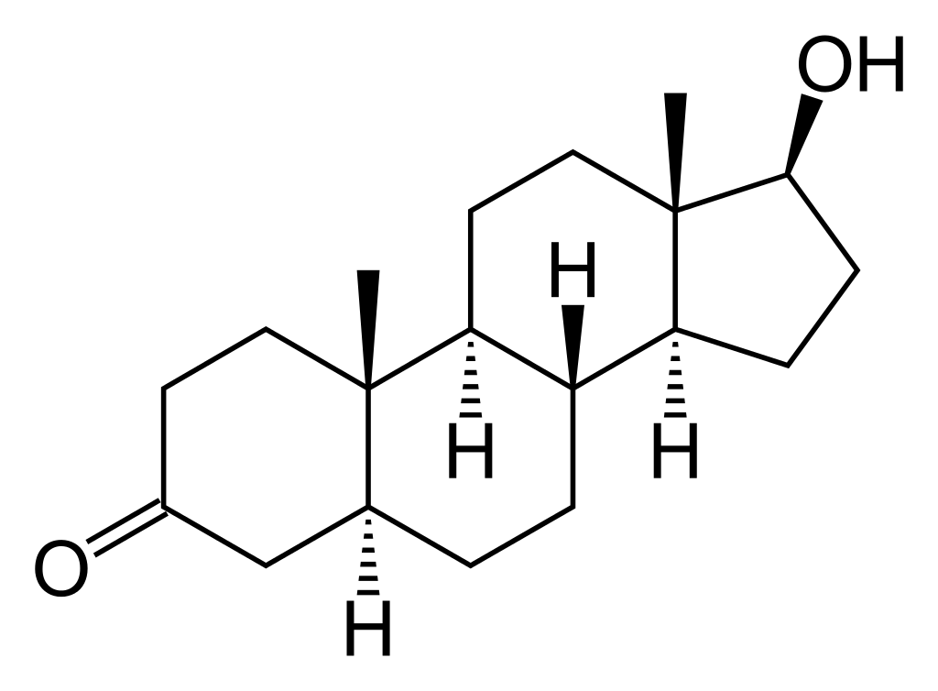
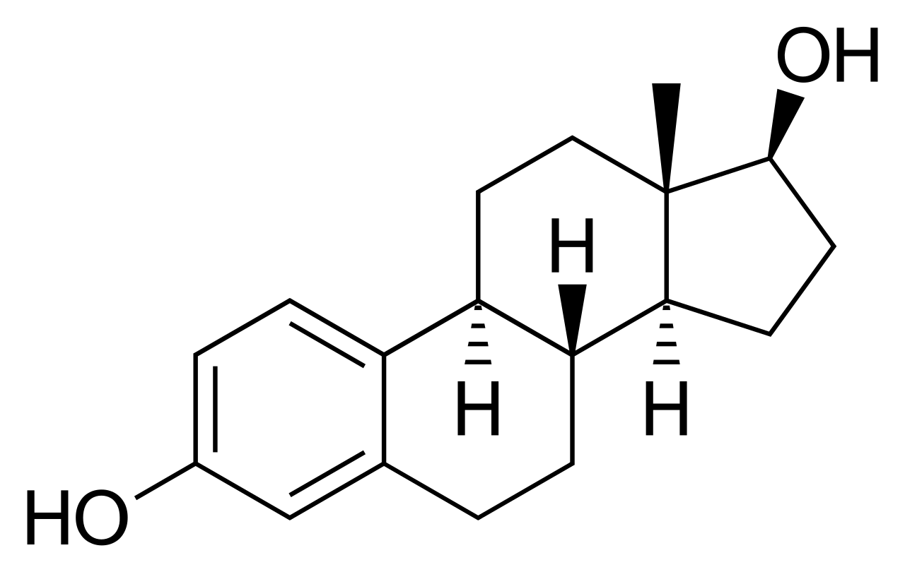
Pathogenesis of opioid-induced hypogonadism
Pathogenesis of opioid-induced hypogonadism
Hypothalamus
Inhibit
Opioids can influence the secretion of hormones at different levels of the hypothalamus–pituitary–gonadal axis
Opioids can also promote the development of hypogonadism by directly inhibiting GnRH through the μ-opioid receptor
–
Central
effects
Opioids
GnRH
Decrease
in
Inhibit
Pituitary gland
–
FSH
LH
Total
testosterone
levels
Stimulate
+
Testis
5-α reductase 1
P450 aromatase
Peripheral
effects
Testosterone
GnRH, gonadotropin-releasing hormone; FSH, follicular-stimulating hormone; LH, luteinising hormone; DHT, dihydrotestosterone
Adapted from Coluzzi F et al. J Endocrinol Invest 2018;41:1377–88.
DHT
Oestradiol
Notes:
The endocrine system can be severely affected by chronic opioid treatment, leading to a decrease in total testosterone levels and opioid-induced hypogonadism.
Opioids can influence the secretion of hormones at different levels of the hypothalamus–pituitary–gonadal axis.
Opioids generally increase levels of growth hormone, thyroid-stimulating hormone and prolactin, but there are conflicting reports on the effects of opioids on arginine vasopressin and adrenocorticotropic hormone.
In addition, opioids can lead to the development of hypogonadism by directly inhibiting GnRH through the μ-opioid receptor, reducing libido and causing erectile dysfunction, bone loss and/or infertility.
GnRH, gonadotropin-releasing hormone
Reference
Coluzzi F et al. J Endocrinol Invest 2018;41:1377–88.

Slide 6
In a retrospective study, hypogonadism was associated with longer duration of action of opioids and BMI, but not total daily opioid dose
In a retrospective cohort study of men diagnosed with chronic pain for >3 months, men on long-acting opioids* had 4.78 times greater odds of developing hypogonadism, compared with men on short-acting opioids*
BMI was also significantly associated with hypogonadism, but daily opioid dose was not
Prevalence of hypogonadism among men using long- or short-acting opioids* for chronic pain
Duration of action (long- vs short- acting opioids*)
4.78 (1.51 to 15.07)
p=0.008
1.02 (0.99 to 1.05)
p=0.29
BMI
(kg/m²)
1.13 (1.03 to 1.24)
p=0.006
20
Odds ratio (95% CI)
*Long-acting opioids: buprenorphine, fentanyl, methadone, controlled-release morphine, standard-release oxycodone; Short-acting opioids: hydrocodone, immediate-release oxycodone; BMI, body mass index; CI, confidence interval; MSE, morphine-standardised equivalent dose
Rubinstein AL et al. Clin J Pain 2013;29:840–5.
6
Notes:
This retrospective US cohort study evaluated data from men aged 26–79 years (N=81; mean age: 51 years; median/mean BMI: 29/31 kg/m²) who had a diagnosis of chronic pain (defined as pain lasting for >3 months without any aetiology that allowed for definitive or curative treatment) and were on a stable dose of opioid therapy for ≥3 months, of whom 46 were hypogonadal and 35 were not.
After controlling for daily opioid dose and BMI, men on long-acting opioids* had 4.78 times greater odds of becoming hypogonadal than men on short-acting opioids* (95% CI: 1.51 to 15.07; p=0.008).
In total, 74% (n=34/46) of men receiving long-acting opioids were hypogonadal compared with 34% (n=12/35) of men using short-acting opioids exclusively.
After controlling for daily opioid dose and duration of action of opioid, BMI was also found to be significantly associated with hypogonadism; for every unit increase of BMI, patients had an additional 13% higher odds of being hypogonadal (95% CI: 1.03 to 1.24; p=0.006).
The model also showed that for every 10 mg increase in daily opioid dose, patients had an additional 2% greater chance of being hypogonadal, but this was not significant (95% CI: 0.99 to 1.05; p=0.29).
*Long-acting opioids: buprenorphine, fentanyl, methadone, controlled-release morphine, standard-release oxycodone; Short-acting opioids: hydrocodone, immediate-release oxycodone
BMI, body mass index; CI, confidence interval; OR, odds ratio
Reference
Rubinstein AL et al. Clin J Pain 2013;29:840–5.

Slide 7
In a retrospective study, odds of hypogonadism were higher with opioids that maintain very stable serum drug levels
In a retrospective cohort study of men with chronic non-cancer pain managed with a single type of long- (n=190) or short-acting (n=969) opioid for ≥90 days:
Transdermal fentanyl, methadone and oxycodone were associated with higher odds of hypogonadism versus hydrocodone
Increased doses of hydrocodone and oxycodone were associated with higher odds of hypogonadism
Adjusted odds ratio for hypogonadism among men using opioids for chronic pain
Opioid (referent: hydrocodone)
25.73 (2.82 to 234.97)
0.22 (0.00 to 65.96)
7.33 (3.29 to 16.33)
2.40 (0.92 to 6.28)
3.15 (1.87 to 5.33)
Effect of dose (per 10 mg MSE)
0.96 (0.88 to 1.03)
1.18 (1.09 to 1.28)
1.34 (0.61 to 2.94)
0.99 (0.97 to 1.02)
1.05 (0.99 to 1.11)
1.01 (1.00 to 1.02)
300
Odds ratio (95% CI)
CI, confidence interval; MSE, morphine-standardised equivalent dose
Rubinstein AL & Carpenter DM. Pain Med 2017;18:637–44.
Notes:
This retrospective US cohort study evaluated data from men aged 18–80 years (N=1159) who had chronic non-cancer pain and were on a stable regimen of a single opioid for ≥90 days (n=190 received a long-acting opioid, n=969 received a short-acting opioid).
Hypogonadism was noted in 69.2%, 60.8%, 52.1%, 50.4%, 42.9%, 35.5% and 34.2% of patients receiving fentanyl, methadone, morphine, oxycodone, hydromorphone, codeine and hydrocodone, respectively.
Results for each opioid were analysed with reference to hydrocodone, because the bivariate results indicated that patients using hydrocodone were least likely to be androgen-deficient; moreover, it was the largest group.
Fentanyl [OR 25.73 (95% CI: 2.82 to 234.97)], methadone [OR 7.33 (95% CI: 3.29 to 16.33)] and oxycodone [OR 3.15 (95% CI: 1.87 to 5.33)] were all associated with higher odds of hypogonadism than hydrocodone.
Morphine was also associated with elevated odds of hypogonadism compared to hydrocodone [OR 2.40 (95% CI: 0.92 to 6.28)]; however, this result was not statistically significant.
The highest odds of hypogonadism appeared to be associated with those opioids that maintain very stable serum drug levels.
The findings of this study suggest that before commencement of opioid therapy or modification of existing opioid therapy, patients should undergo testosterone testing.
CI, confidence interval; OR, odds ratio
Reference
Rubinstein AL & Carpenter DM. Pain Med 2017;18:637–44.

Slide 8
Chronic opioid use may increase the odds of developing hypogonadism in a dose-dependent manner
In a retrospective, case-control study of men on long-term opioid therapy for >3 months (N=357), the odds of developing hypogonadism increased by 44% for every 100 units in maximum MEDD [OR 1.44 (95% CI: 1.16 to 1.78); p=0.0008)
Prevalence of hypogonadism among chronic opioid users according to maximum MEDD
Prevalence of hypogonadism (%)
CI, confidence interval; MEDD, morphine equivalent daily dose; OR, odds ratio
Eshraghi Y et al. American Academy of Pain Medicine (AAPM) 2020 annual meeting; Abstract LB015.
Notes:
This retrospective, case-control study evaluated data from men aged 18–80 years (N=357) who were chronic opioid users (defined as continuous opioid use for >3 months), of whom 95 had hypogonadism/low testosterone and 263 did not (controls).
Exclusion criteria included a hypogonadism diagnosis prior to starting chronic opioid therapy, history of Klinefelter syndrome, chromosomal abnormalities, cryptorchidism, varicocele, myotonic dystrophy, mumps infection, radiation exposure to the testes, testicular torsion, long-term corticosteroid use, prostate cancer, and known endocrine disorder.
Each patient in the hypogonadism group was matched to ≤4 controls by age, race and BMI. MEDD data were collected from electronic health records.
Hypogonadism prevalence varied with dose, ranging from 15.6% among men with a MEDD <100 (n=135) to 50.0% among men with a MEDD of 500–800 (n=14).
There was a linear association between long-term opioid use and hypogonadism, with the odds of developing hypogonadism increasing by 44% per 100-unit difference in maximum MEDD [OR 1.44 (95% CI: 1.16 to 1.78), p=0.0008).
Study limitations included its retrospective nature, unmeasured confounders, and small sample sizes, especially among patients taking high opioid doses.
The study findings suggest that men receiving higher doses of chronic opioid therapy should be screened for hypogonadism.
BMI, body mass index; CI, confidence interval; MEDD, morphine equivalent daily dose; OR, odds ratio
Reference
Eshraghi Y et al. American Academy of Pain Medicine (AAPM) 2020 annual meeting; Abstract LB015.

Slide 9
TTh significantly decreases all-cause mortality and other adverse health outcomes in men with opioid-induced hypogonadism versus TTh non-use
In a cohort study of long-term opioid users with testosterone deficiency, those receiving TTh (n=14,121) had significantly lower all-cause mortality and incidences of MACE, anaemia, and femoral or hip fractures than those not receiving TTh (n=7151)
Likelihood of adverse outcomes after 6 years of follow-up in men with opioid-induced hypogonadism on chronic opioid therapy (N=21,272)
1.0 [Reference]
0.51 (0.42 to 0.61)
1.0 [Reference]
0.58 (0.51 to 0.67)
1.0 [Reference]
0.73 (0.68 to 0.79)
1.0 [Reference]
0.68 (0.48 to 0.96)
Covariate-adjusted hazard ratio (95% CI)
CI, confidence interval; MACE, major adverse cardiovascular outcomes; TTh, testosterone therapy
Jasuja GK et al. JAMA Netw Open 2019;2:e1917141.
Notes:
This was a cohort study of men on long-term opioid therapy with low testosterone levels [<10.4 nmol/L (<300 ng/dL)] under the care of Veterans Health Administration facilities in the USA from 1 October 2008 to 30 September 2014.
Male patients with HIV infection, gender dysphoria or prostate cancer, or who received TTh in 2008 were excluded.
In total, 21,272 long-term opioid users [mean (SD) age: 53 (10) years] were included for analysis, of whom 14,121 (66.4%) received TTh and 7151 (33.6%) did not.
After adjusting for covariates*, opioid users who received TTh had significantly lower all-cause mortality [HR 0.51 (95%CI: 0.42 to 0.61)] and incidences of MACE** [HR 0.58 (95% CI: 0.51 to 0.67)], anaemia [HR 0.73 (95%CI 0.68 to 0.79)] and femoral or hip fractures [HR 0.68 (95%CI: 0.48 to 0.96)] during the 6-year follow-up period, compared with their counterparts without a TTh prescription.
*Adjusted for age, race/ethnicity, marital status, BMI, copay requirement, zip code poverty level, and baseline status of the following clinical conditions: indications for pain, chronic pain conditions, use of glucocorticoids, congestive heart failure, cancers, coronary artery disease, hypertension, diabetes, hyperlipidaemia, liver disease, chronic kidney disease, stroke or transient ischaemic attack, dementia, depression, bipolar disease, substance use disorder, alcohol dependence, psychosis, and use of antipsychotic medications. **MACE: incident cases (new occurrence) of myocardial infarction or thrombotic stroke or death
BMI, body mass index; HIV, human immunodeficiency virus; HR, hazard ratio; MACE, major adverse cardiovascular events; SD, standard deviation; TTh, testosterone therapy
Reference
Jasuja GK et al. JAMA Netw Open 2019;2:e1917141.

Slide 10
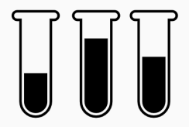
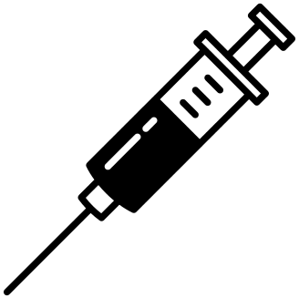
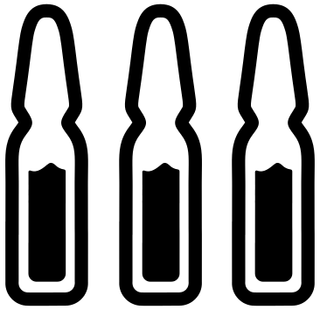
Considerations for patients starting opioid treatment, and for initiating TTh in men using opioids
Consider measuring testosterone levels in all men before prescribing opioid treatment, and select opioids with a lower affinity for the μ-opioid receptor¹
When assessing the impact of opioids on testosterone, the effects of age and medical conditions should be considered²
In symptomatic patients with opioid-induced hypogonadism, if opioid discontinuation is unlikely, TTh may be initiated¹
This decision should be discussed with the patient, emphasising that while there is some evidence to support positive short-term outcomes, the long-term effect of TTh in men with opioid-induced hypogonadism is unknown
TTh, testosterone therapy
1. Coluzzi F et al. J Endocrinol Invest 2018;41:1377–88; 2. Cepeda MS et al. Pain Med 2015;16:2235–42.
Notes:
Clinicians should be aware of the following considerations regarding the management of both: i) patients starting opioid treatment, and ii) those who are already receiving opioids, but have symptoms of low testosterone and may therefore benefit from initiating TTh.
Measurement of testosterone levels should be considered in all men before prescribing opioid treatment, and choosing an opioid with a lower affinity for the μ-opioid receptor may be preferred over a higher-affinity opioid.¹
When assessing the impact of opioids on testosterone, the effects of age and medical conditions should be considered. In a cross-sectional study using NHANES 2011–2012 data for a representative sample of men aged ≥17 years (N=5229; n=320 and n=4909 exposed or unexposed to opioids, respectively), after controlling for opioid exposure, increases in age and number of comorbidities were associated with significantly greater odds of having low testosterone levels, compared with younger age and/or fewer underlying conditions.²
In symptomatic patients with opioid-induced hypogonadism, if opioid discontinuation is unlikely, TTh may be initiated.¹
This decision should be discussed with the patient, emphasising that while there is some evidence to support positive short-term outcomes, the long-term effect of TTh in men with opioid-induced hypogonadism is unknown.
NHANES, National Health and Nutrition Examination Survey; TTh, testosterone therapy
References
1. Coluzzi F et al. J Endocrinol Invest 2018;41:1377–88; 2. Cepeda MS et al. Pain Med 2015;16:2235–42.

Slide 11
Summary
Opioid-induced hypogonadism is an under-recognised condition⁷
Regular opioid use in men with chronic pain can suppress testosterone levels and lead to opioid-induced hypogonadism^{1,2}
Most studies of men receiving chronic opioid therapy report a hypogonadism prevalence of >50%, confirming the significant impact of opioids in reducing testosterone levels²
Opioid-induced hypogonadism is associated with impaired sexual function and decreased quality of life²
Use of long-acting opioids, opioids that maintain very stable serum drug levels, and higher opioid doses, may all increase the odds of developing hypogonadism^{3–5}
Clinicians should be alert to the potential risks in men starting opioid treatment, and consider TTh in symptomatic men with opioid-induced hypogonadism who are unable to discontinue opioid use²
In men with opioid-induced hypogonadism, TTh can decrease the risk of death and adverse health outcomes, including MACE, anaemia and upper-leg fractures⁶
MACE, major adverse cardiac events; TTh, testosterone therapy
1. Bawor M et al. Drug Alcohol Depend 2015;149:1–9; 2. Coluzzi F et al. J Endocrinol Invest 2018;41:1377–88; 3. Rubinstein AL et al. Clin J Pain 2013;29:840–5; 4. Rubinstein AL & Carpenter DM. Pain Med 2017;18:637–44; 5. Eshraghi Y et al. American Academy of Pain Medicine (AAPM) 2020 annual meeting; Abstract LB015; 6. Jasuja GK et al. JAMA Netw Open 2019;2:e1917141. 7. Reddy RG et al. BMJ 2010; Aug 31;341:c4462.

