Slide 1
Testosterone & Sexual Function
Besins Healthcare
Global Medical Affairs
March 2021

Slide 2
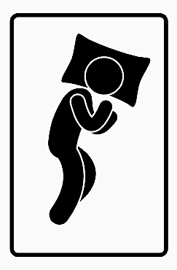
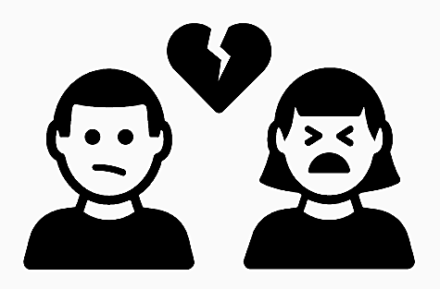
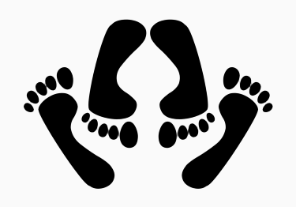
Sexual dysfunction is a common sign of hypogonadism in men
23–36% of men with sexual dysfunction have hypogonadism
Sexual symptoms
include:
Reduced sexual
desire/libido
Reduced
sexual activity
ED
Fewer/diminished
nocturnal erections
ED, erectile dysfunction; PDE-5, phosphodiesterase type 5; TTh, testosterone therapy
Dohle GR et al. European Association of Urology Guidelines on Male Hypogonadism 2018. Available at: https://uroweb.org/guideline/male-hypogonadism/ (last accessed January 2021).
Notes:
Symptoms of sexual dysfunction are the most predictive determinant sign of potential male hypogonadism: 23–36% of men with sexual dysfunction also have hypogonadism.
Sexual symptoms can include reduced sexual desire and activity, ED and fewer/diminished nocturnal erections.
The most prevalent symptoms of hypogonadism in ageing men are reduced sexual desire/libido, reduced sexual activity, and ED.
ED, erectile dysfunction
Reference
Dohle GR et al. European Association of Urology Guidelines on Male Hypogonadism 2018. Available at: https://uroweb.org/guideline/male-hypogonadism/ (last accessed January 2021).

Slide 3
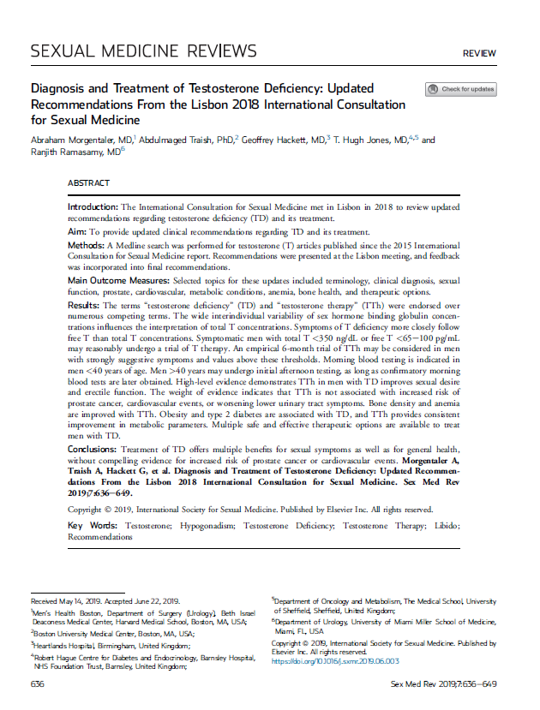
ICSM 2018 guidelines
Sexual symptoms are a prominent presenting feature for men with TD
[Level of evidence: 1, Grade: A]
Testing for TD should be performed in men with decreased libido, ED and/or difficulty achieving orgasm
[Level of evidence: 2, Grade: B]
TTh may improve libido, erection quality, and other sexual symptoms
[Level of evidence: 1, Grade: A]
TTh may salvage erectile function in men who have failed PDE-5 inhibitors
[Level of evidence: 2, Grade: B]
ED, erectile dysfunction; ICSM, International Consultation for Sexual Medicine; PDE-5, phosphodiesterase type 5; TD, testosterone deficiency; TTh, testosterone therapy
Morgentaler A et al. Sex Med Rev 2019;7:636–49.
Notes:
ICSM 2018 guidelines
The most common and reliable symptoms of TD are sexual, and include reduced or absent libido, ED, difficulty achieving orgasm, reduced intensity of orgasm, and reduced sexual sensation in the genital region.
Decreased libido is one of the primary symptoms of TD; it may occur with or without any other symptoms or signs, and is strongly suggestive of TD in men aged >50 years without obvious other cause, such as major depression, relationship issues, stress, or use of medications known to influence libido (most notably, selective serotonin reuptake inhibitors).
TTh use improves sexual desire and erectile function in men with hypogonadism.
The ICSM 2018 guidelines recommend that:
“Sexual symptoms are a prominent presenting feature for men with TD” (level of evidence: 1, grade: A)
“Testing for TD should be performed in men with decreased libido, ED and difficulty achieving orgasm”
(level of evidence: 2, grade: B)
“TTh may improve libido, erection quality and other sexual symptoms” (level of evidence: 1, grade: A)
“TTh may salvage erectile function in men who have failed PDE-5 inhibitors”
(level of evidence: 2, grade: B)
ED, erectile dysfunction; ICSM, International Consultation for Sexual Medicine; PDE-5, phosphodiesterase type 5; TD, testosterone deficiency; TTh, testosterone therapy
Reference
Morgentaler A et al. Sex Med Rev 2019;7:636–49.

Slide 4
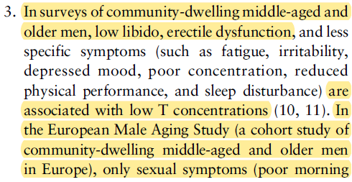
Endocrine Society Clinical Practice Guideline
TTh and sexual function in hypogonadal men
Conclusions from a systematic review and meta-analysis commissioned by the Endocrine Society
T treatment in hypogonadal men with low libido is associated with significantly greater improvement in libido, erectile function and sexual activity vs placebo
T does not significantly improve sexual function and activity in men who do not have low T concentrations in the hypogonadal range
PDE-5 inhibitors can improve erectile function in eugonadal and hypogonadal men; however, RCTs have failed to demonstrate further improvements in erectile function with the addition of T to an optimised regimen of PDE-5 inhibitors
TTh does not improve ejaculatory function in men with low T concentrations and ejaculatory dysfunction
We recommend TTh in hypogonadal men to induce and maintain secondary sex characteristics and correct symptoms of testosterone deficiency
[Strength of recommendation: strong, quality of evidence: moderate]
PDE-5, phosphodiesterase type 5; RCT, randomised controlled trial; T, testosterone; TTh, testosterone therapy
Bhasin S et al. J Clin Endocrinol Metab 2018;103:1715–44.
Notes:
Endocrine Society guidelines
Endocrine Society guidelines list ‘reduced sexual desire (libido) and activity’ and ‘decreased spontaneous erections, erectile dysfunction’ as symptoms/signs suggestive of testosterone deficiency in men.
A systematic review and meta-analysis commissioned by the Endocrine Society found that TTh use is associated with significant improvements in libido, erectile function and sexual activity versus placebo in men with hypogonadism (but not eugonadal men).
Endocrine Society guidelines state:
“We recommend TTh in hypogonadal men to induce and maintain secondary sex characteristics and correct symptoms of testosterone deficiency” [strong recommendation, moderate-quality evidence]
TTh, testosterone therapy
Reference
Bhasin S et al. J Clin Endocrinol Metab 2018;103:1715–44.

Slide 5
AUA 2018 guidelines
The AUA 2018 guidelines state that:
The main purpose of TTh is to achieve therapeutic testosterone levels and provide relief of symptoms or signs
Data from clinical trials in men with hypogonadism demonstrate that TTh use leads to statistically significant improvements in erectile function and sex drive
Patients should be informed that TTh may result in improvements in erectile function, low sex drive, anemia, bone mineral density, lean body mass, and/or depressive symptoms [moderate recommendation, evidence level: grade B]
AUA, American Urological Association; TTh, testosterone therapy
Mulhall JP et al. J Urol 2018;200:423–32.
Notes:
AUA 2018 guidelines
The AUA 2018 guidelines highlight that TTh use can improve erectile function and low libido in men with hypogonadism.
They recommend that:
“Patients should be informed that TTh may result in improvements in erectile function, low sex drive, anemia, bone mineral density, lean body mass, and/or depressive symptoms” (moderate recommendation, evidence level: grade B)
AUA, American Urological Association; TTh, testosterone therapy
Reference
Mulhall JP et al. J Urol 2018;200:423–32.

Slide 6
EAU 2018 guidelines
TTh can improve body composition, bone mineralisation, signs of the metabolic syndrome, male sexual problems, diabetes regulations, memory and depressive symptoms [level of evidence: 3]
In hypogonadal men with ED, start with a PDE-5 inhibitor as first-line treatment and add testosterone in case of a poor response to PDE-5 inhibitor treatment [strong recommendation]
EAU, European Association of Urology; ED, erectile dysfunction; PDE-5, phosphodiesterase type 5; TTh, testosterone therapy
Dohle GR et al. European Association of Urology Guidelines on Male Hypogonadism 2018. Available at: https://uroweb.org/guideline/male-hypogonadism/ (last accessed January 2021).
Notes:
EAU 2018 guidelines
The EAU 2018 guidelines highlight that sexual dysfunction (most commonly reduced sexual desire/activity and ED) is the most predictive determinant sign of potential hypogonadism in men.
Data from RCTs show that TTh moderately increases sexual function, including sexual arousal, interest, drive and activity, in men with hypogonadism.
In a recent meta-analysis of RCTs on TTh and sexual function, TTh was shown to have a positive influence on sexual function but only in hypogonadal men (total testosterone <8 nmol/L).
Improvement of sexual symptoms largely depends on the aetiology of the dysfunction:
TTh may help improve response to PDE-5 inhibitors in hypogonadal men, and a recent meta-analyses of studies of daily PDE-5 inhibitor use showed that they were equally effective in eugonadal or hypogonadal men.
For ED management, PDE-5 inhibitors are usually effective and work quickly (in contrast to TTh, which may take months to show effects on ED), and may also increase serum testosterone levels.
The guidelines recommend that:
“TTh can improve body composition, bone mineralisation, signs of the metabolic syndrome, male sexual problems, diabetes regulations, memory and depressive symptoms” (level of evidence: 3)
“In hypogonadal men with ED, start with a PDE-5 inhibitor as first-line treatment and add testosterone in case of a poor response to PDE-5 inhibitor treatment” (strong recommendation)
EAU, European Association of Urology; ED, erectile dysfunction; PDE-5, phosphodiesterase type 5; RCT, randomised controlled trial; T2DM, type 2 diabetes mellitus; TTh, testosterone therapy
Reference
Dohle GR et al. European Association of Urology Guidelines on Male Hypogonadism 2018. Available at: https://uroweb.org/guideline/male-hypogonadism/ (last accessed January 2021).

Slide 7
TTh significantly improves erectile function versus placebo in men with hypogonadism
Meta-analysis of 8 RCTs evaluating the effect of TTh on erectile function in men with hypogonadism, via the IIEF-15 questionnaire
Overall, TTh use was associated with a significant improvement in erectile function versus placebo in men with hypogonadism
Meta-analysis: effect of TTh on erectile function (assessed using the IIEF-15) in men with hypogonadism
Study
Mean difference (95% CI)
Chiang et al. 2007
Allan et al. 2008
Chiang et al. 2009
Jones et al. 2011
Hackett et al. 2013
Basaria et al. 2015
Brocket et al. 2016
Snyder et al. 2016
Overall
3.50 (-2.19 to 9.19); p=0.23
4.20 (-1.81 to 10.21); p=0.17
5.30 (1.66 to 8.94); p=0.00
0.80 (-2.12 to 3.72); p=0.59
3.48 (0.41 to 6.55); p=0.03
1.40 (0.81 to 1.99); p=0.00
2.80 (1.14 to 4.46); p=0.00
2.64 (1.08 to 4.20); p=0.00
2.31 (1.41 to 3.22); p=0.001
-7.0
-3.5
0
3.5
7.0
Favours placebo
Favours TTh
CI, confidence interval; IIEF, International Index of Erectile Function; RCT, randomised controlled trial; TTh, testosterone therapy
Rastrelli G et al. Maturitas 2018;112:46–52. Graph adapted from same reference.
Notes:
For this narrative review, an extensive search of PubMed was performed up to 31 January 2018 using the following terms: ((“testosterone”[MeSH Terms] OR “testosterone”[All Fields]) AND (“sexual behavior”[MeSH Terms] OR (“sexual”[All Fields] AND “behavior”[All Fields]) OR “sexual behavior”[All Fields] OR “sexual”[All Fields]) AND (“physiology”[Subheading] OR “physiology”[All Fields] OR “function”[All Fields] OR “physiology”[MeSH Terms] OR “function”[All Fields])), limiting the results to studies of men (filters: humans and male) published in English. The retrieved papers were scrutinised for evidence on the relationship between endogenous testosterone and sexual function and the effect of TTh on sexual symptoms.
Findings from a meta-analysis of 8 randomised, placebo-controlled clinical trials that evaluated erectile function through the IIEF-15 questionnaire confirmed the efficacy of TTh in significantly improving erectile function in men with hypogonadism.
Less marked, but still significant, improvements in erectile function were also seen with increasing BMI and/or increasing prevalence of T2DM.
BMI, body mass index; IIEF, International Index of Erectile Function; MeSH, Medical Subject Headings; T2DM, type 2 diabetes mellitus; TTh, testosterone therapy
Reference
Rastrelli G et al. Maturitas 2018;112:46–52.

Slide 8
TTh significantly improves sexual desire versus placebo in men with hypogonadism
Meta-analysis of 6 RCTs evaluating the effect of TTh on sexual desire in men with hypogonadism, via the IIEF-15 questionnaire
Overall, TTh use was associated with a significant improvement in sexual desire versus placebo in men with hypogonadism
Meta-analysis: effect of TTh on sexual desire (assessed using the IIEF-15) in men with hypogonadism
Study
Mean difference (95% CI)
Allan et al. 2008
Chiang et al. 2009
Jones et al. 2011
Hackett et al. 2013
Basaria et al. 2015
Brocket et al. 2016
Overall
0.10 (-1.51 to 1.71); p=0.90
0.10 (-0.01 to 0.21); p=0.08
0.50 (-0.18 to 1.18); p=0.15
0.73 (0.04 to 1.42); p=0.04
0.27 (0.13 to 0.41); p=0.00
0.80 (0.33 to 1.27); p=0.00
0.33 (0.12 to 0.54); p=0.001
-2.0
-1.0
0
1.0
2.0
Favours placebo
Favours TTh
CI, confidence interval; IIEF, International Index of Erectile Function; RCT, randomised controlled trial; TTh, testosterone therapy
Rastrelli G et al. Maturitas 2018;112:46–52. Graph adapted from same reference.
Notes:
For this narrative review, an extensive search of PubMed was performed up to 31 January 2018 using the following terms: ((“testosterone”[MeSH Terms] OR “testosterone”[All Fields]) AND (“sexual behavior”[MeSH Terms] OR (“sexual”[All Fields] AND “behavior”[All Fields]) OR “sexual behavior”[All Fields] OR “sexual”[All Fields]) AND (“physiology”[Subheading] OR “physiology”[All Fields] OR “function”[All Fields] OR “physiology”[MeSH Terms] OR “function”[All Fields])), limiting the results to studies of men (filters: humans and male) published in English. The retrieved papers were scrutinised for evidence on the relationship between endogenous testosterone and sexual function and the effect of TTh on sexual symptoms.
A meta-analysis of 6 randomised, placebo-controlled clinical trials that evaluated sexual desire using the IIEF-15 questionnaire showed that sexual desire in men with hypogonadism is significantly improved by TTh administration.
IIEF, International Index of Erectile Function; MeSH, Medical Subject Headings; TTh, testosterone therapy
Reference
Rastrelli G et al. Maturitas 2018;112:46–52.

Slide 9
TTh significantly improves orgasm versus placebo in men with hypogonadism
Meta-analysis of 7 RCTs evaluating the effect of TTh on orgasm in men with hypogonadism, via the IIEF-15 questionnaire
Overall, TTh use was associated with a significant improvement in orgasm versus placebo in men with hypogonadism
Meta-analysis: effect of TTh on orgasm (assessed using the IIEF-15) in men with hypogonadism
Study
Mean difference (95% CI)
Allan et al. 2008
Chiang et al. 2009
Jones et al. 2011
Hackett et al. 2013
Basaria et al. 2015
Paduch et al. 2015
Brock et al. 2016
Overall
1.50 (-0.93 to 3.93); p=0.23
3.80 (1.37 to 6.23); p=0.00
0.20 (-0.96 to 1.36); p=0.74
1.69 (0.55 to 2.83); p=0.00
0.19 (-0.12 to 0.50); p=0.22
-0.30 (-0.72 to 0.12); p=0.16
0.80 (0.33 to 1.27); p=0.00
0.63 (0.05 to 1.21); p=0.03
-6.0
-3.0
0
3.0
6.0
Favours placebo
Favours TTh
CI, confidence interval; IIEF, International Index of Erectile Function; RCT, randomised controlled trial; TTh, testosterone therapy
Rastrelli G et al. Maturitas 2018;112:46–52. Graph adapted from same reference.
Notes:
For this narrative review, an extensive search of PubMed was performed up to 31 January 2018 using the following terms: ((“testosterone”[MeSH Terms] OR “testosterone”[All Fields]) AND (“sexual behavior”[MeSH Terms] OR (“sexual”[All Fields] AND “behavior”[All Fields]) OR “sexual behavior”[All Fields] OR “sexual”[All Fields]) AND (“physiology”[Subheading] OR “physiology”[All Fields] OR “function”[All Fields] OR “physiology”[MeSH Terms] OR “function”[All Fields])), limiting the results to studies of men (filters: humans and male) published in English. The retrieved papers were scrutinised for evidence on the relationship between endogenous testosterone and sexual function and the effect of TTh on sexual symptoms.
A meta-analysis of 7 randomised, placebo-controlled clinical trials that evaluated orgasm through the IIEF-15 questionnaire showed that TTh is associated with a significantly greater improvement in orgasm compared with placebo. Moreover, this relationship was inversely proportional to baseline testosterone levels, with increasing levels of improvement in orgasm noted with decreasing baseline testosterone levels.
IIEF, International Index of Erectile Function; MeSH, Medical Subject Headings; TTh, testosterone therapy
Reference
Rastrelli G et al. Maturitas 2018;112:46–52.

Slide 10
TTh improves sexual function and symptoms, including sexual satisfaction, libido and morning erections, in hypogonadal men
Comparisons of 5 separate meta-analyses evaluating the relationship between TTh administration and selected sexual parameters in hypogonadal men
Meta-analyses: efficacy of TTh on sexual symptoms among men with hypogonadism
Sexual satisfaction
Isidori et al. 2005*
Bolona et al. 2007**
Corona et al. 2014***
Ponce et al. 2018*
Libido
Isidori et al. 2005*
Bolona et al. 2007**
Corona et al. 2014***
Elliot et al. 2016***
Ponce et al. 2018*
Morning erections
Isidori et al. 2005*
Bolona et al. 2007**
Corona et al. 2014***
Trials included (n)
Mean difference (range)
4
7
2
5
5
10
14
3
4
7
1.16 (0.04 to 2.29)
0.86 (0.40 to 1.32)
0.16 (0.01 to 0.31)
1.60 (0.29 to 2.92)
1.31 (0.40 to 2.22)
0.95 (0.41 to 1.50)
0.33 (0.16 to 0.50)
0.17 (0.01 to 0.24)
1.53 (1.00 to 2.06)
0.92 (0.36 to 1.48)
-2.0
-1.0
0
1.0
2.0
3.0
4.0
Favours placebo
Favours TTh
Cut-offs used to define hypogonadism in each meta-analysis were (total testosterone level): *10 nmol/L, **10.4 nmol/L, ***12 nmol/L
TTh, testosterone therapy
Rastrelli G et al. Sex Med Rev 2019;7:464–75. Graph adapted from same reference.
Notes:
A review was conducted to summarise all available evidence regarding the effect of TTh on sexual function/outcomes in men with hypogonadism complaining of sexual dysfunction.
A comprehensive Medline, Embase and Cochrane search was performed including the following words: (“testosterone”[MeSH Terms] OR “testosterone”[All Fields]) AND (“sexual behavior”[MeSH Terms] OR (“sexual”[All Fields] AND “behavior”[All Fields]) OR “sexual behavior”[All Fields] OR “sexual”[All Fields]) AND (“physiopathology”[Subheading] OR “physiopathology”[All Fields] OR “dysfunction”[All Fields]). Publications were included from 1 January 1969 to 1 August 2018.
To ensure comparable data, the review focused only on those meta-analyses reporting sexual function outcomes as effect size, with a small, medium and large treatment-effect size considered to be 0.2, 0.5 and 0.8, respectively.
The number of trials included in each meta-analysis studied ranged from 4 to 29, comprising 657 to 3,165 men.
Libido outcomes were documented in all meta-analyses considered, while the effect of TTh on morning erections and sexual satisfaction was reported by 2 and 3 studies, respectively.
Three meta-analyses used a hypogonadism threshold of total testosterone level of ~10 nmol/L and two meta-analyses used a total testosterone level of 12 nmol/L.
Among these patients with hypogonadism, TTh administration resulted in a significant improvement in all sexual function parameters evaluated versus placebo.
MeSH, Medical Subject Headings; TTh, testosterone therapy
Reference
Rastrelli G et al. Sex Med Rev 2019;7:464–75.

Slide 11
The Testosterone Trials: the impact of TTh on seven clinical outcomes in older men with low testosterone
Shared characteristics of the Testosterone Trials
12 US study sites
TTrials (n=7): Sexual Function, Physical Function, Vitality, Cognitive Function, Anaemia, Cardiovascular, Bone
Non-randomised, double-blinded, placebo-controlled design
Men with average testosterone level <9.5 nmol/L (<275 ng/dL)
Participants received 1% testosterone gel in a pump dispenser (5 g/day, adjusted to maintain normal testosterone levels for a young man) or placebo gel for 12 months
Treatment allocated by minimisation (allows balancing with a larger number of variables than stratified randomisation)
Balancing variables included age ≤ or >75 years, screening testosterone levels ≤ or >6.9 nmol/L (200 ng/dL), use/non-use of antidepressants and use/non-use of PDE-5 inhibitors
PDE-5, phosphodiesterase type 5; TTh, testosterone therapy
Snyder PJ et al. Endocr Rev 2018;39:369–86.
Notes:
The Testosterone Trials were 7 coordinated clinical trials conducted at 12 US sites to assess the efficacy of TTh in older men with hypogonadism [testosterone levels <9.5 nmol/L (<275 ng/dL)]:
Sexual Function.
Physical Function.
Vitality.
Cognitive Function.
Anaemia.
Cardiovascular.
Bone.
Participants were allocated to receive 1% testosterone gel (5 g/day, adjusted to maintain normal testosterone levels for a young man) or placebo gel for 1 year, and efficacy was assessed every 3 months.
Participants were allocated treatment by minimisation, which allows balancing with a larger number of variables than stratified randomisation.
Balancing variables included age < or >75 years, screening testosterone levels < or >6.9 nmol/L (200 ng/dL), use/non-use of antidepressants and use/non-use of PDE-5 inhibitors.
PDE-5, phosphodiesterase type 5; TTh, testosterone therapy
Reference
Snyder PJ et al. Endocr Rev 2018;39:369–86.

Slide 12
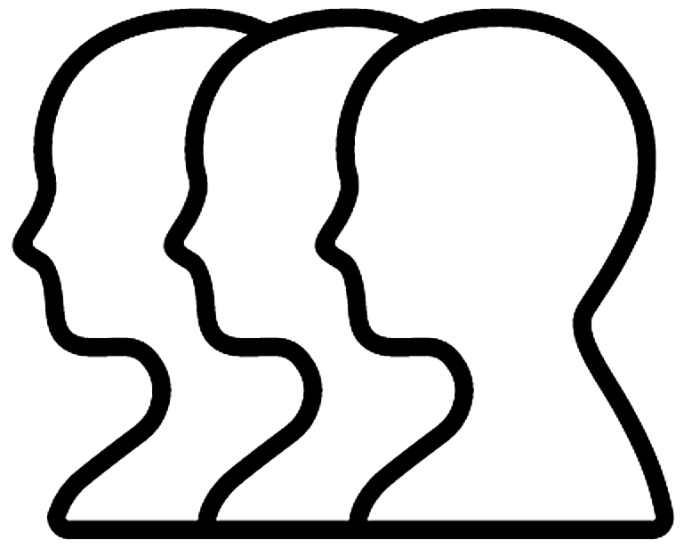
Sexual Function Trial: effect of TTh on sexual activity in older men with low testosterone
To determine if TTh for older men with low testosterone increases sexual activity, assessed by PDQ-Q4
Aim
459
n=
enrolled in the Sexual Function Trial and analysed
n=
771
enrolled in all TTrials and analysed
Selected baseline characteristics and demographics
Mean age
Race
PDE-5 inhibitor use
72.2 years
89% White
8.4%
BMI, body mass index; PDE-5, phosphodiesterase type 5; PDQ-Q4, question 4 of the Psychosexual Daily Questionnaire; TTh, testosterone therapy
Snyder PJ et al. N Engl J Med 2016;374:611–24; Snyder PJ et al. Endocr Rev 2018;39:369–86.
Notes:
The PDQ is a 7-day diary used in multiple trials to evaluate both the frequency and intensity of sexual desire and performance across sexual activities.¹
PDQ-Q4 asks participants to list how many of 12 specified activities (sexual daydreams, anticipation of sex, sexual interactions with partner, flirting by you, flirting toward you, orgasm, ejaculation, intercourse, masturbation, night spontaneous erection, day spontaneous erection, and erection in response to sexual activity) they engaged in each day of the week, and the daily count is averaged over 7 days for a total score ranging from 0–12 (higher scores indicate more activity).^{1,2}
Previous studies show that in hypogonadal men, sexual activity assessed by the PDQ significantly improved after administration of TTh.¹
In the Sexual Function Trial, sexual activity was assessed by PDQ-Q4, administered by interactive voice response daily for 7 days at baseline and 3, 6, 9 and 12 months. An average of the scores for the 7 days at each time point were taken.³
PDQ-Q4 was also administered to all men in the T Trials; however, the primary outcome was determined only for men who were enrolled in the Sexual Function Trial, and analyses of PDQ-Q4 in the overall T Trial population were exploratory only.^{2,3}
PDQ-Q4, question 4 of the Psychosexual Daily Questionnaire (PDQ); TTh, testosterone therapy
References
1. Wang C et al. J Sex Med 2018;15:997–1009; 2. Snyder PJ et al. N Engl J Med 2016;374:611–24; 3. Snyder PJ et al. Endocr Rev 2018;39:369–86.

Slide 13
Sexual Function Trial: TTh significantly improved sexual function versus placebo in older men with low testosterone
Averaged over all follow-up visits, TTh significantly increased sexual activity versus placebo among hypogonadal men enrolled in both the Sexual Function Trial and across all TTrials^{1,2}
TTh also substantially increased libido and, to a lesser degree, erectile function²
Association between TTh and increased sexual activity in men with low testosterone
Effect of TTh on sexual activity, assessed by PDQ-Q4, in older men with low testosterone²
Men enrolled in the Sexual Function Trial (n=459)
All men in the TTrials
(n=771)
1.0
p<0.001
1.0
p<0.001
0.8
0.8
0.6
0.6
0.4
0.4
Change from baseline in response to PDQ-Q4
Change from baseline in response to PDQ-Q4
0.2
0.2
0
0
-0.2
-0.2
-0.5
TTh
Placebo
-0.5
0
3
6
9
12
0
3
6
9
12
No. at risk
TTh
Placebo
Month
No. at risk
TTh
Placebo
Month
230
229
206
201
208
191
205
191
193
194
387
384
348
335
349
317
339
314
328
319
PDQ-Q4, question 4 of the Psychosexual Daily Questionnaire; TTh, testosterone therapy
1. Snyder PJ et al. N Engl J Med 2016;374:611–24; 2. Snyder PJ et al. Endocr Rev 2018;39:369–86. Graph adapted from reference 2.
Notes:
TTh, compared with placebo, substantially increased sexual activity, averaged over all follow-up visits, for men enrolled in the Sexual Function Trial (n=459) and also for all men in the TTrials (n=771). This effect was seen for most types of sexual activity assessed, including sexual daydreams, flirting, sexual intercourse, masturbation and spontaneous erections at night.^{1,2}
The treatment effect (defined as the mean difference in the change from baseline between participants assigned to TTh and those assigned to placebo) was 0.58 and 0.62 for men in the Sexual Function Trial and all men in the TTrials, respectively (both p<0.001).³
The clinical significance of this effect can be judged from the effect size of 0.45, which is close to a ‘moderate’ effect of 0.5, and that TTh increased sexual activity of all types about four times a week.¹
Elevations in plasma testosterone level during TTh were proportional to increases in PDQ-Q4 score (p<0.001 by instrumental variable analysis).³
TTh also substantially increased libido and, to a lesser degree, erectile function.¹
Incremental increases in total and free testosterone and oestradiol levels were substantially associated with greater improvements in sexual activity and libido, but not erectile function.¹
CI, confidence interval; OR, odds ratio; PDQ-Q4, question 4 of the Psychosexual Daily Questionnaire; TTh, testosterone therapy
References
1. Snyder PJ et al. Endocr Rev 2018;39:369–86; 2. Matsumoto AM. Curr Opin Endocr Metab Res 2019;6:34–41; 3. Snyder PJ et al. N Engl J Med 2016;374:611–24.

Slide 14
TTh improves sexual function among men with hypogonadism in observational registry studies
Six large observational registry studies have examined the effect of TTh on sexual function in men with hypogonadism
In these studies, TTh improved erectile function, libido and ejaculation vs baseline and/or no treatment
Sexual function parameters
Study | Patients (n) | Mean age (years) | Follow-up (months) | Testosterone preparation | Erectile function | Libido | Ejaculation | Citation
NR
TRiUS | 849 | 51.2 | 12 | 1% testosterone gel |  |  |  | Khera et al. 2011
NR
RHYME | 750 | 59.1 | 36 | Mixed preparations |  |  |  | Rosen et al. 2017
SIAMS-NOI | 1,954 | 50.9 | 12 | Mixed preparations |  |  |  | Rastrelli et al. 2016
NR
IPASS | 1,438 | 49.2 | 9–12 | Long-acting injectable TU |  |  |  | Zitzmann et al. 2013
Prospective registry | 428 | 65.6 | 60 | Long-acting injectable TU |  |  |  | Permpongkosol et al. 2016
NR
NR
Prospective registry | 261 | 58.0 | 96 | Long-acting injectable TU |  |  |  | Almehmadi et al. 2016
IPASS, International Post-Authorisation Surveillance Study; NR, not reported; RHYME, Registry of Hypogonadism in Men; SIAMO-NOI, Società Italiana di Andrologia e Medicina della sessualità–Osservatorio Nazionale Outcome Ipogonadismo; TTh, testosterone therapy; TRiUS, Testim Registry in the USA; TU, testosterone undecanoate Rastrelli G et al. Sex Med Rev 2019;7:464–75.
Notes:
Six large observational registry studies have examined the effect of TTh on sexual function in men with hypogonadism.¹
TRiUS is a multicentre registry of men with hypogonadism (N=849; mean age: 51.2 ± 11.9 years) treated with a testosterone 1% topical gel and followed up for 12 months. TTh use resulted in an improvement of all sexual function domains investigated, including erectile function, libido and ejaculation.²
RHYME is a prospective, multinational patient registry including untreated men with diagnosed hypogonadism (N=999; mean age: 59.1 ± 10.5 years), of whom 750 received ≥1 TTh prescription during 3 years of follow-up. Compared with TTh-untreated men, those who received TTh showed an overall improvement of sexual desire and erectile function.³
SIAMO-NOI is an Italian disease registry with a collection of longitudinal data of men with hypogonadism (n=432; mean age: 50.9 ± 14.9 years) attending 15 highly specialised Italian endocrinology/andrology centres, who were followed up for 12 months. TTh use was associated with an improvement of all IIEF-15 subdomains, including orgasmic function.⁴
IPASS is a large survey of long-acting injectable TU use at 155 centres in 23 countries in Europe, Asia, Latin America and Australia. Overall, 1,438 men with hypogonadism (mean age: 49.2 ± 13.9 years) received 6,333 injections and were followed for up to 12 months. TTh use led to significant improvement of erectile function and sexual desire, as well as overall quality of life. In addition, men who also reported concomitant PDE-5 inhibitor use had an overall significant improvement of sexual outcomes during the combined therapy.⁵
Other registries with longer follow-up periods confirmed the above findings.^{6,7} A study of 428 men with hypogonadism (mean age: 65.6 years) treated with long-acting TU for up to 8 years showed a constant, progressive improvement in all IIEF-15 subdomains and the Aging Male Symptoms score,⁶ and similar results were reported in another registry study of 261 men with hypogonadism (mean age: 58 years) treated with long-acting injectable TU for up to 5 years.⁷
IIEF, International Index of Erectile Function; IPASS, International, Post-Authorisation Surveillance Study; PDE-5, phosphodiesterase type 5; RHYME, Registry of Hypogonadism in Men; SIAMO-NOI, Società Italina di Andrologia e Medicina della sessualità–Osservatorio Nazionale Outcome Ipogonadismo; TRiUS, Testim Registry in the USA; TTh, testosterone therapy
References
1. Rastrelli G et al. Sex Med Rev 2019;7:464–75; 2. Khera M et al. J Sex Med 2011;8:3204–13; 3. Rosen RC et al. J Sex Med 2017;14:1104–15; 4. Rastrelli G et al. J Endocrinol Invest 2016;39:695–708; 5. Zitzmann M et al. J Sex Med 2013;10:579–88; 6. Permpongkosol S et al. J Sex Med 2016;13:1199–211; 7. Almehmadi Y et al. Arab J Urol 2016;14:31–6.

Slide 15
Summary
Sexual dysfunction is a common sign of hypogonadism in men, with up to one-third of men with symptoms also having hypogonadism¹
Current guidelines recommend that men presenting with sexual dysfunction should be evaluated for low testosterone levels, and TTh and PDE-5 inhibitor use should be considered if appropriate^{1–5}
Data from RCTs, meta-analyses and observational and registry studies show that in men with hypogonadism, TTh significantly improves sexual symptoms, including ED, decreased libido and sexual activity, orgasm and poor erection quality^{6–9}
ED, erectile dysfunction; PDE-5, phosphodiesterase type 5; RCT, randomised controlled trial; TTh, testosterone therapy
1. Dohle GR et al. European Association of Urology Guidelines on Male Hypogonadism 2018. Available at: https://uroweb.org/guideline/male-hypogonadism/ (last accessed January 2021); 2. Khera M et al. J Sex Med 2016;13:1787–804; 3. Morgentaler A et al. Sex Med Rev 2019;7:636–49; 4. Bhasin S et al. J Clin Endocrinol Metab 2018;103:1715–44; 5. Mulhall JP et al. J Urol 2018;200:423–32; 6. Snyder PJ et al. N Engl J Med 2016;374:611–24; 7. Snyder PJ et al. Endocr Rev 2018;39:369–86; 8. Rastrelli G et al. Maturitas 2018;112:46–52; 9. Rastrelli G et al. Sex Med Rev 2019;7:464–75.

