Slide 1
Testosterone & Depression
Marcela Mineiro, PhD Medical Advisor Besins Healthcare Brazil

Slide 2
Testosterone: general aspects
2) Associations – testosterone and depression

Slide 3
Testosterone: general aspects

Slide 4
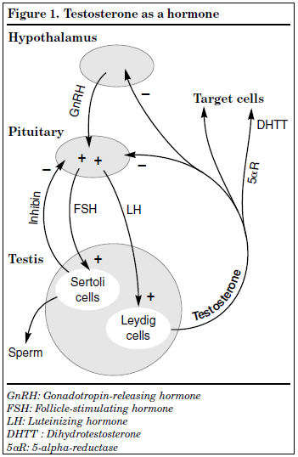
Hypothalamic-pituitary-gonadal axis
Pulsatile releases of GnRH (gonadotrophin releasing hormone)
Stimulation (+) of GnRH in the pituitary secretion of gonadotropins (LH and FSH)
Stimulus (+) of LH and FSH over the Testis, stimulating the production of testosterone and sperm
Testosterone negative stimulation (-) on LH and FSH levels and LH and FSH on GnRH.

Slide 5
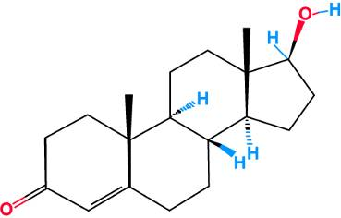
Testosterone
Main androgen in man
95% synthesized by Leydig cells from cholesterol
Secreted into the bloodstream
Required for:
Fetal male sexual differentiation
Puberty
Maintenance of male secondary sexual characteristics
Tanagho EA & McAninch JW. In Smith‘s General Urology. 2003: 1-17. Winters JS, Clark BJ. In Androgens in Health and Disease. 2003: 3-22.

Slide 6
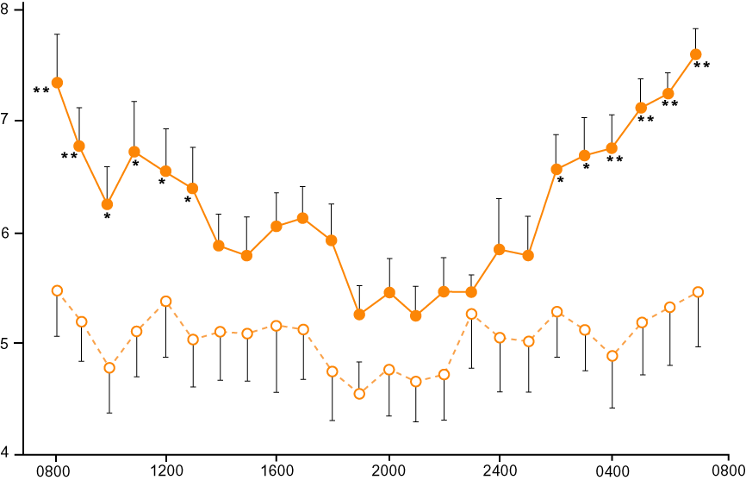
Circadian rhythm of testosterone in men
Youg men
(30.4 years)
Testosterone (ng/ml)
Elderly men
(70.4 years)
Tenover JL, Matsumoto AM et al. J Gerontol Med Sci 1988; 43:M163-169

Slide 7
Serum testosterone
Total Testosterone
2 %
Free T
44 % bound to SHBG
54 % bound to albumin
Biologically available to all target tissues
56% T Bioavailable
Free Testosterone Calculator http://www.issam.ch/freetesto.htm

Slide 8
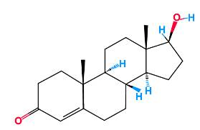
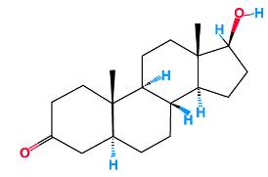
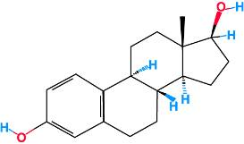
Testosterone metabolism
Mainly by the liver: conversion to androsterone and dehydroepiandrosterone
Peripheral tissues (prostate, fat, skin): conversion to active metabolites
Dihydrotestosterone (conversion by 5-alpha-reductase enzyme)
Estradiol (conversion by aromatase enzyme)
Testosterone
Dihydrotestosterone
(DHT)
Estradiol
Winters JS, Clark BJ. In Androgens in Health and Disease. 2003: 3-22.

Slide 9
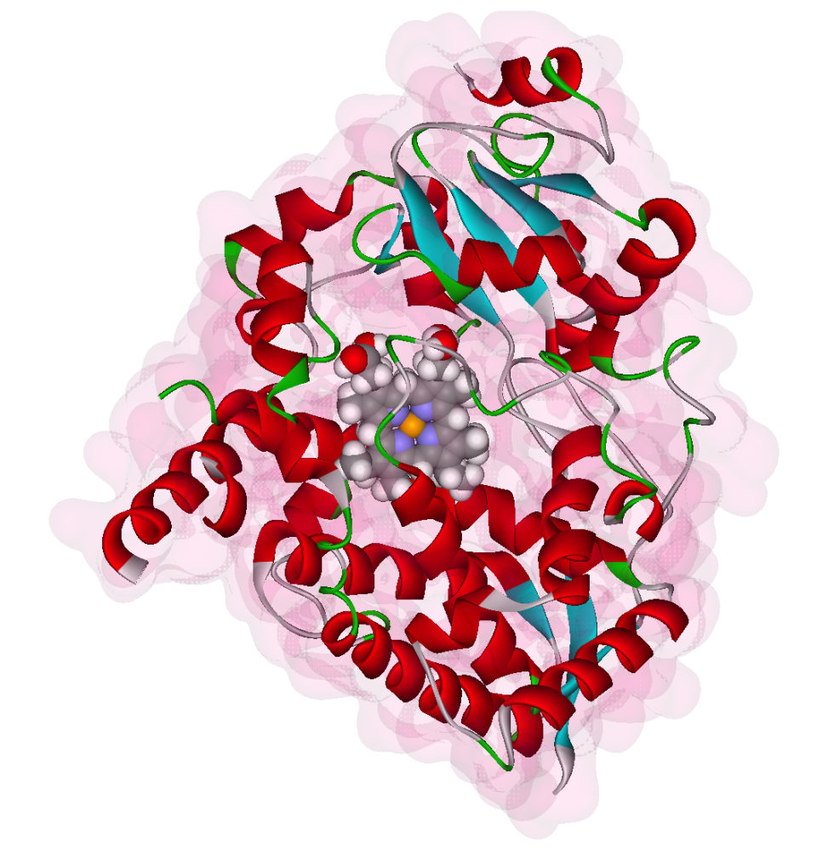
Cytochrome P450 3A4
Cytorome P₄₅₀ enzyme
Catalyzes hydroxylation and biotransformation from hydrophobic to hydrophilic substance -> excretion
Substances that enhance the function of this enzyme:
Ginger, garlic, licorice (St. John's wort)
Increase testosterone clearance
Reduce testosterone levels
Hashimoto et al. Eur J Biochemistry 1993 218:585.
Thomas Effert: Molekulare Pharmakologie und Toxikologie:
Biologische Grundlagen von Arzneimitteln und Giften. Springer, Berlin 2006

Slide 10
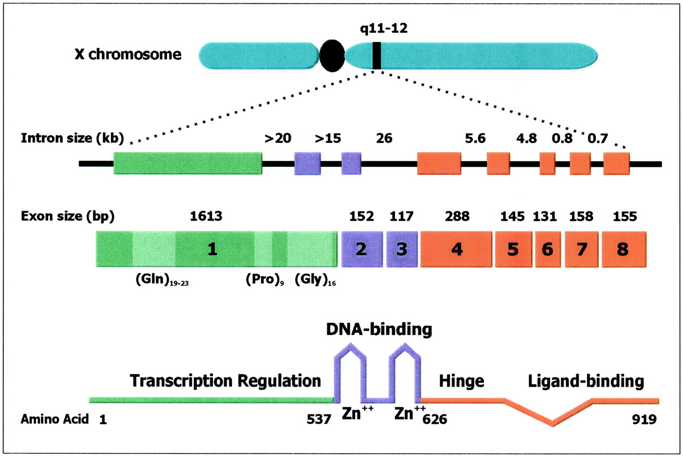
Androgen receptor
11 - 31 CAG repeats
Notes:
Androgen receptor and the CAG polimorfism found in the gene.
There is an inverse relationship between these repeats and testosteorne actions.

Slide 11
Modulation of androgen effects
Number of CAG repeats
9
37
≥ 38
Increasing
transcriptional activity
Kennedy
Syndrome
Mhatre et al. Nature Genetics 1993 5:184–8; Beilin et al. J Mol Endocrinol 2000 25:85-96

Slide 12
Associations:
Testosterone and Depression

Slide 13
Depressive disorders
Depressive disorders, such as major depressive disorder (MDD) and dysthymic disorder, are psychiatric illnesses with devastating personal and social consequences owing to a persistent depressed mood, negative thoughts, and fatigue.
The World Health Organization has declared depression to be the leading cause of disability worldwide (1).
Current pharmacologic treatment options show limited effectiveness in countering the disease (2,3) and approximately 30% of patients do not experience sustained symptomatic remission despite multiple treatment attempts (4).
Although depressive disorders are more prevalent in women, more than 100 million men are currently affected, constituting approximately one-third of all patients with depression (1,5).
1. World Health Organisation (WHO). Depressio and Other Common Mental Disorders: Global Health Estimates; 2. Cipriani A, Furukawa TA, Salanti G, et al. Lancet. 2018; 391(10128):1357-1366; 3. Turner EH et al. N Engl J Med. 2008;358(3):252-260; 4. Rush AJ et al. Am J Psychiatry. 2006;163 (11):1905-1917; 5. Salk RH et al. Psychol Bull. 2017;143(8):783-822.

Slide 14
Depression: a complex disorder
Emotional symptoms
Physical symptoms
Functional symptoms
Sadness
Easy cry
Loss of interest
Irritability
Feelings of guilt
Suicidal ideation
Lack of energy
Changes in appetite
Sleep disorders
Pains
Difficulty concentrating
Change in psychomotricity
Loss of productivity
Slow
Less ability for social interaction
Relational loss
Isolation
Impaired libido
Notes:
Depression is a complex disease, with multiple aspects – emotional, physical and functional symptons, that can all lead to an impaired libido. This might be the most importante intersection between hipogonadism and depression: impaired libido as a common sympton in both deseases

Slide 15
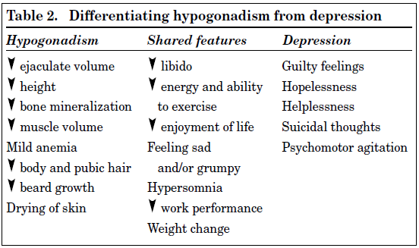
Clinical characteristics
Zarrouf FA et al. J Psychiatric Pract. 2009,15(4):289-305)
Notes:
Not only impaired libido, but there are some other features that hypogonadism and depression share.

Slide 16
T level and depressive symptons in epidemiological studies
Massachusetts Male Aging Study Araujo AB et al., Psychosom Med. 1998;60:458-65
Rancho Bernardo Study Barrett-Connor E et al., J Clin Endocrinol Metab. 1999;84:573-77
ADAM Questionnaire Study Morley JE et al., Metabolism. 2000;49:1239-42
More depressive symptoms in men with low levels of free T
Seidman SN et al. Biol Psychiatry. 2001;50(5):371-6
Notes:
Starting with these important epidemiological studies on the prevalence of hypogonadism that also show that men with low levels of free T have more depressive symptons. As you can see, they are not recent studies and the fiding related to depression were only secondary outcomes.

Slide 17
Cross-sectional and prospective studies reported no association between total or free testosterone and MDD or severity of MDD symptoms.
Other studies have shown that men with low or lower levels of free or total testosterone are more often depressed, have increased severity of MDD symptoms, or have an increased risk for first onset of MDD after two years.
In 823 men (mean age 43.5 years), baseline plasma levels of total testosterone, 5α-DHT, androstenedione and SHBG were determined, whereas free testosterone was calculated.
MDD status was assessed at baseline and after two years using structured interviews and individual MDD symptoms were self-rated at baseline, and after one and two years.
The authors examined whether androgen levels 1) differ between men with and without MDD cross-sectionally, 2) are associated with an elevated risk for onset of MDD prospectively, and 3) associate with all individual MDD symptoms, or only with hypogonadism overlapping symptoms.
de Wit AE, et al. Psychoneuroendocrinology. 2021 Aug;130:105278

Slide 18
None of the androgen levels were associated with current or onset (incidence or recurrence) of MDD.
de Wit AE, et al. Psychoneuroendocrinology. 2021 Aug;130:105278
Notes:
Their results support the idea that circulating androgens synthesised by the testes are of limited clinical relevance to Major depressive disorder symptons in adult men

Slide 19
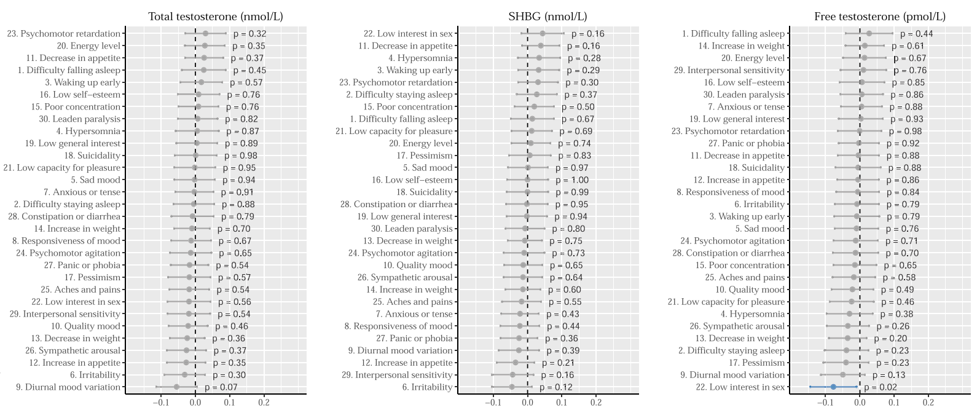
Association with individual MDD symptoms:
de Wit AE, et al. Psychoneuroendocrinology. 2021 Aug;130:105278
Notes:
Levels of some steroids may be associated with some individual MDD symptoms.

Slide 20
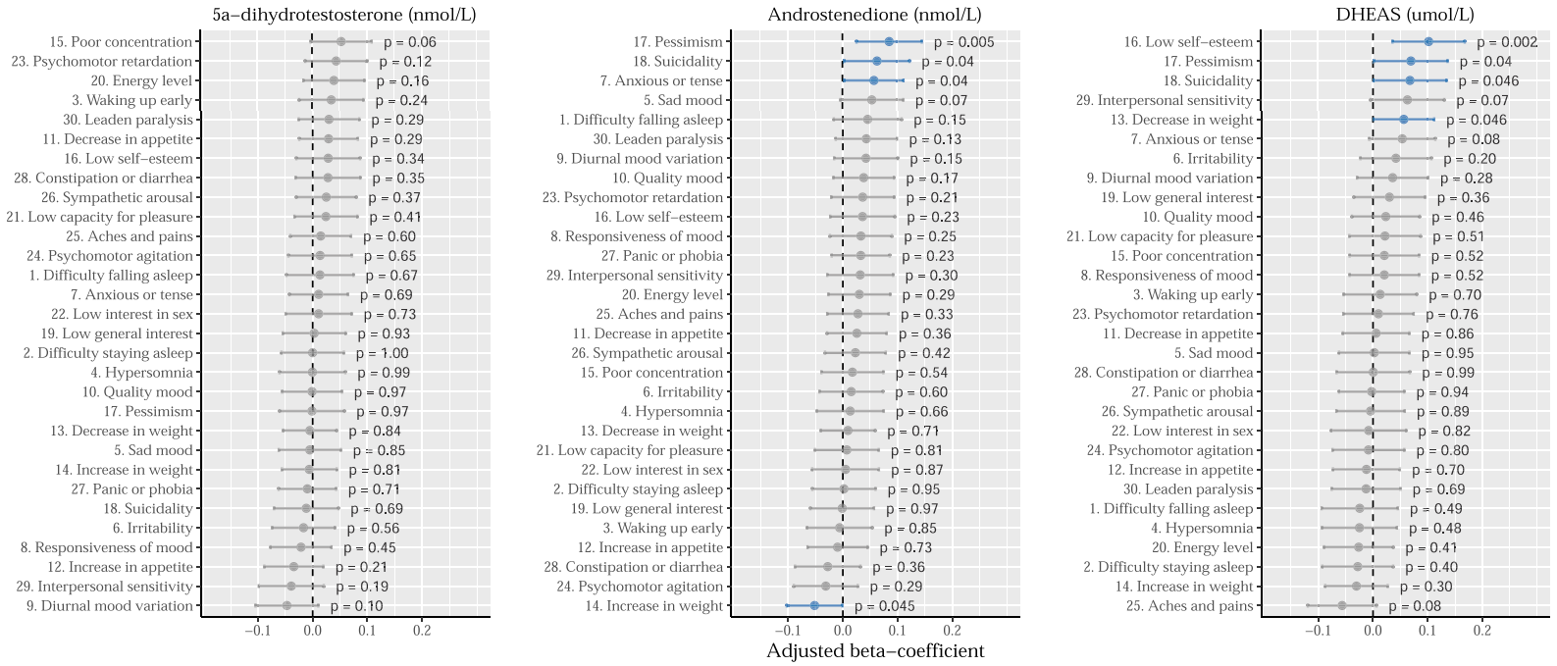
Association with individual MDD symptoms:
de Wit AE, et al. Psychoneuroendocrinology. 2021 Aug;130:105278
Notes:
Levels of some steroids may be associated with some individual MDD symptoms.

Slide 21
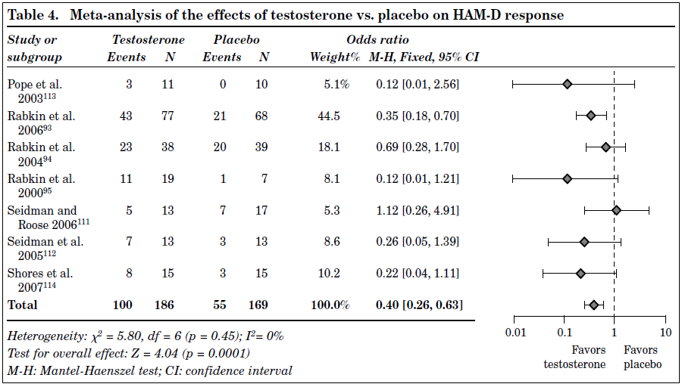
Effects of testosterone on HAM-D response
Significant positive effect of TT therapy on HAM-D response in depressed patients when compared with placebo
Zarrouf FA et al. J Psychiatric Pract. 2009,15(4):289-305)
Notes:
Meta-analysis of the 7 studies (2009) showed a significant positive effect of TT therapy on HAM-D response in depressed patients when compared with placebo. The treatment groups had 100 responses (events) and the placebo groups had 55 responses (z = 4.04, p <0.0001).

Slide 22
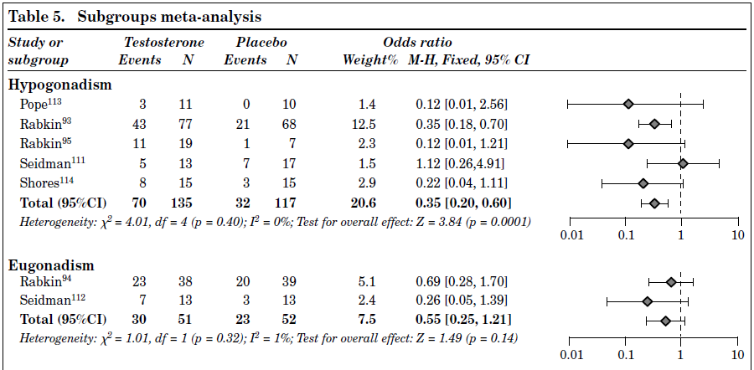
Effects of testosterone on HAM-D response - Subgroup analysis
Hypogonadal vs. eugonadal response
TT had a significant effect on HAM-D response in the hypogonadal subpopulation, but did not have a significant effect in the eugonadal ones
Zarrouf FA et al. J Psychiatric Pract. 2009,15(4):289-305)
Notes:
TT had a significant effect on HAM-D response in the hypogonadal subpopulation (z = 3.84, p = 0.0001), but did not have a significant effect in the eugonadal subpopulation (z = 1.49, p = 0.14).

Slide 23
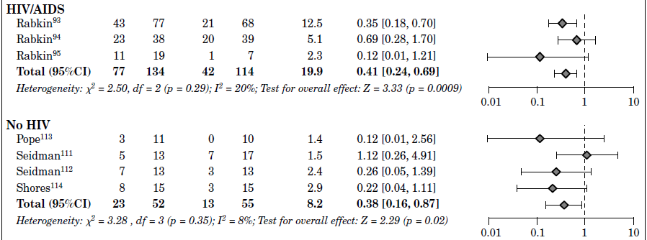
Effects of testosterone on HAM-D response - Subgroup analysis
HIV/AIDS status
Zarrouf FA et al. J Psychiatric Pract. 2009,15(4):289-305)
Notes:
TT had a significant effect on HAM-D response in HIV/AIDS patients (z = 3.33, p = 0.0009) and also had a smaller but still significant effect in patients with negative HIV/AIDS status (z = 2.29, p = 0.02).

Slide 24
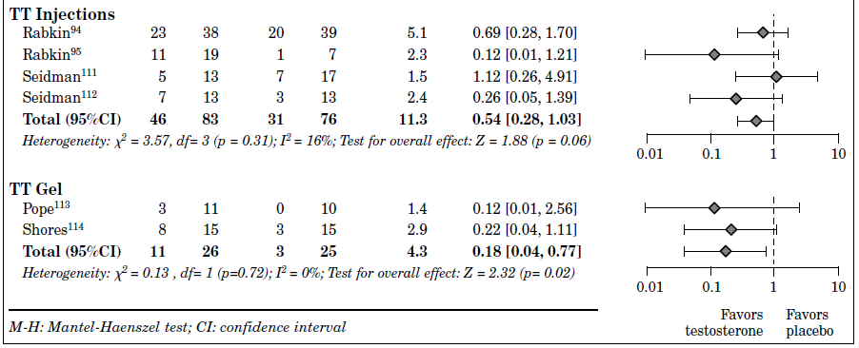
Effects of testosterone on HAM-D response - Subgroup analysis
Route of administration: Intramuscular versus external application
Significant treatment effect in the subpopulation treated with TT gel, and a nonsignificant effect in the subpopulation who received IM administration
Zarrouf FA et al. J Psychiatric Pract. 2009,15(4):289-305)
Notes:
Analysis of these subgroups showed a significant treatment effect in the subpopulation treated with TT gel (z = 2.32, p = 0.02), and a nonsignificant effect in the subpopulation who received IM administration (z = 1.88, p = 0.06).
Part of the explanation for these results may be that using the IM route of administration for depressed patients may enhance feelings of helplessness and thus affect the response..

Slide 25
Notes:
Is testosterone treatment associated with an alleviation of depressive symptoms in men compared with placebo?
27 randomized placebo-controlled clinical trials involving a total of 1890 men found that testosterone treatment was associated with a significant reduction of depressive symptoms, particularly in participants who received higher-dosage regimens.
The available evidence supports the clinical utility of adjunct testosterone treatment for depressive symptoms in men, but more methodologically rigorous trials are needed to unequivocally determine efficacy, ideal dosage regimens, and other moderators.

Slide 26
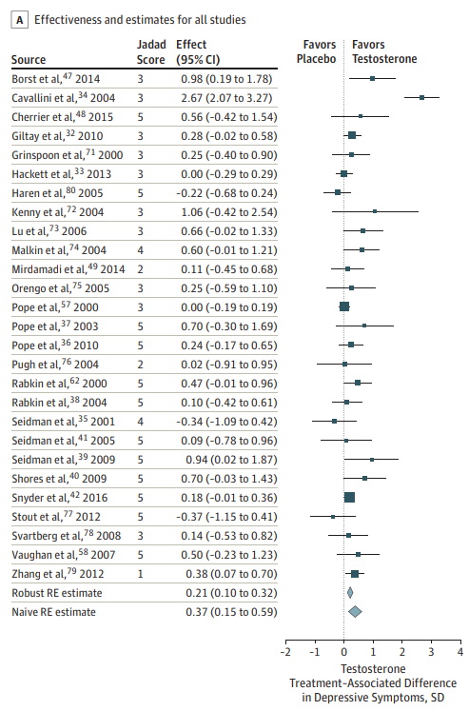
Results: Treatment Effectiveness and Efficacy
Testosterone treatment appears to be effective and efficacious in reducing depressive symptoms in men ...
Walther A et al. JAMA Psychiatry. 2019 Jan; 76(1): 31–40.
Notes:
The robust estimate (excluding 1 study with an outlying effect; Cook distance, 2.01) suggested that testosterone treatment was accompanied by a significant difference of Hedges g of 0.21 SD (SE, 0.05; 95% CI, 0.10-0.32; z = 3.87; P < .001) in depressive symptoms compared with placebo administration

Slide 27
Results: Treatment Effectiveness and Efficacy
Testosterone treatment appears to be effective and efficacious in reducing depressive symptoms in men...
Walther A et al. JAMA Psychiatry. 2019 Jan; 76(1): 31–40.
Notes:
These estimates correspond approximately with a testosterone treatment–associated efficacy of OR, 2.30 (95% CI, 1.30-4.06; log[OR], 0.83; SE, 0.29; 95% CI, 0.26-1.40; z = 2.87; P = .004) in favor of a clinically relevant reduction in depressive symptoms. These effects exceed the efficacy thresholds for pharmacologic agents for depression therapy

Slide 28
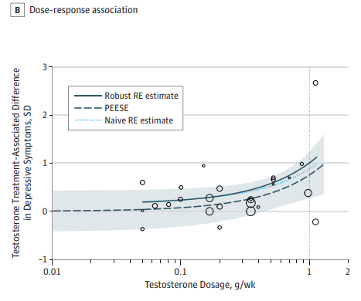
Results: Dose-responde
Testosterone treatment appears to be effective and efficacious in reducing depressive symptoms in men ...
... particularly when higher-dosage regimens were applied in carefully selected samples
Walther A et al. JAMA Psychiatry. 2019 Jan; 76(1): 31–40.
Notes:
TThe robustness of this conceptually important dose-response association is shown in Figure 3B, which highlights that, even in the most conservative bias scenario, the depression-alleviating effect of testosterone treatment remained clinically significant when high testosterone dosages (>500 mg/wk) were administered and symptom variability was kept low (by sampling from homogeneous participant populations).

Slide 29
To investigate and critically analyze the current evidence regarding the impact of TRT on depression and depressive symptoms in adult men with late-onset TD compared with placebo.
Fifteen studies encompassing 1586 individuals were included. Six RCTs investigated the impact of TRT on patients with late-onset TD compared with placebo in patients with clinically significant levels of depression, and nine RCTs investigated the impact of TRT on patients with late-onset TD compared with placebo in patients with no clinically significant depression.
Investigated the effect of testosterone replacement therapy (TRT) on depressive symptoms in patients with late-onset testosterone deficiency. TRT improves depressive symptoms in most trials, except in patients with major depressive disorder.
Vartolomei MD, et al. Eur Urol Focus. 2020 Jan 15;6(1):170-177

Slide 30
Vartolomei MD, et al. Eur Urol Focus. 2020 Jan 15;6(1):170-177
Notes:
TRT reduces depressive symptoms, as observed in (small-sized) placebo-controlled RCTs of patients with pretreatment clinical mild depression. In men with MDD, the impact of short-term (ie, 6 wk) TRT on depressive symptoms is not clinically significant. TRT should thus be considered after taking into account all the risks, benefits, and alternatives in patients with dysthymia and mild depression as part of a shared decision-making process together with the patient. The optimal length and type of TRT and the synergistic effect with standard antidepressive strategies need to be further studied, taking into account of long-term benefits, risks, and adverse events.

Slide 31
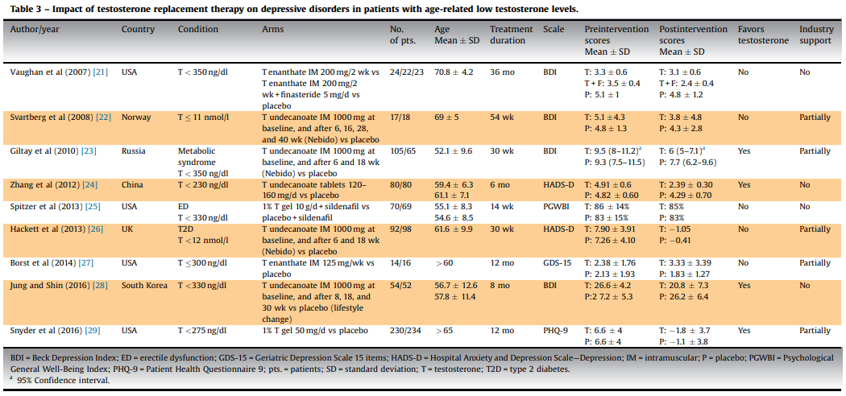
Results: TRT on depressive disorders in patients with LOH
Vartolomei MD et al. E uropean Urology Focus. 2 0 18.

Slide 32
AR polymorphism and depression
Genetic polymorphism of the androgen receptor seems to determine the vulnerability of some men to depression, which would be triggered when T levels decrease below a certain threshold in this subpopulation
Seidman SN et al. Biol Psychiatry. 2001;50(5):371-6

Slide 33
AR polymorphism and depression
Depression in man
Age > 50 years
% With Depression
(Patient Health Questionnaire)
P=0.01 T
P<0.001 CAGn
Schneider, Nieschlag, Gromoll, Zitzmann et al, Am J Ger Psych 2010
<19 19–24 >24
<10 10 – 12 >12
AR CAGn
Total Testosterone nmol / L
Notes:
The higher the number of repetitions, the higher the percentage of depressed men. And at the same time this is accompanied by lower levels of testosterone

Slide 34
AR polymorphism and depression
Depressed mood in older men
n = 296, > 50 Years
% Depressive
P=0.01 -> T
P<0.001 -> CAGn
Zitzmann et al, Am J Ger Psych 2010
<10 10 – 12 >12
<19 19–24 >24
AR CAGn
Total Testosterone
Notes:
Again, another study showing the same: androgen receptor activity modulates hipogonadism but also depression
34

Slide 35
Take home messages
“Whenever they are working up one of these two diagnoses, physicians should also consider the other.”
Zarrouf FA et al. J Psychiatric Pract. 2009,15(4):289-305)
Men with depression and poor response to antidepressant treatment
Assessment of T levels

Slide 36
THANK YOU!

