Slide 1
Testosterone and osteoporosis in men

Slide 2
Introduction
“A condition characterised by low bone mass and microarchitectural bone deterioration that leads to bone fragility and fracture susceptibility”
WHO (1994) definition of osteoporosis¹
Bone is lost with advancing age in men, leading to an increased risk of fractures, even with minimal trauma²
Osteoporosis often causes compression spine fractures and femoral neck fractures in elderly men, resulting in significant morbidity and mortality, and a substantial health and social care burden^{2,3}
With an increasingly ageing population, osteoporosis in men is becoming widely recognised as an important public health issue⁴
The pathogenesis of osteoporosis in men is multifactorial; however, testosterone is known to play a key role in maintaining BMD in men^{2,3}
BMD, bone mineral density; WHO, World Health Organization.
1. World Health Organization. Assessment of fracture risk and its application to screening for postmenopausal osteoporosis. Report of a WHO Study Group. World Health Organization Technical Report Series 1994;843:1–129; 2. Francis RM. Clin Endocrinol 1999;50:411‒4; 3. Shigehara K et al. J Clin Med 2021;10:530; 4. NIH Osteoporosis and Related Bone Diseases National Resource Center. Available at: https://www.bones.nih.gov/health-info/bone/osteoporosis/men (accessed August 2022).
Notes:
Bone is lost with advancing age in men, leading to an increased risk of fractures, even with minimal trauma.¹
Around 15% of symptomatic vertebral and 20% of hip fractures occur in men.¹
In 1994, the World Health Organization defined osteoporosis as: “A condition characterised by low bone mass and microarchitectural bone deterioration that leads to bone fragility and fracture susceptibility.”²
Osteoporosis often causes compression spine fractures and femoral neck fractures in elderly men, resulting in significant morbidity and mortality and a substantial health and social care burden.^{1,3}
Bone fracture due to osteoporosis decreases men’s quality of life.³
While the pathogenesis of osteoporosis in men is multifactorial, testosterone is known to play a key role in maintaining BMD in men.^{1,3}
With an increasingly ageing population, osteoporosis in men is becoming widely recognised as an important public health issue, and osteoporosis/bone fracture prevention in men is a growing focus for clinicians.^{3,4}
BMD, bone mineral density.
References
1. Francis RM. Clin Endocrinol 1999;50:411‒42.
2. World Health Organization. Assessment of fracture risk and its application to screening for postmenopausal osteoporosis. Report of a WHO Study Group. World Health Organization Technical Report Series 1994;843:1–129.
3. Shigehara K et al. J Clin Med 2021;10:530.
4. NIH Osteoporosis and Related Bone Diseases National Resource Center. Available at: https://www.bones.nih.gov/health-info/bone/osteoporosis/men. (accessed August 2022).

Slide 3
The burden of osteoporosis may be higher in men than in women
The prevalence of osteoporosis in men increases with age but remains lower than in women of similar ages¹
Prevalence (%)
All-cause prevalence of osteoporosis by sex and age¹
Age range (years)
Men tend to sustain osteoporotic fractures up to 10 years later in life than women¹
However, the mortality and morbidity associated with male hip fractures are higher than in women¹
Furthermore, men with known fragility fractures are less likely to receive treatment compared with women¹
Peak bone mass
Bone mass acquisition to reach peak bone mass²
Male
Female
Menopause
Low bone mass
Bone mass
Suboptimal
lifestyle factors
Osteoporosis
0
10
20
30
40
50
60
Age (years)
1. Golds G et al. Int J Endocrinol 2017;2017:4602129; 2. Rozenberg S et al. Maturitas 2020;138:14‒25.
Notes:
The prevalence of male osteoporosis in men increases with age but remains lower than in women of similar ages across the lifespan.¹
An individual’s fracture risk at any given age is largely determined by their bone mass, which results from bone acquired during growth and early adulthood and subsequent ageing-related bone loss.²
The process of bone mass accrual is largely determined by genetic factors (accounting for 60–80 % of the variability seen in bone mass), but can also be affected by general health status and lifestyle factors.²
Although the prevalence of osteoporosis amongst men is considerably lower
than in women, male osteoporosis and osteopenia (i.e. loss of bone mineral density) and their clinical consequences are significant.¹
Men tend to sustain osteoporotic fractures up to 10 years later in life than women. However, the mortality and morbidity associated with male hip fractures are higher than in women.¹
Furthermore, men with known fragility fractures are less likely to receive treatment compared with women.¹
References
1. Golds G et al. Int J Endocrinol 2017;2017:4602129. 2. Rozenberg S et al. Maturitas 2020;138:14‒25.

Slide 4
Process of bone remodelling
Bone resorption and formation are regulated by osteoclasts and osteoblasts, respectively
The normal bone remodeling process consists of 5 phases:
Osteoblasts
Osteoblasts
Osteoblasts
Osteoblasts
Osteoclast progenitors
Osteoblasts
Osteoclasts
Pre-osteoblasts
Pre-osteoblasts
Pre-osteoblasts
Osteoclasts
Pre-osteoblasts
Osteoclasts
Osteoclasts
Pre-osteoblasts
Osteoclasts
Osteocytes
Osteocytes
Osteocytes
Osteocytes
Osteocytes
1
Resting
2
Activation
3
Resorption
4
Reversal
5
Formation
Osteoclasts are recruited to the bone surface where they generate an acidic micro-environment, dissolving and resorbing the bone’s mineral content
Osteoclasts then undergo apoptosis and osteoblasts are recruited to the bone surface, where they deposit collagen, which is mineralised to form new bone
International Osteoporosis Foundation. Available at: https://www.osteoporosis.foundation/health-professionals/about-osteoporosis/bone-biology (accessed August 2022).
Notes:
Bone resorption and formation are regulated by osteoclasts and osteoblasts, respectively.
Osteoblasts are cells derived from mesenchymal stem cells and are responsible for bone matrix synthesis and subsequent mineralisation. In the adult skeleton, the majority of bone surfaces that are not undergoing formation or resorption (i.e. not being remodelled) are lined by bone lining cells.
Osteoclasts are large multinucleated cells derived from the haematopoietic lineage. Osteoclasts function in the resorption of mineralised tissue and are found attached to the bone surface at sites of active bone resorption.
Once peak bone mass has been achieved in adulthood, bone mass and structural integrity is maintained by the process of remodelling, which involves the coupling of bone formation and bone resorption.
The normal bone remodelling process consists of 5 phases: resting, activation, resorption, reversal and formation.
Osteoclasts are recruited to the bone surface where they generate an acidic micro-environment, dissolving and resorbing the bone’s mineral content.
Osteoclasts then undergo apoptosis and osteoblasts are recruited to the bone surface, where they deposit collagen, which is mineralised to form new bone.
Reference
International Osteoporosis Foundation. Available at: https://www.osteoporosis.foundation/health-professionals/about-osteoporosis/bone-biology (accessed August 2022).

Slide 5
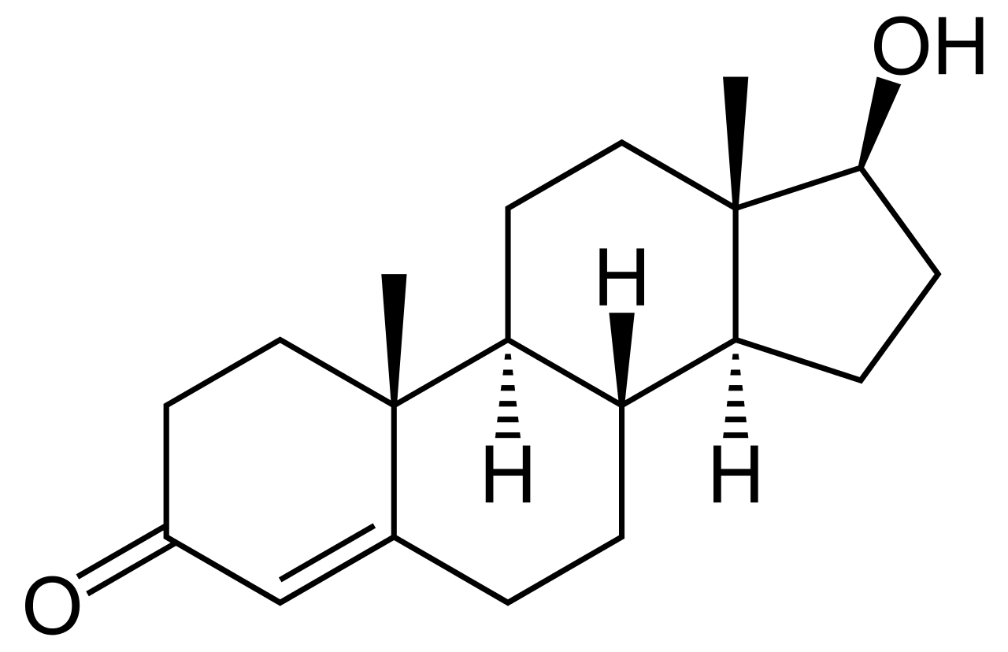
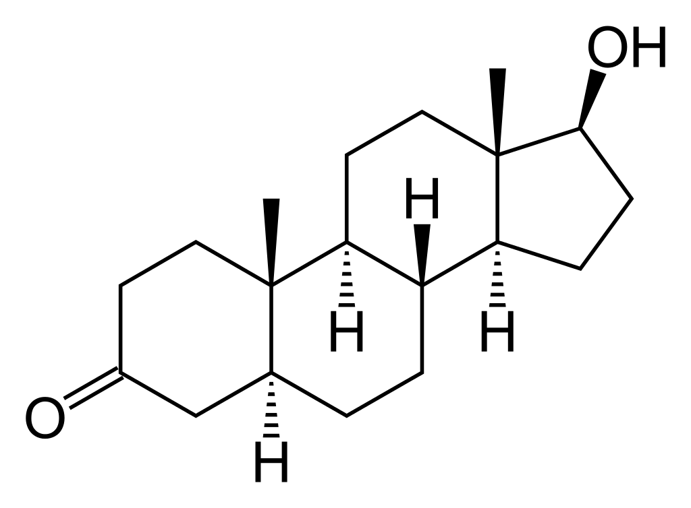
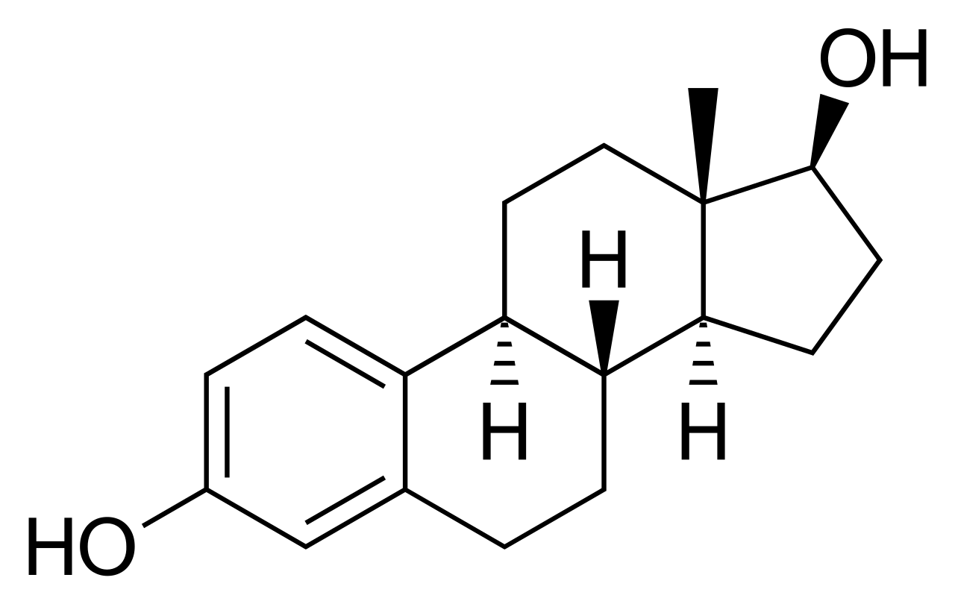
The role of testosterone in bone metabolism
Testosterone is converted to highly active DHT by 5-α reductase 1 in the cytoplasm of target cells
DHT can induce androgenic activity by binding to the AR
5-α reductase 1
P450 aromatase
Testosterone is converted to E2 by P450 aromatase
E2 binds to the ER and exerts an oestrogenic action
Testosterone
DHT
E2
IL-1, IL-7, IGF-1, NF-κB, TNFα
IL-6
IGF-1
IGF-BP
AR
ERα
ERα is one of two ER subtypes and is mainly associated with bone metabolism
Osteoblast
Osteoclast
Testosterone can increase AR expression levels in osteoblasts, promoting osteoblast differentiation and suppressing osteoblast and chondrocyte apoptosis
RANKL
TGF-β
Testosterone also has indirect effects on bone metabolism through various cytokines and growth factors
Bone
formation
Bone
resorption
AR, androgen receptor; DHT, dihydrotestosterone; E2, oestradiol; ER, oestrogen receptor; IGF, insulin-like growth factor; IGF-BP, IGF-binding protein; IL, interleukin; NF-κB, nuclear factor kappa light chain enhancer of activated B cells; RANKL, receptor activator of NF-κB ligand; TGF, transforming growth factor; TNF, tumour necrosis factor. Shigehara K et al. J Clin Med 2021;10:530.
Notes:
Testosterone plays an important role in maintaining BMD in men.
Testosterone is converted to highly active DHT by 5-α reductase 1 in the cytoplasm of target cells. DHT can induce androgenic activity by binding to the AR.
AR is present in chondrocytes and osteoblasts, although its expression varies widely by age and bone site. Testosterone acts directly on osteoblasts via AR and consequently can promote bone formation. In addition, testosterone has indirect effects on bone metabolism through various cytokines and growth factors.
Testosterone can also increase levels of AR expression in osteoblasts, promoting osteoblast differentiation and suppressing osteoblast and chondrocyte apoptosis.
Testosterone is converted to E2 by P450 aromatase; E2 binds to the ER and exerts an oestrogenic action.
Testosterone positively regulates the expression of IGF-1 and IGF-BP in osteoblasts. The differentiation and proliferation of chondrocytes and osteoblasts are induced by IGF-1 and IGF-BP, and suppression of chondrocyte apoptosis promotes bone formation.
Testosterone activates the expression of TGF-β in osteoblasts and promotes osteoblast differentiation.
Testosterone suppresses the activity of IL-6, which activates osteoclasts and promotes bone resorption.
There is little evidence supporting the hypothesis that testosterone has a direct effect on osteoclasts.
AR, androgen receptor; BMD, bone mineral density; DHT, dihydrotestosterone; E2, oestradiol; ER, oestrogen receptor; IGF, insulin-like growth factor; IGF-BP, IGF-binding protein; IL, interleukin; TGF, transforming growth factor.
Reference
Shigehara K et al. J Clin Med 2021;10:530.

Slide 6
The role of testosterone in bone metabolism
5-α reductase 1
P450 aromatase
In osteoblasts, testosterone:
Positively regulates expression of IGF-1 and IGF-BP
Activates expression of TGF-β and promotes osteoblast differentiation
Testosterone
DHT
E2
IL-1, IL-7, IGF-1, NF-κB, TNFα
IL-6
IL-6
IGF-1
IGF-1
IGF-BP
IGF-BP
AR
ERα
Testosterone suppresses the activity of IL-6, which activates osteoclasts and promotes bone resorption
IGF-1 and IGF-BP induce differentiation and proliferation of chondrocytes and osteoblasts
Suppression of chondrocyte apoptosis promotes bone formation
Osteoblast
Osteoclast
RANKL
TGF-β
TGF-β
Testosterone also has indirect effects on bone metabolism through various cytokines and growth factors
Bone
formation
Bone
resorption
AR, androgen receptor; DHT, dihydrotestosterone; E2, oestradiol; ER, oestrogen receptor; IGF, insulin-like growth factor; IGF-BP, IGF-binding protein; IL, interleukin; NF-κB, nuclear factor kappa light chain enhancer of activated B cells; RANKL, receptor activator of NF-κB ligand; TGF, transforming growth factor; TNF, tumour necrosis factor. Shigehara K et al. J Clin Med 2021;10:530.
Notes:
Testosterone plays an important role in maintaining BMD in men.
Testosterone is converted to highly active DHT by 5-α reductase 1 in the cytoplasm of target cells. DHT can induce androgenic activity by binding to the AR.
AR is present in chondrocytes and osteoblasts, although its expression varies widely by age and bone site. Testosterone acts directly on osteoblasts via AR and consequently can promote bone formation. In addition, testosterone has indirect effects on bone metabolism through various cytokines and growth factors.
Testosterone can also increase levels of AR expression in osteoblasts, promoting osteoblast differentiation and suppressing osteoblast and chondrocyte apoptosis.
Testosterone is converted to E2 by P450 aromatase; E2 binds to the ER and exerts an oestrogenic action.
Testosterone positively regulates the expression of IGF-1 and IGF-BP in osteoblasts. The differentiation and proliferation of chondrocytes and osteoblasts are induced by IGF-1 and IGF-BP, and suppression of chondrocyte apoptosis promotes bone formation.
Testosterone activates the expression of TGF-β in osteoblasts and promotes osteoblast differentiation.
Testosterone suppresses the activity of IL-6, which inhibits osteoclast formation.
There is little evidence supporting the hypothesis that testosterone has a direct effect on osteoclasts.
AR, androgen receptor; BMD, bone mineral density; DHT, dihydrotestosterone; E2, oestradiol; ER, oestrogen receptor; IGF, insulin-like growth factor; IGF-BP, IGF-binding protein; IL, interleukin; TGF, transforming growth factor.
Reference
Shigehara K et al. J Clin Med 2021;10:530.

Slide 7
The impact of testosterone deficiency on bone metabolism in men
5-α reductase 1
P450 aromatase
Testosterone deficiency decreases BMD through increased IL-6 activation
Testosterone
Low testosterone
DHT
E2
IL-1, IL-7, IGF-1, NF-κB, TNFα
IL-6
IL-6
IGF-1
IGF-BP
AR
ERα
Osteoblast
Osteoclast
RANKL
RANKL
Testosterone deficiency boosts RANKL production from osteoblasts
Increased RANKL levels promote bone resorption, decreasing BMD
TGF-β
Bone
formation
Bone
resorption
AR, androgen receptor; BMD, bone mineral density; DHT, dihydrotestosterone; E2, oestradiol; ER, oestrogen receptor; IGF, insulin-like growth factor; IGF-BP, IGF-binding protein; IL, interleukin; NF-κB, nuclear factor kappa light chain enhancer of activated B cells; RANKL, receptor activator of NF-κB ligand; TGF, transforming growth factor; TNF, tumour necrosis factor. Shigehara K et al. J Clin Med 2021;10:530.
Notes:
Testosterone deficiency increases the production of RANKL from osteoblasts.
Increased RANKL levels promote bone resorption which leads to a decrease in BMD.
Testosterone deficiency also decreases BMD through increased IL-6 activation which promotes osteoclast formation and bone resorption.
BMD, bone mineral density; IL, interleukin; NF-κB, nuclear factor kappa light chain enhancer of activated B cells; RANKL, receptor activator of NF-κB ligand.
Reference
Shigehara K et al. J Clin Med 2021;10:530.

Slide 8
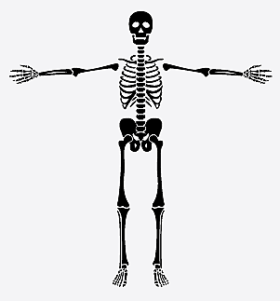
Free testosterone is an independent predictor of bone mineral density and fractures in elderly men
The Swedish part of the multinational Osteoporotic Fractures in Men (MrOS) study investigated whether serum testosterone levels were associated with BMD and fractures in a large cohort of elderly men (N=2908; average age: 75.4 years)
Free testosterone was an independent positive predictor of BMD in all analysed sites except lumbar spine
Free testosterone levels below the median were independent predictors of prevalent osteoporosis-related fractures and X-ray verified vertebral fractures
Arm β 0.093; p=0.001
OR (95% CI), p value
Femur trochanter β 0.068; p=0.002
Lumbar spine β 0.004; p=0.869
1.27 (1.05–1.57)
p<0.05
Total hip β 0.061; p=0.006
Adjusted OR for previous fractures
Total body β 0.092; p<0.001
1.56 (1.14–2.14)
p<0.01
The highest predictive value was found in bones with a relatively high cortical bone content, including the arm and hip
2.00 (1.34–2.86)
p<0.001
1
2
3
BMD, bone mineral density; CI, confidence interval; OR, odds ratio. Mellström D et al. J Bone Miner Res 2006;21:529–35.
Notes:
The multinational Osteoporotic Fractures in Men (MrOS) study is a multicentre study including elderly men in Sweden, Hong Kong and the United States.
The Swedish part of the MrOS study investigated whether serum testosterone levels were associated with BMD in a large cohort of 2908 elderly men (average age: 75.4 years).
Study subjects were randomly identified using national population registers.
Bone parameters were measured using DEXA, and prevalent fractures were recorded using standardised questionnaires and vertebral X-ray analyses.
Serum levels of total testosterone, total E2, and sex hormone-binding globulin were measured by radioimmunoassay. Free testosterone and free E2 were derived from mass action equations.
Free testosterone was an independent positive predictor of BMD in total body, total hip, femur trochanter, and arm but not lumbar spine BMD.
The highest predictive value was found in bones with a relatively high cortical bone content, including the arm and hip.
Free testosterone levels below the median were independent predictors of prevalent osteoporosis-related fractures and X-ray–verified vertebral fractures.
The predictive value of free testosterone for prevalent fractures was not affected by adjustment for BMD.
BMD, bone mineral density; DEXA, dual-energy X-ray absorptiometry; E2, oestradiol.
Reference
Mellström D et al. J Bone Miner Res 2006;21:529‒35.

Slide 9
T Trials Bone Trial: effect of TTh on vBMD and strength in older men with low testosterone
To determine if TTh for 1 year in older men with low testosterone increases vBMD, assessed using quantitative CT
^{Primary} ^{objective}
211
enrolled
n=
Osteoporosis was not an entry criterion
Selected baseline characteristics and demographics
Mean age
Race
Mean BMI
72.3 years
86% White
31.2 kg/m²
BMI, body mass index; CT, computed tomography; TTh, testosterone therapy; vBMD, volumetric bone mineral density.
Snyder PJ et al. JAMA Intern Med 2017;177:471–9; Snyder PJ et al. Endocr Rev 2018;39:369–86.
Notes:
The T Trials Bone Trial was a randomised, placebo-controlled, double-blind trial that investigated whether testosterone treatment of older men with low testosterone increases vBMD (assessed using QCT) and estimated bone strength.
To enrol in the T-Trials overall, participants had to qualify for at least 1 of the 3 main trials. If they qualified, they could participate in the Bone Trial.
Men were excluded if they were taking a medication known to affect bone, except for calcium and over-the-counter vitamin D preparations; if they did not have ≥1 evaluable lumbar vertebra; and/or if they had a DEXA T-score at any site of less than −3.0.
Osteoporosis was not an entry criterion for the study.
A total of 211 men were enrolled in the Bone Trial with a mean age of 72.3 years and a mean body mass index of 31.2 kg/m²; 86% of participants were white.
Participants were randomly assigned to receive testosterone or placebo gel for 1 year.
The primary efficacy outcome was percent change from baseline in vBMD of trabecular bone in the lumbar spine, assessed by QCT.
vBMD was chosen as the main method of assessment rather than aBMD by DEXA because it is not artifactually influenced by osteophytes and aortic calcification, and because it can distinguish between trabecular bone, which testosterone primarily affects, and cortical bone.
Secondary outcomes were vBMD of peripheral bone and whole bone of the lumbar spine and trabecular, peripheral and whole bone of the hip; estimated strength of the same sites by finite element analysis from computed tomographic data; and aBMD of the spine and hip by DEXA.
aBMD, areal BMD; BMD, bone mineral density; DEXA, dual-energy X-ray absorptiometry; QCT, quantitative computed tomography; TTh, testosterone therapy; vBMD, volumetric BMD.
References
Snyder PJ et al. JAMA Intern Med 2017;177:471–9; Snyder PJ et al. Endocr Rev 2018;39:369–86.

Slide 10
T Trials Bone Trial: TTh significantly increased vBMD and bone strength vs placebo in older men with low testosterone
TTh significantly increased vBMD and estimated bone strength, especially in trabecular bone and the spine, but also in peripheral bone and the hip
TTh increased mean lumbar spine trabecular vBMD by an additional 6.8% (95% CI: 4.8 to 8.7%; p<0.001, r² 0.26) and estimated spine trabecular bone strength by an additional 8.5% (95% CI: 6.0 to 10.9%; p<0.001) vs placebo
12
vBMD
16
Estimated bone strength
*
*
Effect of TTh on vBMD and estimated bone strength in older men with low testosterone
10
14
*
TTh
Placebo
8
*
12
10
*
6
*
8
Change from baseline (%)
Change from baseline (%)
4
*
*
*
6
**
2
4
*
*
0
2
0
-2
-2
Trabecular
Peripheral
Whole
Trabecular
Peripheral
Whole
Trabecular
Peripheral
Whole
Trabecular
Peripheral
Whole
Spine
Hip
Spine
Hip
*p<0.001, **p<0.005 vs placebo.
CI, confidence interval; TTh, testosterone therapy; vBMD, volumetric bone mineral density.
Snyder PJ et al. JAMA Intern Med 2017;177:471–9.
Notes:
TTh was associated with significantly greater increases versus placebo in mean lumbar spine trabecular vBMD [7.5% (95% CI: 4.8% to 10.3%) vs 0.8% (95% CI: −1.9% to 3.4%); treatment effect 6.8% (95% CI: 4.8% to 8.7%; p<0.001)], spine peripheral vBMD, and hip trabecular and peripheral vBMD.
TTh was also associated with significantly greater increases in mean estimated spine trabecular bone strength [10.8% (95% CI: 7.4% to 14.3%) vs 2.4% (95% CI: −1.0% to 5.7%); treatment effect 8.5% (95% CI: 6.0% to 10.9%; p<0.001)], spine peripheral bone, and hip trabecular and peripheral bone.
The estimated strength increases were greater in trabecular than peripheral bone and greater in the spine than the hip.
CI, confidence interval; TTh, testosterone therapy; vBMD, volumetric bone mineral density.
Reference
Snyder PJ et al. JAMA Intern Med 2017;177:471–9.

Slide 11
T4 Bone Trial: effect of TTh on vBMD and bone microarchitecture in men aged ≥50 years with low testosterone at risk of/with newly diagnosed T2DM
To determine if TTh for 2 years in men aged ≥50 years with low testosterone at risk of/with newly diagnosed T2DM increases distal tibial cortical vBMD, assessed using HR-pQCT
^{Primary} ^{objective}
177
136
enrolled; (77%) completed baseline
n=
and 2-year assessment of bone microarchitecture
Osteoporosis was not an entry criterion
Selected baseline characteristics and demographics
Serum testosterone
Mean age
Mean BMI
60.0–60.3 years
10.0–10.1
nmol/L
34.1–34.8 kg/m²
BMI, body mass index; HR-pQCT, high resolution peripheral quantitative computed tomography; TTh, testosterone therapy; vBMD, volumetric bone mineral density.
Ng Tang Fui M et al. J Clin Endocrinol Metab 2021;106:e3143‒e3158.
Notes:
T4DM was a 2-year randomised, placebo-controlled, double-blind trial.
The T4 Bone substudy was conducted to determine whether TTh for 2 years in men aged ≥50 years with low testosterone at risk of/with newly diagnosed T2DM increases distal tibial cortical vBMD, assessed using HR-pQCT.
Inclusion criteria included age 50‒74 years, waist circumference ≥95 cm, impaired glucose tolerance or newly diagnosed T2DM, and a fasting serum testosterone drawn between 8 and 10 am of ≤14 nmol/L (403 ng/dL) by immunoassay. Serum testosterone was remeasured together with serum E2 in baseline and on-study serum fasted samples drawn between 8 and 10 am at the end of the study, using validated liquid chromatography–tandem mass spectrometry.
Exclusion criteria included hypothalamic pituitary-testicular pathology, TTh in the past 12 months, or history of androgen abuse at any time. Additionally, in T4 Bone, men receiving osteoporosis drug therapy before or during the trial were excluded.
Participants were enrolled in a lifestyle programme (Weight Watchers) and randomised 1:1 to receive intramuscular testosterone undecanoate 1000 mg or matched placebo every 3 months (after a 6-week loading dose) for 2 years.
The T4 Bone primary endpoint was between-group change in distal tibial cortical vBMD by HR-pQCT measured over 2 years at baseline and 2 follow-up visits after 66 and 102 weeks. Secondary outcome measures were total and other cortical and trabecular parameters at the distal radius and tibia (HR-pQCT), and the bone markers.
vBMD and microarchitecture were measured at the distal tibia and radius at baseline and at weeks 66 and 102 using HR-pQCT.
Of 177 men enrolled in the trial, 136 (77%) completed baseline and 2-year assessment of bone microarchitecture (mean age: 60.0‒60.3 years; serum testosterone concentration by immunoassay: 10.0–10.1 nmol/L; mean body mass index: 34.1‒34.8 kg/m²).
E2, oestradiol; HR-pQCT, high-resolution-peripheral quantitative computed tomography; T2DM, type 2 diabetes mellitus; TTh, testosterone therapy; vBMD, volumetric bone mineral density.
Reference
Ng Tang Fui M et al. J Clin Endocrinol Metab 2021;106:e3143‒e3158.

Slide 12
T4 Bone Trial: TTh significantly increased vBMD vs placebo in men aged ≥50 years with low testosterone at risk of/with newly diagnosed T2DM
TTh for 2 years significantly increased tibial cortical vBMD by 3.1% vs placebo
TTh also significantly increased radial cortical vBMD, total tibial vBMD and total radial vBMD as well as cortical area and thickness, but did not affect trabecular architecture
Tibial cortical vBMD
Total radial vBMD
Effect of TTh on tibial cortical vBMD (primary endpoint) and total radial vBMD
TTh
Placebo
840
350
835
348
Cortical vBMD (mg HA/cm²)
Total vBMD (mg HA/cm²)
Adjusted mean (95% CI)
346
830
344
825
p<0.001
p=0.002
Baseline
Week 66
Week 102
Baseline
Week 66
Week 102
CI, confidence interval; HA, hydroxyapatite; T2DM, type 2 diabetes mellitus; TTh, testosterone therapy; vBMD, volumetric bone mineral density.
Ng Tang Fui M et al. J Clin Endocrinol Metab 2021;106:e3143‒e3158.
Notes:
Compared with placebo, TTh over 2 years significantly increased the primary endpoint of tibial cortical vBMD, by a MAD of 9.33 mg HA/cm³ (95% CI: 3.96, 14.71), p<0.001, or 3.1% versus placebo.
Similarly, radial cortical vBMD increased by 8.96 mg HA/cm³ (3.30, 14.62), p=0.005, or 2.9%).
TTh significantly increased total vBMD at both tibia [MAD 4.16 mg HA/cm³ (2.14, 6.19), p<0.001 or 1.3%] and radius [MAD 4.42 mg HA/cm³ (1.67, 7.16), p=0.002, or 1.8%].
TTh was also associated with significant increases in both cortical area [tibia MAD 4.11 mm² (2.78, 5.45), p<0.001, or 2.5%; radius MAD 1.60 mm² (0.62, 2.57), p=0.002, or 2.0%] and cortical thickness [tibia MAD 0.03 mm (0.02, 0.05), p<0.001, or 1.7%; radius MAD 0.02 mm (0.01, 0.03), p=0.006, or 1.7%].
Men with lower baseline serum testosterone or lower baseline serum E2 were not more likely to have a larger treatment effect or gain more bone during treatment.
CI, confidence interval; E2, oestradiol; HA, hydroxyapatite; MAD, mean adjusted difference; TTh, testosterone therapy; vBMD, volumetric bone mineral density.
Reference
Ng Tang Fui M et al. J Clin Endocrinol Metab 2021;106:e3143‒e3158.

Slide 13
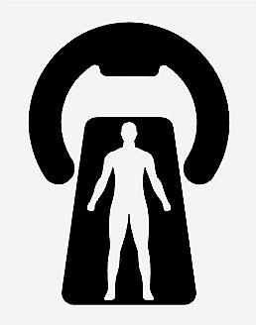
Comparing the T Trials Bone Trial and T4 Bone Trial
 | T Trials Bone Trial¹ | T4 Bone Trial²
Baseline testosterone level | Baseline mean testosterone levels were in the hypogonadal range TTh arm: 8.0 nmol/L (229.6 ng/dL) Placebo arm: 8.3nmol/L (238.8 ng/dL) | Men were not uniformly hypogonadal Testosterone threshold for eligibility: 14 nmol/L (403 ng/dL) The majority were eugonadal at baseline
Age | Older Mean age: 72 years | Younger Mean age: 60 years
Primary endpoint | 7% increase in spine trabecular vBMD at 1 year | 3% increase in tibial cortical vBMD at 2 years
Method of assessment | Quantitative computed tomography | High-resolution peripheral quantitative computed tomography
Other endpoints | Greater increases in trabecular bone | Greater increases in cortical bone
 | Similar changes in areal BMD at hip and spine
1
BMD, bone mineral density; TTh, testosterone therapy; vBMD, volumetric BMD.
1. Snyder PJ et al. JAMA Intern Med 2017;177:471–9; 2. Ng Tang Fui M et al. J Clin Endocrinol Metab 2021;106:e3143‒e3158.
Notes:
Although the findings of the T4 Bone trial are similar in some ways to those of the T Trials Bone Trial, there are also some important differences.
In both trials, TTh increased vBMD versus placebo. The magnitude of the increase of the primary endpoint (tibial cortical vBMD) in the T4 Bone trial (3% in 2 years) was smaller than that of the primary endpoint (spine trabecular vBMD) in the Bone Trial (7% at 1 year). In the T4 Bone trial, larger increases were observed in cortical bone, while the Bone Trial found greater increases in trabecular bone. The changes in aBMD at the hip and spine were similar in the two trials.
There are several possible reasons to explain explain the differences in vBMD response to testosterone in the two trials:
Men in the T4 Bone trial were not uniformly hypogonadal. The testosterone threshold for eligibility in the T4DM Trial was 14 nmol/L (403 ng/dL), and a majority of men had baseline testosterone levels in the eugonadal range. In contrast, the baseline mean testosterone levels in the T Trials Bone Trial were unequivocally hypogonadal (testosterone arm: 8.0 nmol/L [229.6 ng/dL]) and placebo arm: 8.3 nmol/L [238.8 ng/dL]).
Men in the T4 Bone trial were younger (mean age 60 years versus 72 years in the T Trials Bone Trial).
The primary endpoint of the T4 Bone trial was based on the assessment of appendicular bones (radius and distal tibia) while that of the T Trials Bone Trial was based on the assessment of axial bone (spine and hip). However, the anatomic site of assessment is not the likely explanation for the differences, because TTh of men with severe classical hypogonadism substantially increased the trabecular bone volume fraction at the distal tibia but not the cortical bone volume fraction.
There were differences in the assessment techniques – QCT in the T Trials Bone Trial and HR-pQCT in the T4 Bone trial. Although QCT measures cortical and trabecular bone at central sites, it lacks sufficient resolution to provide information about microstructure. By contrast, HR-pQCT can distinguish cortical from trabecular bone with sufficiently high precision to accurately elucidate microarchitecture of cortical and trabecular structures.
aBMD, areal BMD; BMD, bone mineral density; CI, confidence interval; E2, oestradiol; HA, hydroxyapatite; HR-pQCT, high resolution-peripheral quantitative computed tomography; MAD, mean adjusted difference; QCT, quantitative computed tomography; TTh, testosterone therapy; vBMD, volumetric BMD.
Reference
Bhasin S, Snyder PJ. J Clin Endocrinol Metab 2021;106:e3269–e3271.

Slide 14
Testosterone Therapy in Men With Hypogonadism: Endocrine Society 2018 Clinical Practice Guideline
Measurement of serum testosterone concentrations is recommended in men with osteoporosis or low trauma fracture
In hypogonadal men with osteoporosis not considered to be at high risk for fracture, clinicians should repeat BMD measurements of lumbar spine, femoral neck and hip 1‒2 years after initiating TTh to determine response and whether additional therapy with an approved osteoporosis drug is needed
In hypogonadal men with osteoporosis at high risk of bone fracture who are receiving TTh, clinicians should treat osteoporosis with a pharmacologic agent that has been approved for the treatment of osteoporosis
Clinicians should not prescribe TTh for treating osteoporosis in men who have normal testosterone concentrations or as monotherapy to prevent bone fracture in men who are at high risk of bone fracture, regardless of testosterone concentrations
BMD, bone mineral density; TTh, testosterone therapy.
Bhasin S et al. J Clin Endocrinol Metab 2018;103:1–30.
Notes:
The Endocrine Society 2018 Clinical Practice Guideline “Testosterone Therapy in Men With Hypogonadism” provides an update to the “Testosterone Therapy in Men With Androgen Deficiency Syndromes” guideline published in 2010.
This includes the following key recommendations:
Measurement of serum testosterone concentrations is recommended in men with osteoporosis or low trauma fracture.
In hypogonadal men with osteoporosis not considered to be at high risk for fracture, clinicians should repeat BMD measurements of lumbar spine, femoral neck and hip 1‒2 years after initiating TTh to determine response and whether additional therapy with an approved osteoporosis drug is needed.
In hypogonadal men with osteoporosis at high risk of bone fracture who are receiving TTh, clinicians should treat osteoporosis with a pharmacologic agent that has been approved for the treatment of osteoporosis.
Clinicians should not prescribe TTh for treating osteoporosis in men who have normal testosterone concentrations or as monotherapy to prevent bone fracture in men who are at high risk of bone fracture, regardless of testosterone concentrations.
BMD, bone mineral density; TTh, testosterone therapy.
Reference
Bhasin S et al. J Clin Endocrinol Metab 2018;103:1–30.

Slide 15
Summary
Osteoporosis is a condition characterised by low bone mass and microarchitectural bone deterioration that leads to bone fragility and fracture susceptibility¹
In men, osteoporosis is associated with a significant morbidity and mortality burden, which may be higher than that in women; furthermore, men are less likely to receive treatment for fragility fractures than women^{2‒4}
Testosterone plays a key role in maintaining BMD in men and testosterone deficiency is associated with decreased BMD^{2,3}
Free testosterone concentration is an independent predictor of BMD and fractures in elderly men⁵
In the T Trials Bone Trial, TTh significantly increased vBMD and estimated bone strength vs placebo at 1 year in older men with low testosterone, with the most notable effects in trabecular bone and the spine, but also in peripheral bone and the hip⁶
In the T4 Bone Trial, TTh significantly increased tibial cortical vBMD versus placebo at 2 years in men aged ≥50 years with low testosterone at risk of/with newly diagnosed T2DM; TTh also significantly increased radial cortical vBMD, total tibial vBMD and total radial vBMD, as well as cortical area and thickness⁷
The Endocrine Society 2018 Clinical Practice Guideline provides recommendations for the management of hypogonadal men with osteoporosis who are receiving TTh⁸
BMD, bone mineral density; T2DM, type 2 diabetes mellitus; TTh, testosterone therapy; vBMD, volumetric BMD.
1. World Health Organization. Assessment of fracture risk and its application to screening for postmenopausal osteoporosis. Report of a WHO Study Group. World Health Organization Technical Report Series 1994;843:1–129; 2. Francis RM. Clin Endocrinol 1999;50:411‒4; 3. Shigehara K et al. J Clin Med 2021;10:530; 4. Golds G et al. Int J Endocrinol 2017;2017:4602129; 5. Mellström D et al. J Bone Miner Res 2006;21:529–35; 6. Snyder PJ et al. JAMA Intern Med 2017;177:471–9; 7. Ng Tang Fui M et al. J Clin Endocrinol Metab 2021;106:e3143‒e3158; 8. Bhasin S et al. J Clin Endocrinol Metab 2018;103:1–30.

